Slide 1
Parenting Under Grace
Giving yourself grace so you can give your children grace

Slide 2
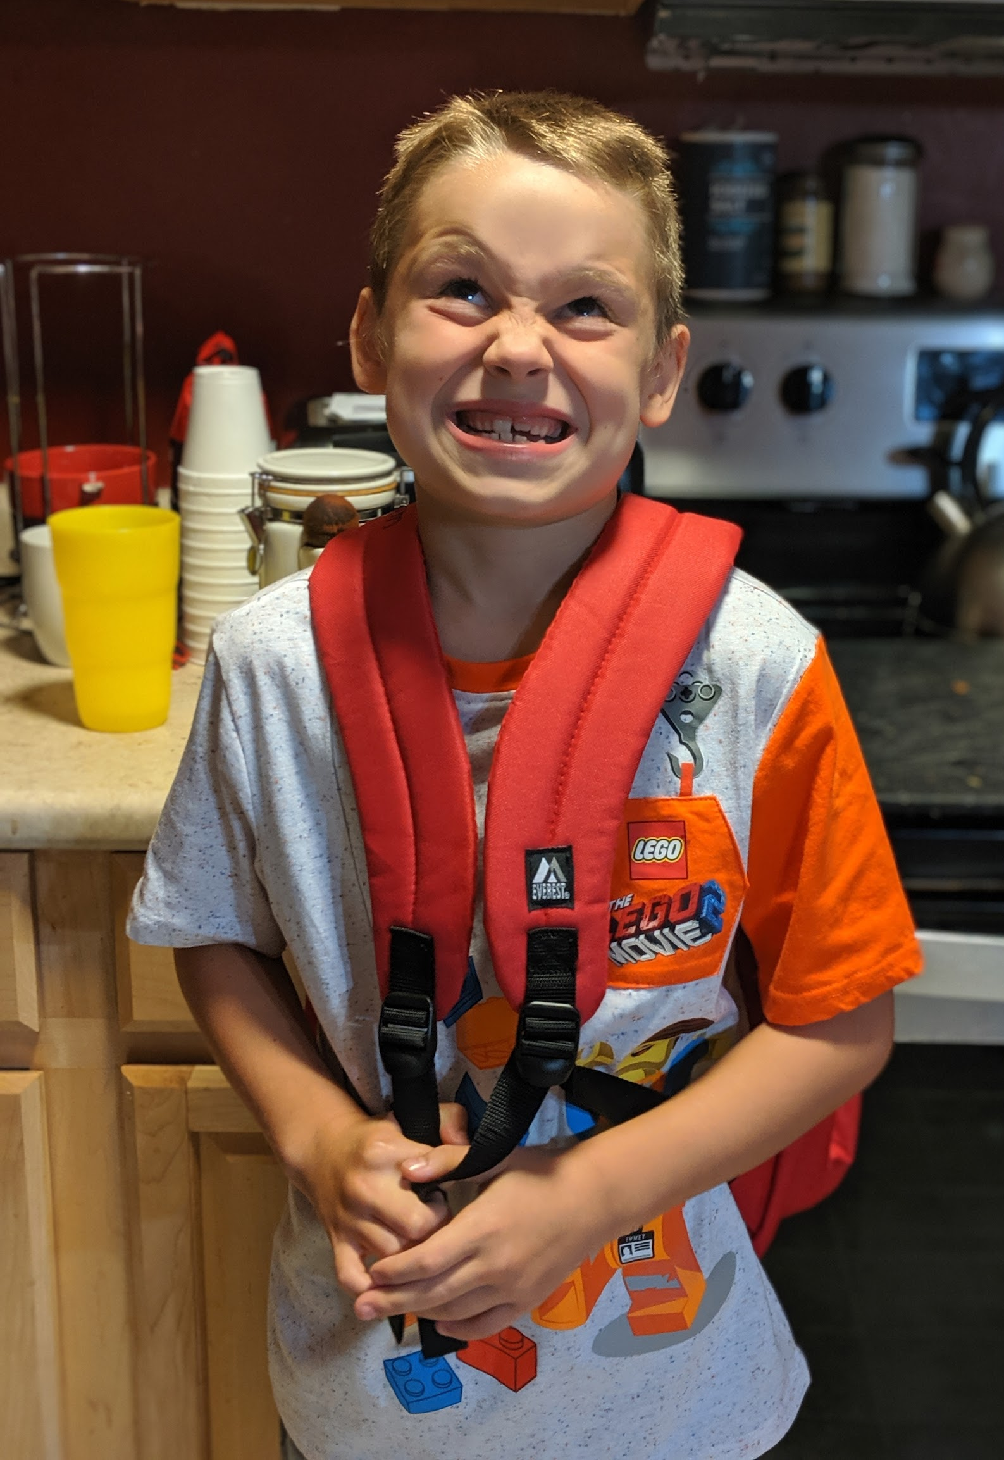
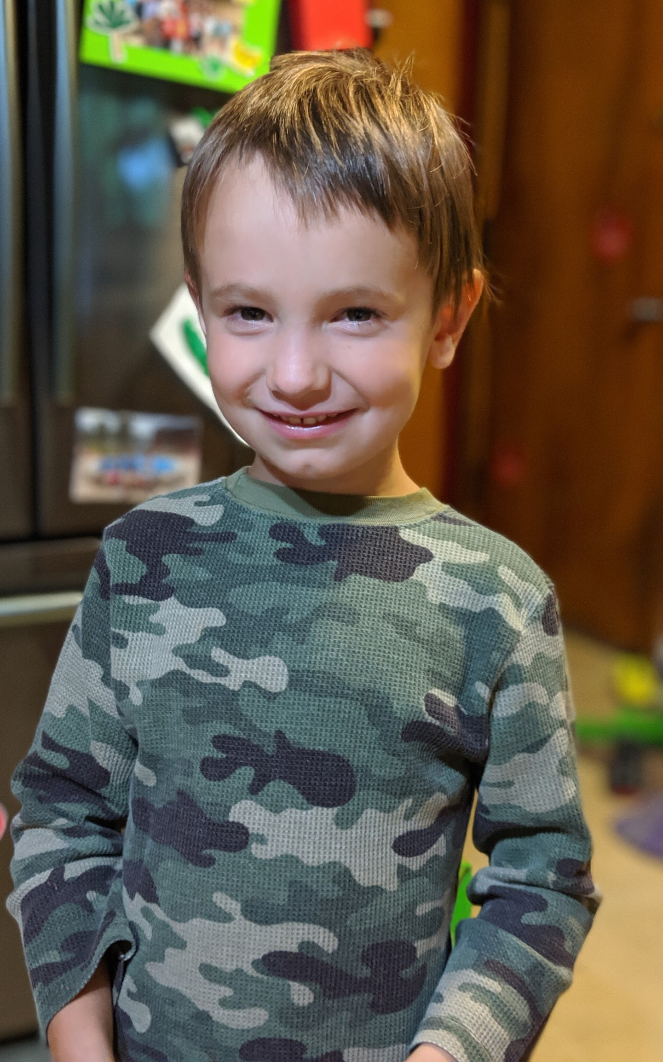
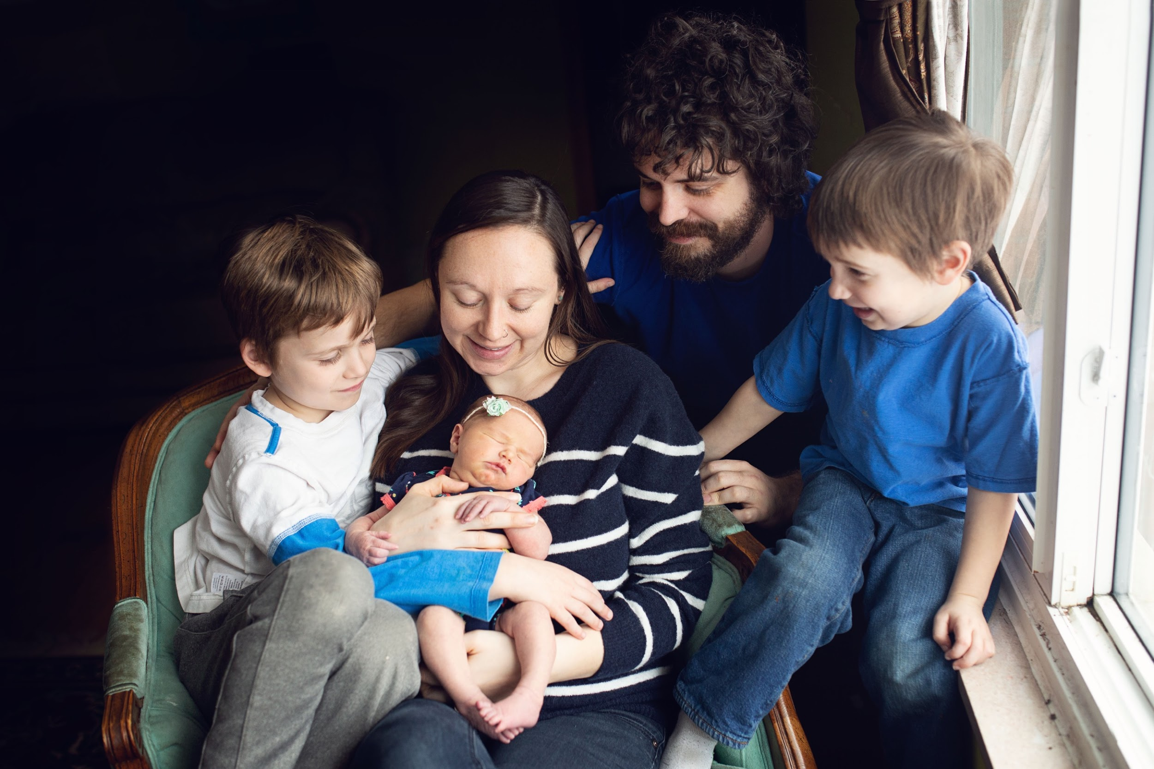
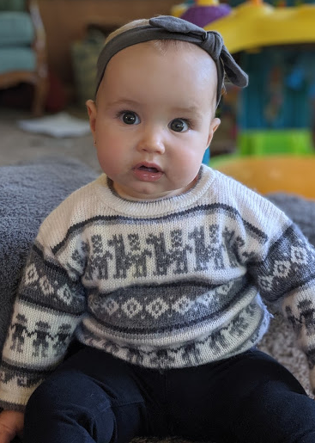
My Family

Slide 3
Our Job as Mothers (parents)
Deut 6:5-7 And you must love the Lord your God with all your heart, all your soul, and all your strength. And you must commit yourselves wholeheartedly to these commands that I am giving you today. Repeat them again and again to your children. Talk about them when you are at home and when you are on the road, when you are going to bed and when you are getting up.
If you are a mother, you have a calling from God. God entrusted into your care a life, a future, a piece of what the world will become. (A Mother’s Heart, Jean Fleming p.17)
Called us to a big responsibility
Our role, God’s role
Come under God’s grace so our children can be under His grace

Slide 4
What is Grace?
Free gift from God (Eph 2:8)
My identity is in Christ (Gal 2:20)
My adequacy is in Christ (2 Cor 3:5)
My value is in Christ (Eph 2:10)
When it comes to parenting it can be easy to forget all these truths!
1 John 3:1a See what great love the Father has lavished on us, that we should be called children of God! And that is what we are!
Eph 2:10 For we are God’s masterpiece. He has created us anew in Christ Jesus, so we can do the good things he planned for us long ago.
Eph 2:8 God saved you by his grace when you believed. And you can’t take credit for this; it is a gift from God.
Gal 2:20 My old self has been crucified with Christ. It is no longer I who live, but Christ lives in me. So I live in this earthly body by trusting in the Son of God, who loved me and gave himself for me.
2 Cor 3:5 It is not that we think we are qualified to do anything on our own. Our qualification comes from God.

Slide 5
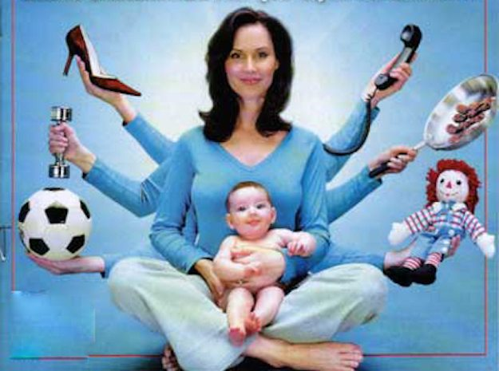

Slide 6
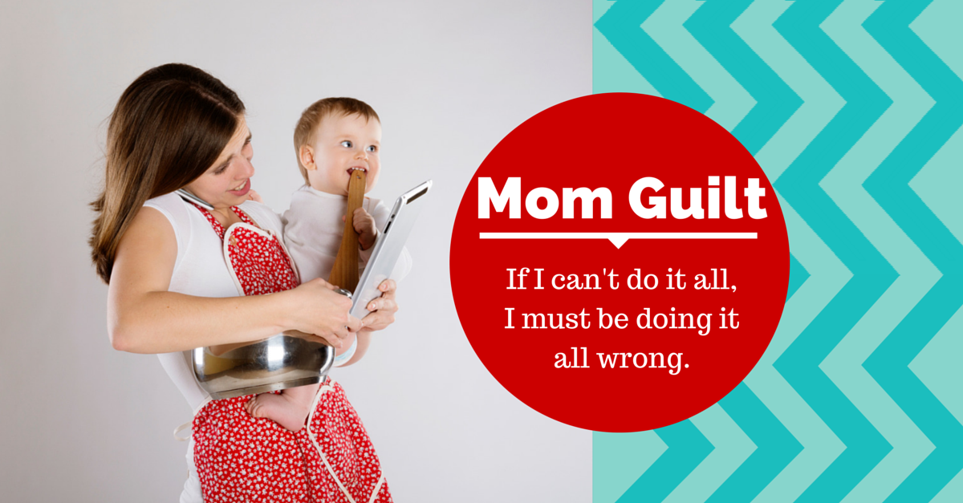

Slide 7
Parenting Under Law or Grace?
Law
Am I better/worse than other parents? What do people think of me?
Grace
Comparison is pointless, we all sin and need God’s grace and are on the same side.
2 Cor 10:12 For we are not bold to class or compare ourselves with some of those who commend themselves; but when they measure themselves by themselves and compare themselves with themselves, they are without understanding
I am responsible for my kids behavior, how they act is a reflection of me
My kids will make mistakes, they are imperfect just like me and need grace

Slide 8
Parenting Under Law or Grace?
Law
Am I doing things right or wrong?
Grace
Love covers a multitude of sin
My identity and value are secure in Christ
I’m not able to do the things I was before, I should be able to handle it all

Slide 9
Parenting Under Law or Grace?
Grace
God chose your family as the best environment for your child's development. He chose you as his mother. God has a plan for your child, and you can be His partner through prayer and planning. (Fleming, AMH)
Law
I can’t do this job. I’m not good enough.

Slide 10
Dealing with Failure
We need days of failure because they help humble us, and through them we can see how God's grace is poured out on the humble. (Elyse Fitzpatrick, Give Them Grace: Dazzling Your Kids with the Love of Jesus)
Law says failure defines who we area- defeated
Grace says failure is a reminder of our need- growth
Romans 8:28 And we know that God causes everything to work together for the good of those who love God and are called according to his purpose for them.

Slide 11
Are You Parenting Under Law or Grace?
the children who actually end up performing better are those who understand that their relationship with God doesn’t depend on their performance...but on Jesus’s performance for them. With the right mixture of fear and guilt, I can get my three children to obey in the short term. But my desire is not that they obey for five minutes or even for five days. My desire is that they obey for fifty years! (Fitzpatrick, Give them grace)
Law
This will lead to guilt or pride
Grace
Freedom from pressure and leads to trust in God
If view ourselves as parents under law or grace, it will affect our kids understanding of God’s grace and their sin! They will see and learn from our example.

Slide 12
God’s role
Psalm 139:13-14 For you created my inmost being; you knit me together in my mother’s womb. I praise you because I am fearfully and wonderfully made; your works are wonderful, I know that full well.
Psalm 127:1 Unless the Lord builds a house, its builders labor in vain. Unless the Lord watches over the city, the watchmen stand guard in vain.
Unless God works, my best efforts are in vain. God must do the real work in my home. (Fleming, A Mother’s Heart)
God created our children and loves them!
Changes hearts
Create a spiritual hunger
Bringing to faith

Slide 13
Our role
Psalm 127:3
Children are a gift from the Lord;
they are a reward from him
We mothers must take care of the possible and trust God for the impossible. We are to love, affirm, encourage, teach, listen, and care for they physical needs of the family. (Ruth Bell Graham)
Express love
PRAY! (in faith, urgently, w/out ceasing)
Enjoy being a mother!
Provide a warm happy home
Minister to needs (physical and emotional) as we are able

Slide 14
Being under grace frees us to show our children grace
It’s not that grace-based homes don’t take their children’s sin seriously. Nor is it that grace-based homes circumvent consequences. It isn’t even that grace-based homes do nothing to protect their children from attacks and temptations that threaten them from the outside. They do all these things, but not for the same reasons. Grace-based homes aren’t trusting in the moral safety of their home or the spiritual environment they’ve created to empower their children to resist sin. . . . They assume that sin is an ongoing dilemma that their children must constantly contend with.
[Children in a grace-based family] are accepted as sinners who desire to become more like Christ rather than be seen as nice Christian kids trying to maintain a good moral code. Grace is committed to bringing children up from their sin; legalism puts them on a high standard and works overtime to keep them from falling down.
Grace understands that the only real solution for our children’s sin is the work of Christ on their behalf. . . . Legalism uses outside forces to help children maintain their moral walk. Their strength is based on the environment they live in. Grace, on the other hand, sees the strength of children by what is inside them—more specifically, Who is inside them.
The graceless home requires kids to be good and gets angry and punishes them when they are bad. The grace-based home assumes kids will struggle with sin and helps them learn how to tap into God’s power to help them get stronger. (T. Keller, Grace-Based Parenting)
Pray
Be Patient
Discipline
Teach identity in Christ not in choices

Slide 15
Books to Read!!!
⭆A Mother’s Heart: A look at values, vision, and character for the Christian mother By Jean Fleming
⭆Give Them Grace: Dazzling Your Kids with the Love of Jesus By Elyse M. Fitzpatrick

