Slide 1
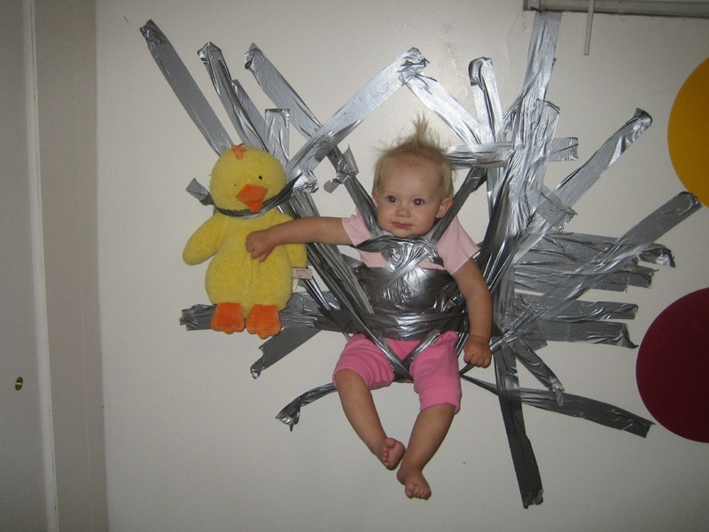
Parenting Group
Ben Foust - 2015
Being a Good Steward of Your Family

Slide 2
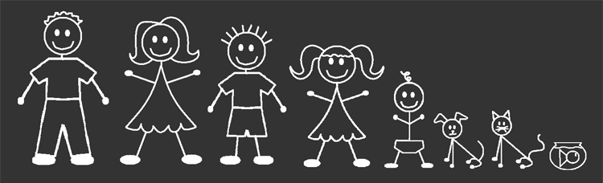
My Credentials:
My Credentials:

Slide 3
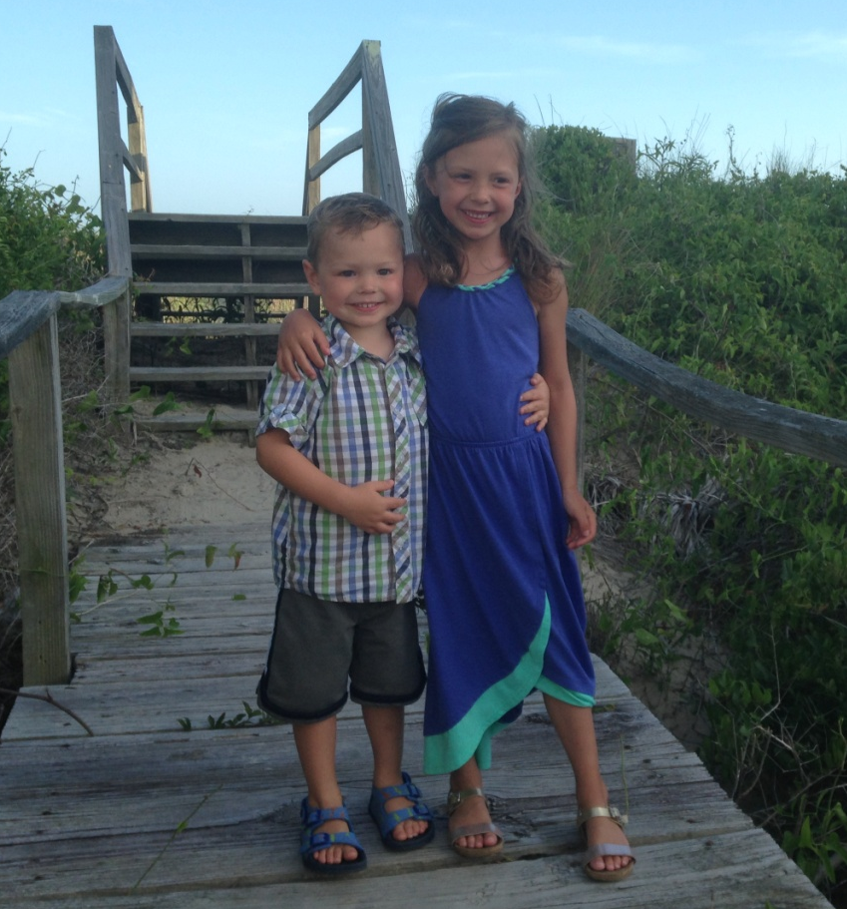
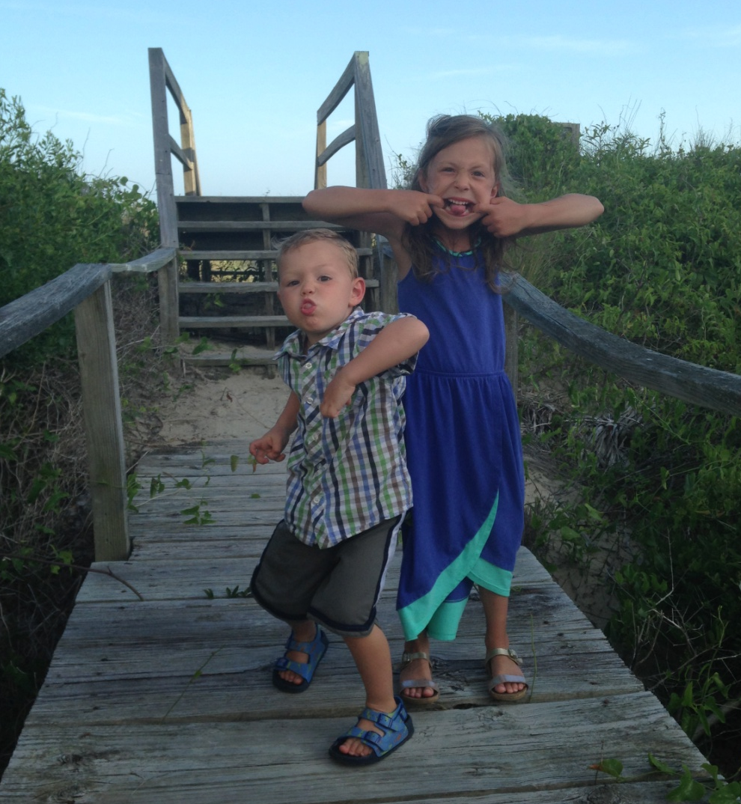
My Credentials:
My Credentials:

Slide 4
My Credentials:
How open to input are you on this topic?
Parenting is hard

Slide 5
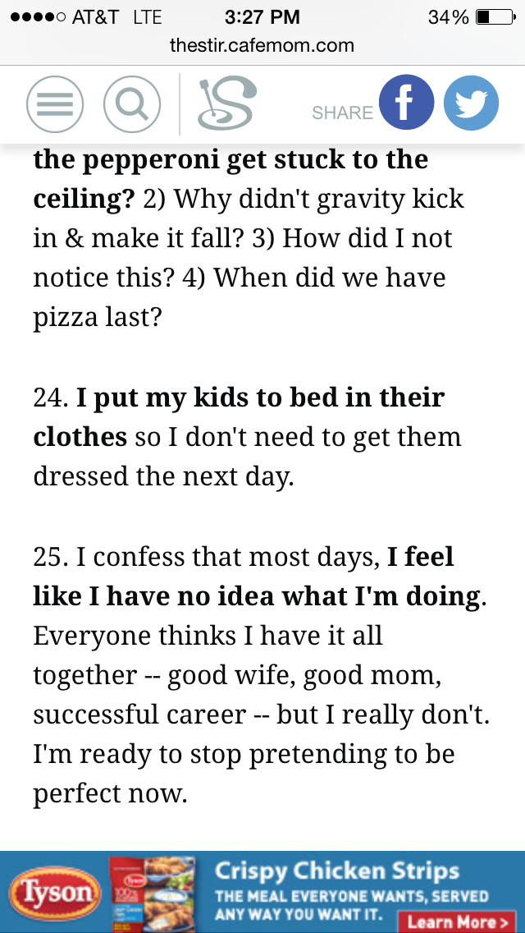
My Credentials:
How open to input are you on this topic?
Parenting is hard

Slide 6
My Credentials:
How open to input are you on this topic?
Parenting is hard
And the stakes are high

Slide 7
My Credentials:
How open to input are you on this topic?
Parenting is hard
And the stakes are high
This calls for “teachability!”
Discouragement Warning: meant to be taken in the context of GRACE

Slide 8
My Credentials:
How open to input are you on this topic?
Parenting is hard
And the stakes are high
This calls for “teachability!”
George Barna’s proposition:

Slide 9
“Fewer than one out of every five parents of young children believe they are doing a good job of training their children morally and spiritually”
George Barna, Revolutionary Parenting, 10
Having a great marriage is hard
Parenting is hard
George Barna’s proposition:

Slide 10
Stewardship
For some reason, God entrusts His most important things to people
^{Genesis 1:28} Then be fruitful and multiply, and fill the earth, and subdue it; and rule over the fish of the sea and over the birds of the sky and over every living thing that moves on the earth.

Slide 11
Stewardship
^{1 Cor 4:1} Let a man regard us in this manner, as servants of Christ and stewards of the mysteries of God. In this case, moreover, it is required of stewards that one be found trustworthy.
For some reason, God entrusts His most important things to people
TRUTH
Managing something that is not mine
Responsibility, Accountability, Anticipation
Much broader than “belongings”
Warrants a response that is
HUMBLE, ACTIVE, and FAITHFUL

Slide 12
Stewardship
^{1 Pet 4:10} As each one has received a special gift, employ it in serving one another as good stewards of the manifold grace of God.
For some reason, God entrusts His most important things to people
Managing something that is not mine
Responsibility, Accountability, Anticipation
Much broader than “belongings”
Warrants a response that is
HUMBLE, ACTIVE, and FAITHFUL

Slide 13
PEOPLE
^{1 pet 5:2} Care for the flock that God has entrusted to you. Watch over it willingly, not grudgingly—not for what you will get out of it, but because you are eager to serve God. ³ Don’t lord it over the people assigned to your care, but lead them by your own good example. ⁴ And when the Great Shepherd appears, you will receive a crown of never-ending glory and honor.
For some reason, God entrusts His most important things to people
Managing something that is not mine
Responsibility, Accountability, Anticipation
Much broader than “belongings”
Warrants a response that is
HUMBLE, ACTIVE, and FAITHFUL

Slide 14
Does family count as “stewardship?”
More valuable than any possession
Important stage for “speaking truth”
Your most important relationships
More important than my ministry?

Slide 15
Does family count as “stewardship?”
More valuable than any possession
Important stage for “speaking truth”
Your most important relationships
Your most important ministry

Slide 16
Does family count as “stewardship?”
More valuable than any possession
Important stage for “speaking truth”
Your most important relationships
Your most important ministry
^{1 Tim 3:5} But if a man does not know how to manage his own household, how will he take care of the church of God?
For Paul, the principles are the same in family and ministry: responsibility, but not ownership

Slide 17
The Good Steward Acts on 2 key convictions:
#1 God is the true, ultimate, eternal owner
Your child is an eternal being, who belongs to God

Slide 18
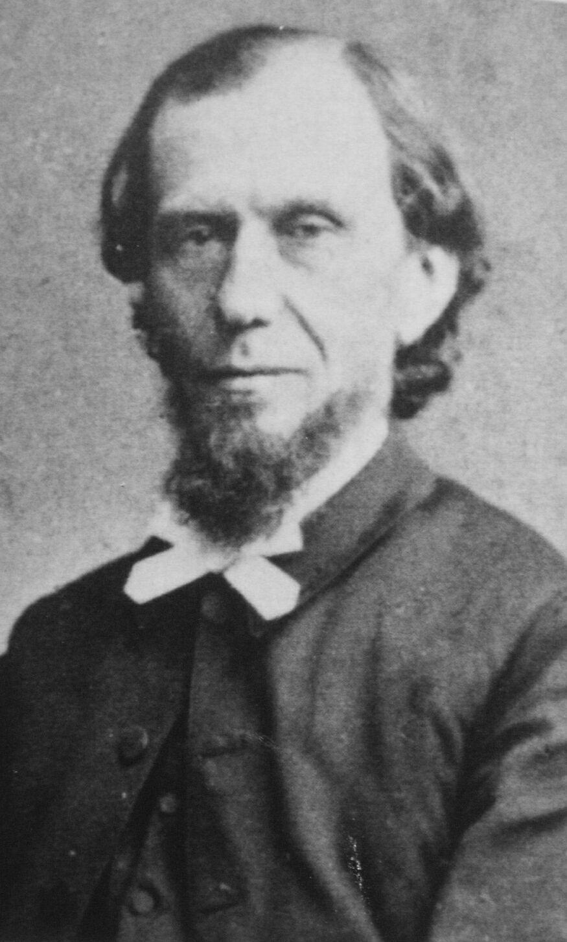
The Good Steward Acts on 2 key convictions:
“And so the eye of faith sees
in each little one a Divine
goodliness. Is it not a being
created in God’s image, with
the faint light of a Divine
glory, of an immortal life,
shining from it? Is it not an object of the great redemption; destined to be a partaker of the precious blood and the Holy Spirit of Jesus, to be the object of the joy of angels and God’s everlasting
#1 God is the true, ultimate, eternal owner
^{1 Pet 3:7} …show her honor as a fellow heir of the grace of life, so that your prayers will not be hindered.
Your spouse is an eternal being, who belongs to God
Likewise your children…

Slide 19
The Good Steward Acts on 2 key convictions:
love and pleasure? A child, whose worth exceeds that of the whole world? A child, that even in this life can be a brother of Jesus, a servant of God, a blessing for the immortal spirits of fellow-men? Surely faith may call the little one unspeakably fair, for it sees it shining as a jewel in the crown of the Lamb, - His joy and His glory.”
- Andrew Murray: The Children for Christ , 9th Day
#1 God is the true, ultimate, eternal owner
^{1 Pet 3:7} …show her honor as a fellow heir of the grace of life, so that your prayers will not be hindered.
Your spouse is an eternal being, who belongs to God
Likewise your children…

Slide 20
The Good Steward Acts on 2 key convictions:
#1 God is the true, ultimate, eternal owner
Your child is an eternal being, who belongs to God
Likewise your spouse…

Slide 21
The Good Steward Acts on 2 key convictions:
#1 God is the true, ultimate, eternal owner
Temporal Values
Eternal Values

Slide 22
The Good Steward Acts on 2 key convictions:
#1 God is the true, ultimate, eternal owner
#2 I have a tremendously important role
Temporal Values
Eternal Values
The eternal facts about my family necessitate a high-valuation of them
And therefore my utmost effort in caring for them

Slide 23
The Good Steward Acts on 2 key convictions:
#1 God is the true, ultimate, eternal owner
#2 I have a tremendously important role
These 2 are held in tension
Temporal Values
Eternal Values
The eternal facts about my family necessitate a high-valuation of them
And therefore my utmost effort in caring for them

Slide 24
The Good Steward Acts on 2 key convictions:
#1 God is the true, ultimate, eternal owner
#2 I have a tremendously important role
These 2 are held in tension
If I misunderstand either one…
Temporal Values
Eternal Values
The eternal facts about my family necessitate a high-valuation of them
And therefore my utmost effort in caring for them

Slide 25
4 kinds of Stewardship
We are all all of these sometimes
Active Role
Big,
Unspiritual Role
Big,
Spiritual Role
Temporal Values
Eternal Values
Small,
Unspiritual Role
Small,
Spiritual Role
Passive Role

Slide 26
4 kinds of Stewardship
We are all all of these sometimes
Let’s apply this model to key areas parenting:
- Purpose of the Relationship
-What you teach and fight for
- Vision
- Prayer
- Time
Active Role
Big,
Unspiritual Role
Big,
Spiritual Role
Temporal Values
Eternal Values
Small,
Unspiritual Role
Small,
Spiritual Role
Passive Role

Slide 27
Purpose of the Relationship
Eternal Values
Small,
Spiritual Role
PURPOSE: has the correct goal; genuinely wants to see children enjoy healthy relationship w/ God
has part of the picture…
Passive Role

Slide 28
Purpose of the Relationship
I think a lot of dads find
themselves here …
Eternal Values
Small,
Spiritual Role
PURPOSE: has the correct goal; genuinely wants to see children enjoy healthy relationship w/ God
ROLE: underestimates his/her role in accomplishing the purpose
Passive Role

Slide 29
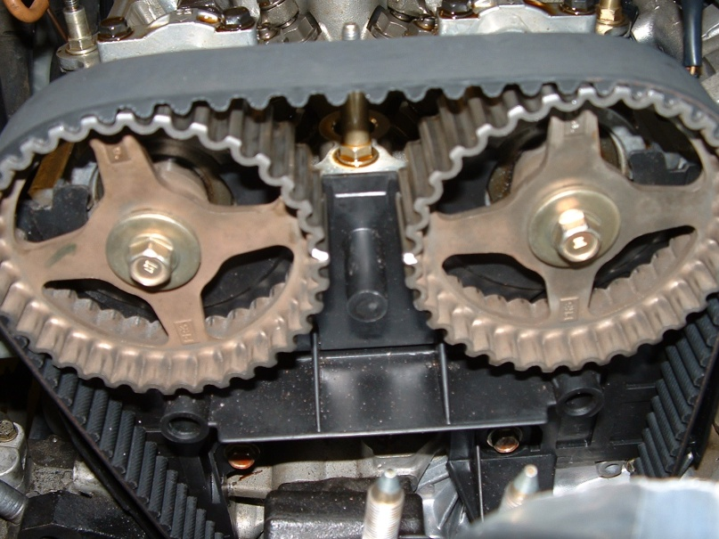
Purpose of the Relationship
Eternal Values
Small,
Spiritual Role
The Steward who “Means Well”
FEELS: along for the ride, oblivious, confused, fearful, paralyzed, guilty
NEEDS TO UNDERSTAND:
Their unique, God-empowered role
Being a good steward takes discipline
Passive Role

Slide 30
Purpose of the Relationship
Temporal Values
“The Bad Steward”
Small,
Unspiritual Role
PURPOSE: mutual bystanders as we pursue our own goals / desires
This person makes 2 mistakes:
Might be selfishly negligent
Or might just be consumed with temporal goals
Passive Role

Slide 31
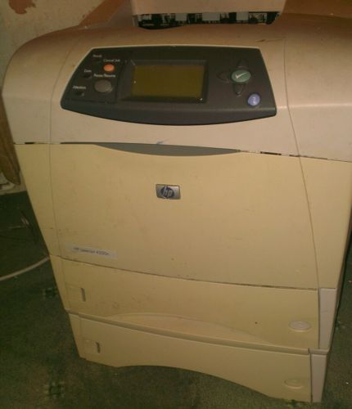
Purpose of the Relationship
Temporal Values
“The Bad Steward”
Small,
Unspiritual Role
PURPOSE: mutual bystanders as we pursue our own goals / desires
ROLE: What role? maybe to keep you from blocking my goals
Unwilling to make sacrifices for kids
Passive Role

Slide 32
Purpose of the Relationship
Temporal Values
“The Bad Steward”
Small,
Unspiritual Role
FEELS: irritated, suffocated, detached, distracted
NEEDS TO UNDERSTAND: The eternal value of his/her family
Passive Role

Slide 33
Purpose of the Relationship
Temporal Values
“The Bad Steward”
Small,
Unspiritual Role
FEELS: irritated, suffocated, detached, distracted
NEEDS TO UNDERSTAND: The eternal value of his/her family
That YOU are not the most important thing
Passive Role

Slide 34
Belongs to ME
Active Role
Big,
Unspiritual Role
“The OWNER”
Belongs to themselves
Temporal Values
“The Bad Steward”
Belongs to the world
Passive Role

Slide 35
Purpose of the Relationship
Active Role
PURPOSE: of my spouse and kids is to complete/enhance my life
“The OWNER”
Temporal Values

Slide 36
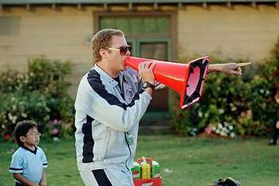
Purpose of the Relationship
Don’t dismiss this one too quickly…
Active Role
ROLE (with children):
ROLE (with children): Push to succeed - get identity/affirmation from kids
PURPOSE: of my spouse and kids is to complete/enhance my life
“The OWNER”
Is this really love?
Temporal Values

Slide 37
Purpose of the Relationship
Don’t dismiss this one too quickly…
Active Role
ROLE (with children): Push to succeed - get identity/affirmation from kids
“Let them beware of this sin, honoring their child more than God; it is the sure way to grief for parents and children together.”
- Andrew Murray: The Children for Christ , 14th Day
PURPOSE: of my spouse and kids is to complete/enhance my life
“The OWNER”
Temporal Values

Slide 38
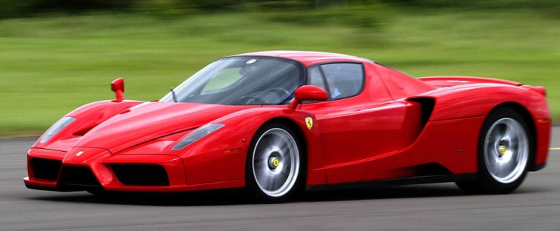
Purpose of the Relationship
The owner is extremely faithful/responsible/ active!
Active Role
ROLE (with children): Push to succeed - get identity/affirmation from kids
PURPOSE: of my spouse and kids is to complete/enhance my life
“The OWNER”
Temporal Values
“helicopter parent”

Slide 39
“Your children have not been given to you to make your life easier, as if they are your little God-given indentured servants. They do not exist to be props for your reputation or trophies of your success. They are not yours to clone in your image. They are not vehicles to live out your unfulfilled dreams. You must face the profound truth that your children belong to their Creator, and that from their first breath they are marching toward a
Parenting according to the “ New Self”
OLD
Result in discipline:
Overbearing / power trip
Or
Overbearing / because I have a lot riding on it

Slide 40
Parenting according to the “ New Self”
destiny. This is who God created them to be. Your job is to help them to understand who they are and who God is and what life is all about.”
- Paul Tripp: Forever
OLD
Result in discipline:
Overbearing / power trip
Or
Overbearing / because I have a lot riding on it

Slide 41
Purpose of the Relationship
Active Role
FEELS: Embattled, Fear & Anxiety, Under Pressure
NEEDS TO UNDERSTAND: Who the True Owner is
^{Acts 20:32} And now I entrust you to God and the message of his grace that is able to build you up and give you an inheritance with all those he has set apart for himself
“The OWNER”
Temporal Values

Slide 42
Purpose of the Relationship
Active Role
MY ROLE (kids):
PURPOSE (kids): children develop a mature relationship with the Lord
Big,
Spiritual Role
The “Good Steward”
Eternal Values

Slide 43
Purpose of the Relationship
Spiritual Champion:
“an irrepressible follower of Jesus Christ who accepts the Bible as truth, lives by its principles, and seeks ways to impact the world and continually deepen his or her relationship with God.”
- George Barna: Revolutionary Parenting
Active Role
MY ROLE (kids):
PURPOSE (kids): children develop a mature relationship with the Lord
Big,
Spiritual Role
The “Good Steward”
Eternal Values

Slide 44
“One of the nonnegotiable factors imbedded within the parenting behaviors of great parents was their insistence on faith in God and obedience to biblical principles as the driving force behind the household culture and their child-rearing practices. Unlike most American parents who deem themselves to be Christian, Revolutionary Parents earnestly accept the role of being the primary and dominant spiritual mentor of their children” George Barna: Revolutionary Parenting, 95
Purpose of the Relationship
Active Role
MY ROLE (kids):
PURPOSE (kids): children develop a mature relationship with the Lord
My children are my disciples!
Big,
Spiritual Role
The “Good Steward”
Eternal Values

Slide 45
Purpose of the Relationship
Active Role
MY ROLE (kids): Shepherd,
MY ROLE (kids): Shepherd, Coach,
MY ROLE (kids): Shepherd, Coach, Mentor,
PURPOSE (kids): children develop a mature relationship with the Lord
Big,
Spiritual Role
The “Good Steward”
NOT a helicopter!
Eternal Values

Slide 46
Purpose of the Relationship
Active Role
^{Eph 1:5} God decided in advance to adopt us into his own family by brining us to himself through Jesus Christ. This is what he wanted to do, and it gave him great pleasure.
MY ROLE (kids): Shepherd,
MY ROLE (kids): Shepherd, Coach,
MY ROLE (kids): Shepherd, Coach, Mentor,
PURPOSE (kids): children develop a mature relationship with the Lord
Starting place for us as parents is our own adoption!
Big,
Spiritual Role
The “Good Steward”
^{Eph 5:1}Imitate God, therefore, in everything you do, because you are his dear children
Eternal Values

Slide 47
Purpose of the Relationship
Active Role
MY ROLE (kids): Shepherd,
MY ROLE (kids): Shepherd, Coach,
MY ROLE (kids): Shepherd, Coach, Mentor,
MY ROLE (kids): Shepherd, Coach, Mentor, Model of God’s love
PURPOSE (kids): children develop a mature relationship with the Lord
Big,
Spiritual Role
The “Good Steward”
Eternal Values

Slide 48
Purpose of the Relationship
Big,
Spiritual Role
The “Good Steward”
^{1 Cor 11:1} And you should imitate me, just as I imitate Christ.

Slide 49
Purpose of the Relationship
My definition of parenting:
Teach them to receive love and leadership from you
As they observe you receive love and leadership from God
Big,
Spiritual Role
The “Good Steward”

Slide 50
Purpose of the Relationship
“Let nothing less content parents than to make it their aim that grace should restore their family life to what God created it to be: a mirror and a foretaste of the love of heaven.”
- Andrew Murray: The Children for Christ 2nd Day
My definition of parenting:
Teach them to receive love and leadership from you
As they observe you receive love and leadership from God
Big,
Spiritual Role
The “Good Steward”

Slide 51
Purpose of the Relationship
Active Role
& Spouse
MY ROLE (kids): Shepherd,
MY ROLE (kids): Shepherd, Coach,
MY ROLE (kids): Shepherd, Coach, Mentor,
MY ROLE (kids): Shepherd, Coach, Mentor, Model of God’s love
My spouse to
PURPOSE (kids): children develop a mature relationship with the Lord
My spouse is my most important disciple!
Big,
Spiritual Role
The “Good Steward”
Is not your spouse God’s primary instrument for sanctification in your life?
Eternal Values

Slide 52
Tim Keller, The Meaning of Marriage:
“Within this Christian vision for marriage, here’s what it means to fall in love. It is to look at another person and get a glimpse of the person God is creating, and to say, “I see who God is making you, and it excites me! I want to be a part of that. I want to partner with you and God in the journey you are taking to his throne. And when we get there, I will look at your magnificence and say, ‘I always knew you

Slide 53
could be like this. I got glimpses of it on earth, but now look at you!’” … This is by no means a naïve, romanticized approach – rather it is brutally realistic. In this view of marriage, each person says to the other, “I see all your flaws, imperfections, weaknesses, dependencies. But underneath them all I see growing the person God wants you to be.” This is radically different from the search for “compatibility.”

Slide 54
Someday they are going to be standing not before the minister but before the Lord. And they will turn to see each other without spot and blemish. And they hope to hear God say “Well done, good and faithful servants. Over the years you have lifted on another up to me. You sacrificed for one another. You held one another up with prayer and with thanksgiving. You confronted each other. You rebuked each other toward me. And now look at you.

Slide 55
You’re radiant.” Romance, sex, laughter, and plain fun are all the by-products of this process of sanctification, refinement, glorification. Those things are important, but they can’t keep the marriage going through years and years of ordinary life. What keeps the marriage going is your commitment to your spouse’s holiness. … That’s your job as a spouse. Any lesser goal than that, any smaller purpose, and you’re just playing at being married.”

Slide 56
Purpose of the Relationship
Active Role
FEELS: Awed, Privileged , Motivated
FEELS: Awed, Privileged , Motivated
Yet Also
Unified with God,
FEELS: Awed, Privileged , Motivated
Yet Also
Unified with God,
Rest, Peace & Confidence,
FEELS: Awed, Privileged , Motivated
Yet Also
Unified with God,
Rest, Peace & Confidence,
Eager Anticipation
Big,
Spiritual Role
The “Good Steward”
Eternal Values
This is the one you want to be!

Slide 57
What You Teach and Fight For

Slide 58
What You Teach and Fight For
Active Role
Usually will not “go to bat” with spouse or kids
The “Owner”
The “Good Steward”
Temporal Values
Eternal Values
The “Bad Steward”
“Means Well” Steward
Passive Role

Slide 59
What You Teach and Fight For
Passive in disciplining children, punctuated by over-disciplining in frustration
Active Role
Will fight with spouse for own priorities and interests
The “Owner”
The “Good Steward”
Temporal Values
Eternal Values
The “Bad Steward”
“Means Well” Steward
Passive Role

Slide 60
What You Teach and Fight For
Active Role
OR the opposite extreme: super-permissive discipline
The “Owner”
The “Good Steward”
Temporal Values
Eternal Values
Fights with spouse for control of the relationship
Often overbearing/ high-pressure in disciplining children
The “Bad Steward”
“Means Well” Steward
Passive Role

Slide 61
What You Teach and Fight For
“many of these parents echoed the idea that they were not trying to become the child’s best friend. “My personal security was found in Christ. My best friend is my wife. My son was my gift to God, to the church, and to the world… If I was determined to win over my boy as my best friend, I would have pandered in ways that are inappropriate for someone responsible for his growth as a man of God. We had many a tense moment over
Active Role
OR the opposite extreme: super-permissive discipline
The “Owner”
The “Good Steward”
Temporal Values
Eternal Values
Fights with spouse for control of the relationship
Often overbearing/ high-pressure in disciplining children
The “Bad Steward”
“Means Well” Steward

Slide 62
What You Teach and Fight For
the years, but I don’t think there was ever any doubt in his mind that I loved him, or about the motivation behind the hard choices and discipline I enforced in his life. And naturally I wanted him to be pround of me, to like spending time with me, and to share his life with me. But part of being a good parent is making the choice to be a parent, not a best friend. - George Barna: Revolutionary Parenting, 51
Active Role
OR the opposite extreme: super-permissive discipline
The “Owner”
The “Good Steward”
Temporal Values
Eternal Values
Fights with spouse for control of the relationship
Often overbearing/ high-pressure in disciplining children
The “Bad Steward”
“Means Well” Steward

Slide 63
What You Teach and Fight For
Good Steward knows 3 things about discipline:
#1 We have to be willing to “go to bat” with our spouse and children for their good
^{Eph 6:4} Fathers, do not provoke your children to anger, but bring them up in the discipline and instruction of the Lord.

Slide 64
…the parent who teaches his child to obey the fifth commandment has guided his feet into the way of all God’s commandments. A child’s first virtue is the honoring and obeying his parents.”
- Andrew Murray: The Children for Christ 14th Day
Parenting in the “New Self”
Therefore, biblical parenting might be defined as:
Teach them to receive love and leadership from you
When we teach our children how to honor mother and father:
As they observe you receive love and leadership from God
We are teaching them how to live within God’s ordered creation
^{1 Cor 10:33} And you should imitate me, just as I imitate Christ.

Slide 65
…the parent who teaches his child to obey the fifth commandment has guided his feet into the way of all God’s commandments. A child’s first virtue is the honoring and obeying his parents.”
- Andrew Murray: The Children for Christ 14th Day
Parenting in the “New Self”
Therefore, biblical parenting might be defined as:
Teach them to receive love and leadership from you
When we teach our children how to honor mother and father:
As they observe you receive love and leadership from God
We are modeling how to have an appropriate relationship with God!
^{1 Cor 10:33} And you should imitate me, just as I imitate Christ.

Slide 66
…the parent who teaches his child to obey the fifth commandment has guided his feet into the way of all God’s commandments. A child’s first virtue is the honoring and obeying his parents.”
- Andrew Murray: The Children for Christ 14th Day
Parenting in the “New Self”
Therefore, biblical parenting might be defined as:
Teach them to receive love and leadership from you
When we teach our children how to honor mother and father:
As they observe you receive love and leadership from God
We are preparing them to have healthy relationships with one another because we have equipped them with the capability of being led
^{1 Cor 10:33} And you should imitate me, just as I imitate Christ.

Slide 67
What You Teach and Fight For
Good Steward knows 3 things about discipline:
#1 We have to be willing to “go to bat” with our spouse and children for their good
What do you fight with your spouse about?
“Lord, what are you up to in my spouse’s life right now?”
How can I get on board with that?

Slide 68
What You Teach and Fight For
Good Steward knows 3 things about discipline:
#1 We have to be willing to “go to bat” with our spouse and children for their good
#2 Based on the “instruction of the Lord”
^{Eph 6:4} Fathers, do not provoke your children to anger, but bring them up in the discipline and instruction of the Lord.
Not: “the instruction of YOU”
Like what?

Slide 69
What You Teach and Fight For
Good Steward knows 3 things about discipline:
#1 We have to be willing to “go to bat” with our spouse and children for their good
#2 Based on the “instruction of the Lord”
^{Mark 12:28} “what commandment is the foremost of all?” ²⁹ Jesus answered, “the foremost is … ³⁰ you shall love the Lord your God with all your heart, and with all your soul, and with all your mind, and with all your strength. ³¹ The second is this, you shall love your neighbor as yourself. There is no other commandment greater than these.”
What outcome really matters to you as a parent?
What outcome really matters to you as a spouse?
LOVE!
Like what?

Slide 70
^{Deut 6:5}And you must love the LORD your God with all your heart, all your soul, and all your strength. ⁶And you must commit yourselves wholeheartedly to these commands that I am giving you today. ⁷Repeat them again and again to your children. Talk about them when you are at home and when you are on the road, when you are going to bed and when you are getting up.⁸ Tie them to your hands and wear them on your forehead as reminders. ⁹Write them on the doorposts of your house and on your gates.
Instruction of the Lord
Old Self
New Self
No Instruction
Intentional
All over / reactive
Focused on what matters
Talk about exasperating!
Like what?

Slide 71
“In a quarter century of doing research I have rarely encountered instances where 100 percent of the group being studied agreed on something. Yet every single Revolutionary Parent we interviewed agreed that the most important focus of their children’s training was the development of Godly Character.”
- George Barna: Revolutionary Parenting Pg 46

Slide 72
What You Teach and Fight For
Good Steward knows 3 things about discipline:
#1 We have to be willing to “go to bat” with our spouse and children for their good
#2 Based on the “instruction of the Lord”
Most parents sincerely want what’s best for their kids …
What would it take for your son or daughter to “have it made?”

Slide 73
What You Teach and Fight For
Good Steward knows 3 things about discipline:
#1 We have to be willing to “go to bat” with our spouse and children for their good
#2 Based on the “instruction of the Lord”
#3 Knows which battles to choose
Most parents sincerely want what’s best for their kids …
What would it take for your son or daughter to “have it made?”
We learn this lesson for ourselves, and then forget it for our kids

Slide 74
The “what-are-you-learning?” Test:
Which battles are you choosing right now?

Slide 75
Do your parents know what God is up to in your life these days?

Slide 76
Which is more important to your mom and dad?
Having good grades OR Having good character

Slide 77
Which is more important to your mom and dad?
success in sports OR success in relationships

Slide 78
Which is more important to your mom and dad?
making money OR being generous

Slide 79
Which is more important to your mom and dad?
Being popular OR Being Loving

Slide 80
Which is more important to your mom and dad?
A full schedule of resume-worthy extra-curriculars?
OR
A meaningful role in Christian fellowship

Slide 81
Which is more important to your mom and dad?
A Prestigious Job OR Growing in word, able to defend faith, fulfilling ministry

Slide 82
“what mom and dad want most from me is ___________”

Slide 83
“what my husband / wife wants most from me is “__________”

Slide 84
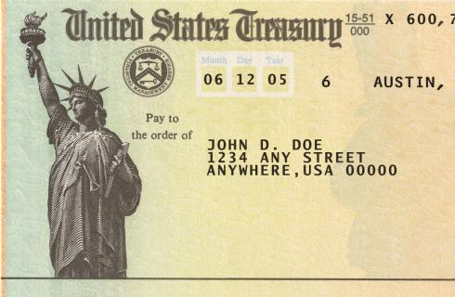
Having a “Vision”
We think about and plan for the things that are valuable to us

Slide 85
Having a “Vision”
Active Role
Like the idea of having a vision, but hasn’t gotten around to it
The “Owner”
The “Good Steward”
Temporal Values
Eternal Values
The “Bad Steward”
“Means Well” Steward
Passive Role

Slide 86
Having a “Vision”
Active Role
Maybe has a great vision for themselves
No interest in developing a vision
The “Owner”
The “Good Steward”
Temporal Values
Eternal Values
The “Bad Steward”
“Means Well” Steward
Passive Role

Slide 87
Having a “Vision”
Active Role
The “Owner”
The “Good Steward”
But it is based on temporal values
Temporal Values
Eternal Values
And/or on the wellbeing of the owner
Has a strong, detailed, articulated vision
The “Bad Steward”
“Means Well” Steward
Passive Role

Slide 88
Having a “Vision”
Good Steward forms a vision that is:
Long and short-run
Multifaceted & specific
For each individual child
For your spouse
For your family

Slide 89
Having a “Vision”
Good Steward forms a vision that is:
Long and short-run
Multifaceted & specific
Aligned with God’s eternal priorities

Slide 90
Having a “Vision”
Good Steward forms a vision that is:
Long and short-run
Multifaceted & specific
Aligned with God’s eternal priorities
So I’m thinking, planning, making goals
But I don’t own it

Slide 91
Having a “Vision”
“Child rearing is the art of handling the unexpected without losing sight of the ultimate goal.”
- George Barna: Revolutionary Parenting Pg 21
Good Steward forms a vision that is:
Long and short-run
Multifaceted & specific
Aligned with God’s eternal priorities
Flexible as God’s work unfolds
constantly watching, revising, laboring in prayer, looking to jump on to His plan

Slide 92
Having a “Vision”
Good Steward forms a vision that is:
Long and short-run
Multifaceted & specific
Aligned with God’s eternal priorities
Flexible as God’s work unfolds
Articulated and held out to the family
Extolled, communicated, modeled
High expectations, because I know the true owner!

Slide 93
Stewardship and Prayer

Slide 94
Stewardship and Prayer
The Good Steward is the only of the 4 that consistently prays for the family
Active Role
The “Owner”
The “Good Steward”
Temporal Values
Eternal Values
While the other 3 take their family for granted, the Good Steward knows that to care for his charge, he must consult with the true owner
The “Bad Steward”
“Means Well” Steward
Passive Role

Slide 95
Stewardship and Prayer
“I could not accurately profile the heart and soul of Revolutionary Parents without emphasizing the premium they place on prayer. ... Please recognize how central prayer was in their parenting. Most of these parents prayed daily for each of their children, asking God to care for them in ways specific to the child and his or her needs.”
- George Barna: Revolutionary Parenting, 113

Slide 96
Stewardship and Prayer
Pray for what?
Praise
Thanksgiving
A good steward always knows the value of what he has
Especially important with your spouse
Some of the most important stewarding we do is away from our family!

Slide 97
Stewardship and Prayer
Pray for what?
Praise
Thanksgiving
A good steward always knows the value of what he has
Especially important with your spouse
^{Eph 5:28} He who loves his own wife loves himself; for no one ever hated his own flesh, but nourishes and cherishes it, just as Christ also does the church

Slide 98
Stewardship and Prayer
Pray for what?
Praise
Thanksgiving
Personal petitions
Intercessions for them
For their heart
For their ministry
For their present steps of faith
For their long term future

Slide 99
Stewardship and Prayer
Pray for what?
Praise
Thanksgiving
Personal petitions
Intercessions for them
Entrusting

Slide 100
Stewardship and Prayer
Practical ideas:
Set aside time to pray with and for family

Slide 101
Stewardship and Prayer
“Nationwide, fewer than one out of every 10 born-again families ... pray together during a typical week, excluding mealtimes.”
- George Barna: Revolutionary Parenting, 31

Slide 102
Stewardship and Prayer
Practical ideas:
Set aside to time to pray with and for family
Pray as a couple for your children
Pray with your kids for your spouse
Share your personal prayer life with them

Slide 103
Stewardship and Time

Slide 104
Stewardship and Time
Active Role
Time is unplanned and not prioritized – time happens to us and we react
The “Owner”
The “Good Steward”
Temporal Values
Eternal Values
The “Bad Steward”
“Means Well” Steward
Passive Role

Slide 105
Stewardship and Time
Active Role
The “Owner”
The “Good Steward”
Priority is me getting to do what I want with my time
Temporal Values
Eternal Values
The “Bad Steward”
“Means Well” Steward
Passive Role

Slide 106
Stewardship and Time
Overscheduled!
Active Role
The “Owner”
The “Good Steward”
Temporal Values
Eternal Values
Family spends time doing what I choose for them
The “Bad Steward”
“Means Well” Steward
Passive Role

Slide 107
Stewardship and Time
“The research revealed an amazing insight into just how much time was spent in dialogue between parent and child on a typical day. The figures ranged between 90 and 120 minutes (verified by both the parent and the child, independent of each other). To place that in context, the typical American family registers less than 15 minutes of direct parent-child conversation each day.”
- George Barna: Revolutionary Parenting, 33
The good Steward makes 2 crucial
moves with their time:
#1 Spend time with your children

Slide 108
Stewardship and Time
“In fact, when we asked young adults what they felt were the most significant mistakes that America’s parents have made, the second highest ranked mistake was not spending enough time with their children. (The failure to provide appropriate discipline was the top-ranked deficiency).”
- George Barna: Revolutionary Parenting, 90
The good Steward makes 2 crucial
moves with their time:
#1 Spend time with your children

Slide 109
Stewardship and Time
The good Steward makes 2 crucial
moves with their time:
#1 Sacrificially spend time with your children
#2 Sacrificially spend time with your spouse
Quality AND Quantity
Have to prioritize it and sacrifice for it
After all, the world has time for your family!

Slide 110
Stewardship and Time
Practical Ideas:
Date Night
Family Time – get creative
Take Vacations
Put your phone away
Invite them in to what you’re doing

Slide 111
Conclusions
Steward your family from the security of total forgiveness!
Make your own relationship with your Heavenly Father priority #1
Talk to each other about this work!
Stewardship of your family may not be glorious work, but it is HEROIC work!
^{Josh 24:15} But as for me and my household, we will serve the Lord.

Slide 112
Contact:
Email: foustb@xenos.org
Follow my teachings at: www.xenos.org/sundayam/
Past Care Group Resources: www.xenos.org/ministry/care-group

Slide 113
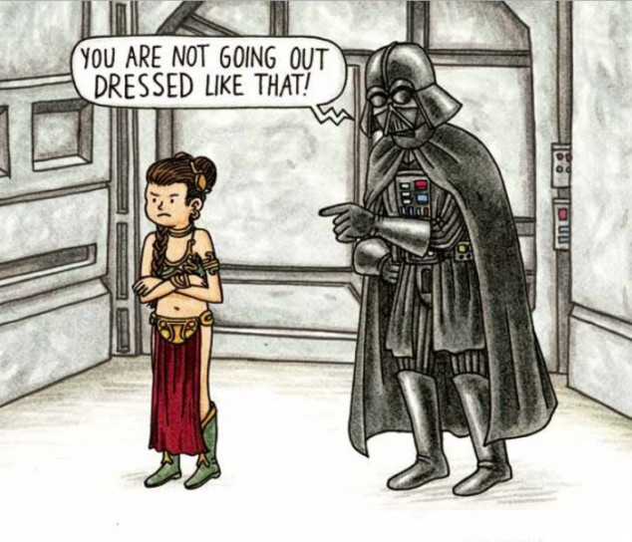
Questions? Comments?
Parenting Group
Ben Foust - 2015
Being a Good Steward of Your Family

