Slide 1
JOHN 20
The Resurrection

Slide 2
John 20
1 Corinthians 15:14,19 – ¹⁴And if Christ has not been raised, our preaching is useless and so is your faith…
¹⁹If only for this life we have hope in Christ, we are of all people most to be pitied.

Slide 3
John 20
#1
EARLY SOURCES

Slide 4
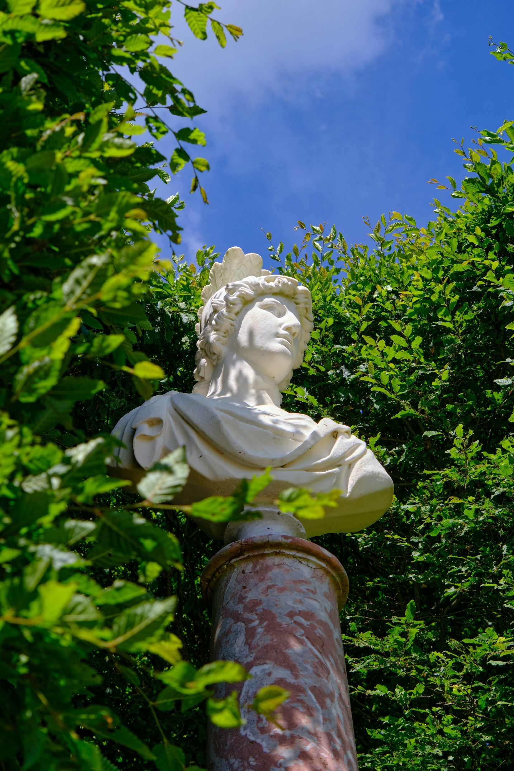
John 20
Alexander the Great
Earliest known biography: 450 years after death
#1
EARLY SOURCES

Slide 5
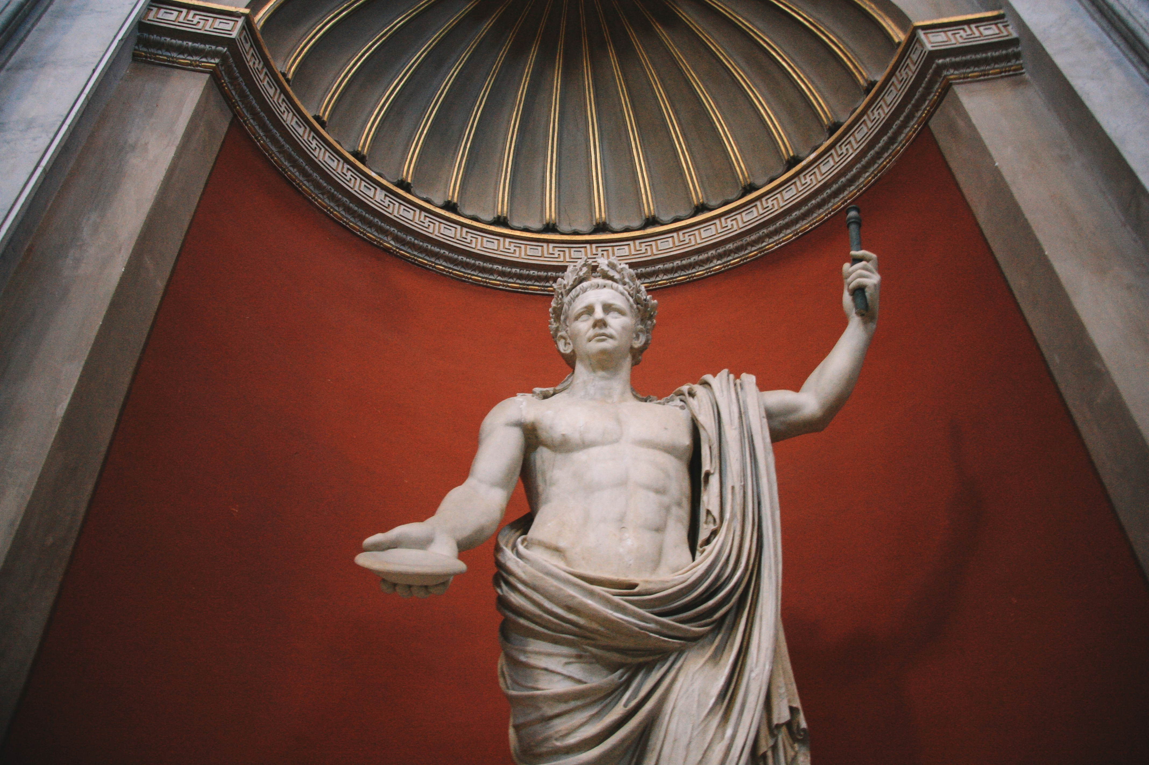
John 20
Tiberius Caesar
Earliest known biography: 70-80 years after death
#1
EARLY SOURCES

Slide 6
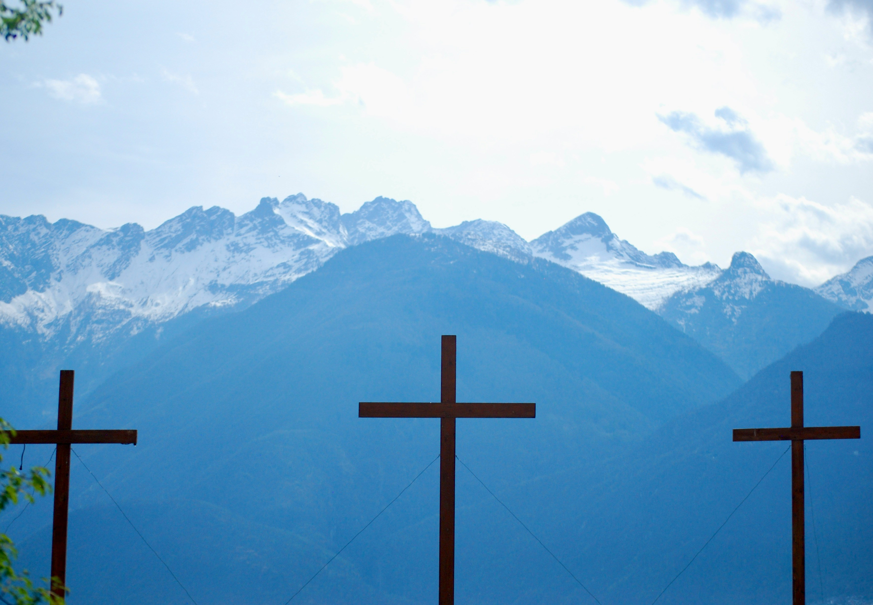
John 20
Jesus Christ
Four biographies within 35-70 years of death
Even earlier sources as well
#1
EARLY SOURCES

Slide 7
John 20
1 Corinthians 15:3-8 – ³For what I received I passed on to you as of first importance: that Christ died for our sins according to the Scriptures,
⁴that he was buried, that he was raised on the third day according to the Scriptures,
⁵and that he appeared to Cephas, and then to the Twelve.
#1
EARLY SOURCES

Slide 8
John 20
1 Corinthians 15:3-8 – ⁶After that, he appeared to more than five hundred of the brothers and sisters at the same time, most of whom are still living, though some have fallen asleep.
⁷Then he appeared to James, then to all the apostles,
⁸and last of all he appeared to me also, as to one abnormally born.
#1
EARLY SOURCES

Slide 9
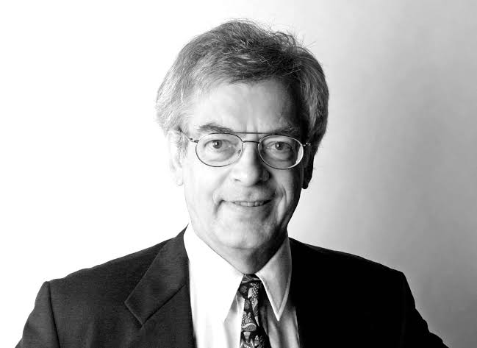
The elements in the tradition are to be dated to the first two years after the crucifixion of Jesus…not later than three years.
Gerd Lüdemann
Atheist biblical scholar
The Resurrection of Jesus: History, Experience, Theology, 171-72
Why would an atheist concede this point?
See language of “received” and “passed on”

Slide 10
John 20
Galatians 1:18 – ¹⁸Then after three years, I went up to Jerusalem to get acquainted with Peter and stayed with him fifteen days.
#1
EARLY SOURCES

Slide 11
John 20
¹Early on the first day of the week, while it was still dark, Mary Magdalene went to the tomb and saw that the stone had been removed from the entrance.
#2
EXECUTION

Slide 12
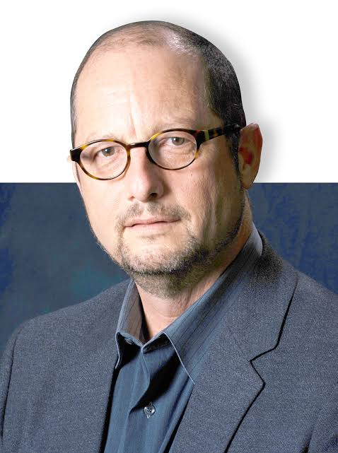
One of the most certain facts of history
is that Jesus was crucified on orders of the Roman prefect of Judea, Pontius Pilate.
Bart D. Ehrman
Agnostic biblical scholar
The Historical Jesus, 162
We have four non-Christian references to the crucifixion

Slide 13
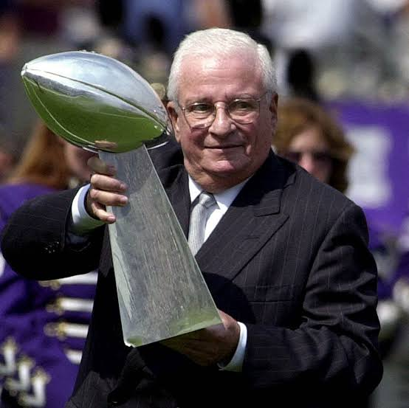
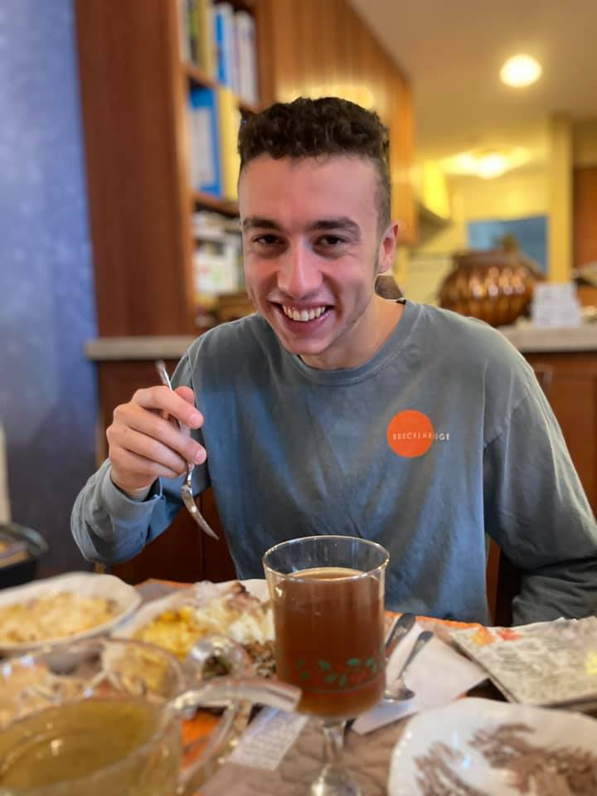
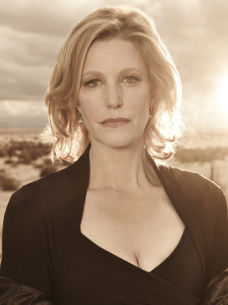

Slide 14
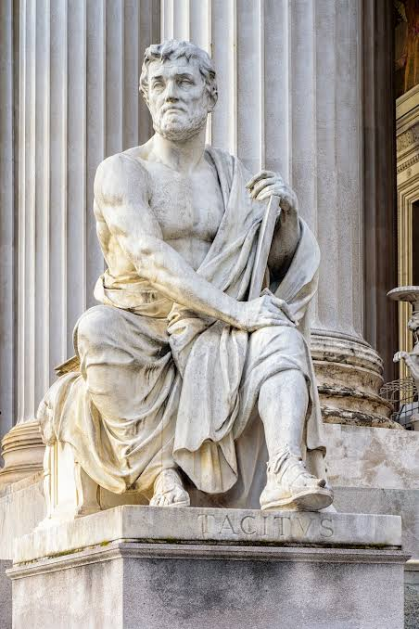
Christus, from whom the name had its origin, suffered the extreme penalty during the reign of Tiberius at the hands of one of our procurators, Pontius Pilate.
Cornelius Tacitus
Non-Christian Roman historian
Annals, 15.44
Modern medical analysis confirms Jesus’ death by crucifixion

Slide 15
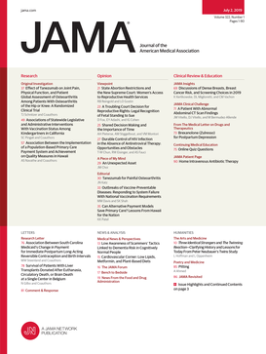
Accordingly, interpretations based on the assumption that Jesus did not die on the cross appear to be at odds with modern medical knowledge.
William D. Edwards, MD; Wesley J. Gabel, MDiv; Floyd E Hosmer, MS, AMI On the Physical Death of Jesus Christ: The Journal of the American Medical Association (March 21, 1986, Volume 256).

Slide 16
John 20
²So she came running to Simon Peter and the other disciple, the one Jesus loved, and said, “They have taken the Lord out of the tomb, and we don’t know where they have put him!”
³So Peter and the other disciple started for the tomb.

Slide 17
John 20
⁴Both were running, but the other disciple outran Peter and reached the tomb first.

Slide 18
John 20
⁵He bent over and looked in at the strips of linen lying there but did not go in.
⁶Then Simon Peter came along behind him and went straight into the tomb. He saw the strips of linen lying there,

Slide 19
John 20
⁷as well as the cloth that had been wrapped around Jesus’ head. The cloth was still lying in its place, separate from the linen.
⁸Finally the other disciple, who had reached the tomb first, also went inside. He saw and believed.
#3
EMPTY TOMB

Slide 20
John 20
How do we know the tomb was empty?
Women as the first witnesses
The Nazareth Inscription
The inability to produce Jesus’ body
⁷as well as the cloth that had been wrapped around Jesus’ head. The cloth was still lying in its place, separate from the linen.
⁸Finally the other disciple, who had reached the tomb first, also went inside. He saw and believed.
#3
EMPTY TOMB

Slide 21
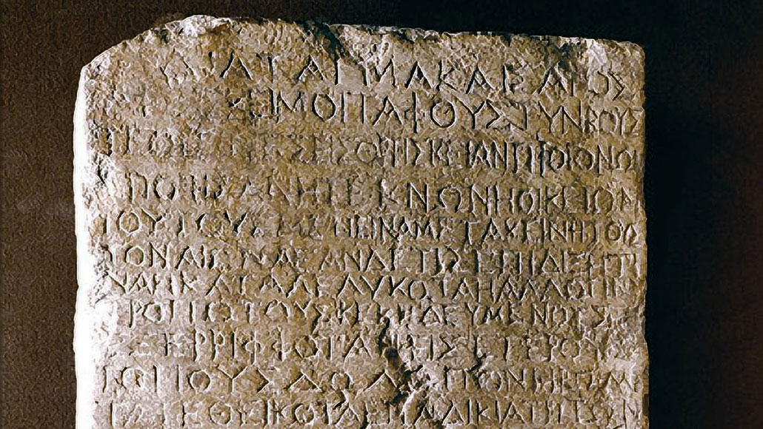
John 20
How do we know the tomb was empty?
Women as the first witnesses
The Nazareth Inscription
The inability to produce Jesus’ body
⁷as well as the cloth that had been wrapped around Jesus’ head. The cloth was still lying in its place, separate from the linen.
⁸Finally the other disciple, who had reached the tomb first, also went inside. He saw and believed.
#3
EMPTY TOMB

Slide 22
John 20
⁹(They still did not understand from Scripture that Jesus had to rise from the dead.)
¹⁰Then the disciples went back to where they were staying.

Slide 23
John 20
¹¹Now Mary stood outside the tomb crying. As she wept, she bent over to look into the tomb
¹²and saw two angels in white, seated where Jesus’ body had been, one at the head and the other at the foot.

Slide 24
John 20
The idea of a dying & rising Messiah was foreign to both Jewish & local pagan cultures
¹³They asked her, “Woman, why are you crying?”
“They have taken my Lord away,” she said, “and I don’t know where they have put him.”
#4
EXPECTATION OF RESURRECTION

Slide 25
John 20
The idea of a dying & rising Messiah was foreign to both Jewish & local pagan cultures
¹³They asked her, “Woman, why are you crying?”
“They have taken my Lord away,” she said, “and I don’t know where they have put him.”
#4
EXPECTATION OF RESURRECTION

Slide 26
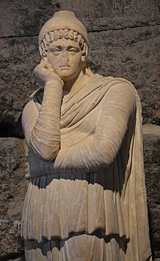
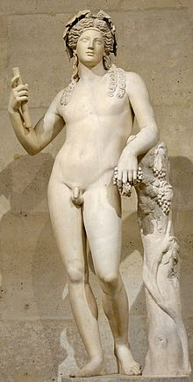
🙈

Slide 27
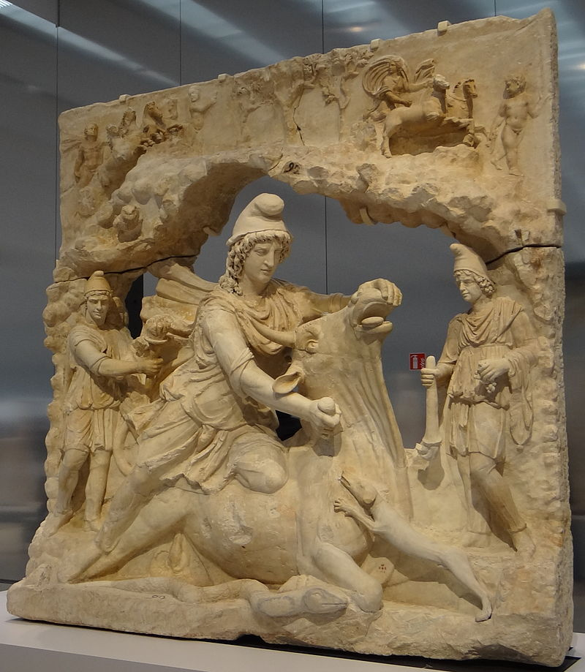

Slide 28
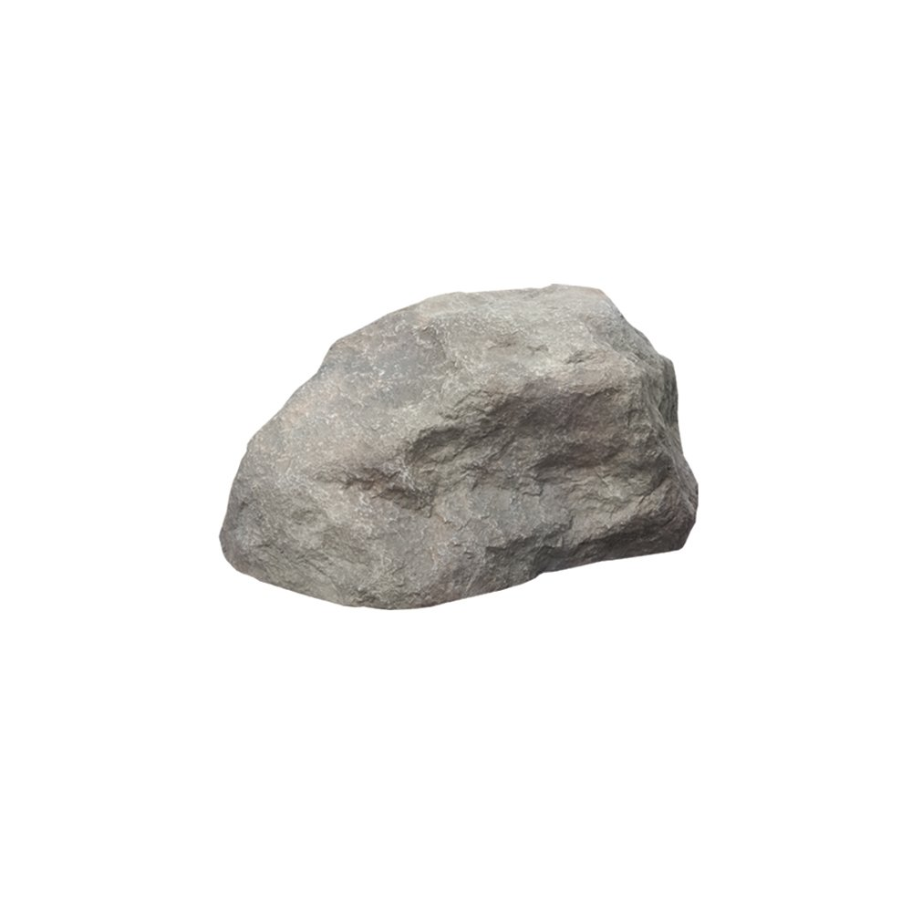

Slide 29
John 20
¹³They asked her, “Woman, why are you crying?”
“They have taken my Lord away,” she said, “and I don’t know where they have put him.”
The idea of a dying & rising Messiah was foreign to both Jewish & local pagan cultures
The disciples didn’t make this up
#4
EXPECTATION OF RESURRECTION

Slide 30
John 20
¹⁴At this, she turned around and saw Jesus standing there, but she did not realize that it was Jesus.

Slide 31
John 20
¹⁵He asked her, “Woman, why are you crying? Who is it you are looking for?” Thinking he was the gardener, she said, “Sir, if you have carried him away, tell me where you have put him, and I will get him.”

Slide 32
John 20
¹⁶Jesus said to her, “Mary.”
She turned toward him and cried out in Aramaic, “Rabboni!” (which means “Teacher”).

Slide 33
John 20
¹⁷Jesus said, “Do not hold on to me, for I have not yet ascended to the Father. Go instead to my brothers and tell them, ‘I am ascending to my Father and your Father, to my God and your God.’”

Slide 34
John 20
¹⁸Mary Magdalene went to the disciples with the news: “I have seen the Lord!” And she told them that he had said these things to her.

Slide 35
John 20
¹⁹On the evening of that first day of the week, when the disciples were together, with the doors locked for fear of the Jewish leaders, Jesus came and stood among them and said, “Peace be with you!”
²⁰After he said this, he showed them his hands and side. The disciples were overjoyed when they saw the Lord.

Slide 36
John 20
²¹Again Jesus said, “Peace be with you! As the Father has sent me, I am sending you.”
²²And with that he breathed on them and said, “Receive the Holy Spirit.
²³If you forgive anyone’s sins, their sins are forgiven; if you do not forgive them, they are not forgiven.

Slide 37
John 20
²⁴Now Thomas (also known as Didymus), one of the Twelve, was not with the disciples when Jesus came.
²⁵So the other disciples told him, “We have seen the Lord!”

Slide 38
John 20
²⁵But he said to them, “Unless I see the nail marks in his hands and put my finger where the nails were, and put my hand into his side, I will not believe.”
²⁶A week later his disciples were in the house again, and Thomas was with them. Though the doors were locked, Jesus came and stood among them and said, “Peace be with you!”

Slide 39
John 20
²⁷Then he said to Thomas, “Put your finger here; see my hands. Reach out your hand and put it into my side. Stop doubting and believe.”
²⁸Thomas said to him, “My Lord and my God!”

Slide 40
John 20
²⁹Then Jesus said to him, “Because you have seen me, you have believed; blessed are those who have not seen and yet have believed.
According to 1 Corinthians 15, at least three groups and three individual people saw Jesus risen from the dead
Consider just the three individuals – Peter, Paul, and James
#5
EYEWITNESSES

Slide 41
It may be taken as historically certain that Peter and the disciples had experiences after Jesus’ death in which Jesus appeared to them as the risen Christ.
Gerd Lüdemann & Alf Ozen
Atheist biblical scholar
What Really Happened to Jesus, 80.
What happened to Peter, Paul, and James?

Slide 42
John 20
²⁹Then Jesus said to him, “Because you have seen me, you have believed; blessed are those who have not seen and yet have believed.
#5
EYEWITNESSES

Slide 43
John 20
Does dying your beliefs make them true?
Dying for your beliefs doesn’t prove the veracity of your belief
But it does prove the sincerity of your belief
What could motivate them to believe, even if it meant dying?
²⁹Then Jesus said to him, “Because you have seen me, you have believed; blessed are those who have not seen and yet have believed.
#5
EYEWITNESSES

Slide 44
John 20
³⁰Jesus performed many other signs in the presence of his disciples, which are not recorded in this book.
³¹But these are written that you may believe that Jesus is the Messiah, the Son of God, and that by believing you may have life in his name.

Slide 45
Conclusions
The disciples believed Jesus was God
We have plenty of evidence to believe that as well

Slide 46
Conclusions
What best explains the resurrection?
Was it a late legend?
Did Jesus swoon?
Did the disciples hallucinate it?
Did the disciples steal the idea from other traditions?
Did the disciples steal the body?
Or did Jesus actually raise from the dead?

Slide 47
Conclusions
What best explains the resurrection?
Was it a late legend?
Did Jesus swoon?
Did the disciples hallucinate it?
Did the disciples steal the idea from other traditions?
Did the disciples steal the body?
Or did Jesus actually raise from the dead?
Romans 1:4 [NASB] – ⁴[Jesus] was declared the Son of God with power by the resurrection from the dead.

Slide 48
Conclusions
The disciples believed Jesus was God
We have plenty of evidence to believe that as well
What’s your takeaway?
You could say you don’t believe. How do you explain the evidence?
You could do nothing – which is the same as saying you don’t believe it.

Slide 49
Conclusions
The disciples believed Jesus was God
We have plenty of evidence to believe that as well
What’s your takeaway?
Or, you could meet Jesus today.
Romans 10:9 – ⁹If you declare with your mouth, “Jesus is Lord,” and believe in your heart that God raised him from the dead, you will be saved.
#6
EXPERIENCE

Slide 50
JOHN 20
The Resurrection

