Slide 2
Jesus made outrageous claims
(1) Equality with God.
John 5:18 (Isaiah 44:7; 46:9)
(2) The judge of humanity.
John 5:22, 27 (Genesis 18:25; Psalm 96:13; 98:9; Ecclesiastes 12:14)
(3) Receiver of universal honor.
John 5:23“They who deify mortal things neglect the honour due to God” (Philo, On Drunkenness, 110).
(4) Giver of eternal life.
John 5:21, 24-25 (Deuteronomy 32:39; 1 Samuel 2:6)
But how can we know that these claims are true?

Slide 3
(Jn. 5:31) If I testify about myself, my testimony is not true.
³² There is another who testifies in my favor, and I know that his testimony about me is true.
Witness #1.
God the Father
Verse 37; John 7:16-17; Romans 8:15-16

Slide 4
(Jn. 5:33) You have sent to John and he has testified to the truth.
³⁴ Not that I accept human testimony; but I mention it that you may be saved.
³⁵ John was a lamp that burned and gave light, and you chose for a time to enjoy his light.
Witness #2.
John the Baptist
John 1:19-28

Slide 5
(Jn. 5:36) I have testimony weightier than that of John.
For the works that the Father has given me to finish—the very works that I am doing—testify that the Father has sent me.
Josephus (AD 100): Jesus was a “worker of amazing deeds.”
Antiquities 18.3
Celsus (AD 150): Jesus “served for hire in Egypt” and learned “certain miraculous powers.”
Origen, Contra Celsum 1.38
Talmud (AD 400): “[Jesus] practiced sorcery and enticed Israel to apostasy.”
b. Sanhedrin 43a
Witness #3.
Miracles
John 1:19-28

Slide 6
(Jn. 5:37) The Father who sent me has himself testified concerning me. You have never heard his voice nor seen his form,
³⁸ nor does his word dwell in you,
for you do not believe the one he sent.

Slide 7
(Jn. 5:39) You study the Scriptures diligently because you think that in them you have eternal life.
“Lots of Torah, lots of life.”
m. Abot 2:6

Slide 8
(Jn. 5:39) You study the Scriptures diligently because you think that in them you have eternal life.
⁴⁰ These are the very Scriptures that testify about me.
Witness #4.
Predictive Prophecy
What is Jesus claiming?
The Hebrew Scriptures predicted him—hundreds of years in advance!

Slide 13
The Messiah will die!

Slide 19
Recorded in Nehemiah 2…

Slide 20
(Neh. 2:1) Early the following spring, in the month of Nisan,
during the twentieth year
of King Artaxerxes’ reign, I was serving the king his wine. I had never before appeared sad in his presence.

Slide 21
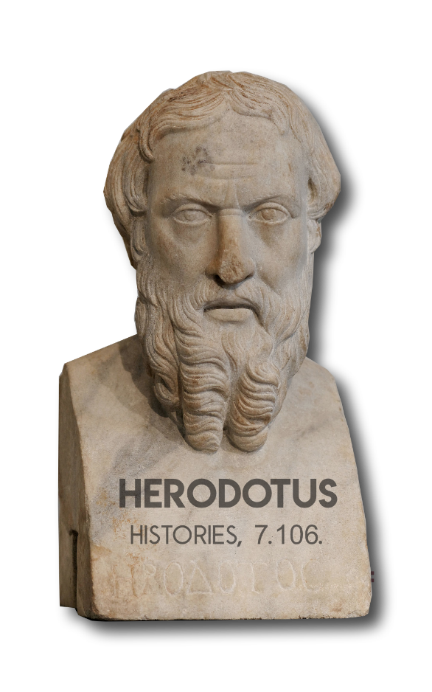
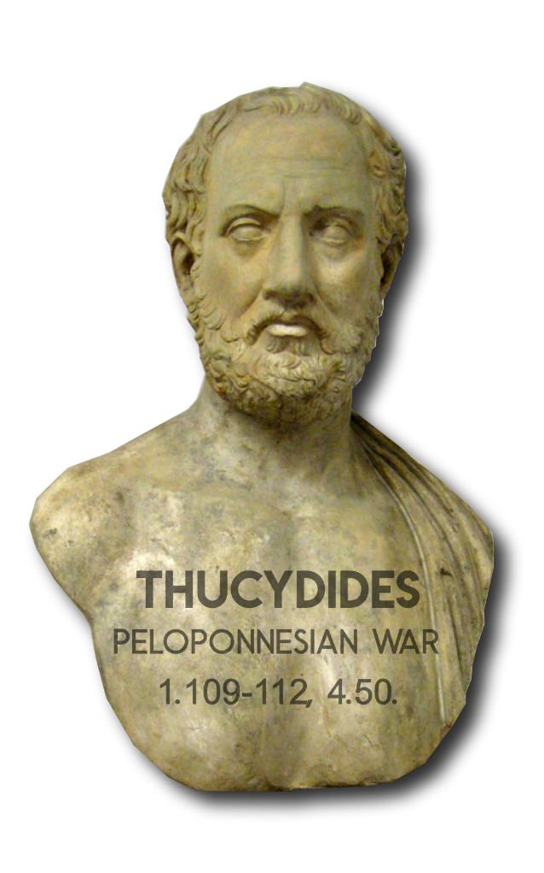
(Neh. 2:1) Early the following spring, in the month of Nisan,
during the twentieth year
of King Artaxerxes’ reign, I was serving the king his wine. I had never before appeared sad in his presence.

Slide 22
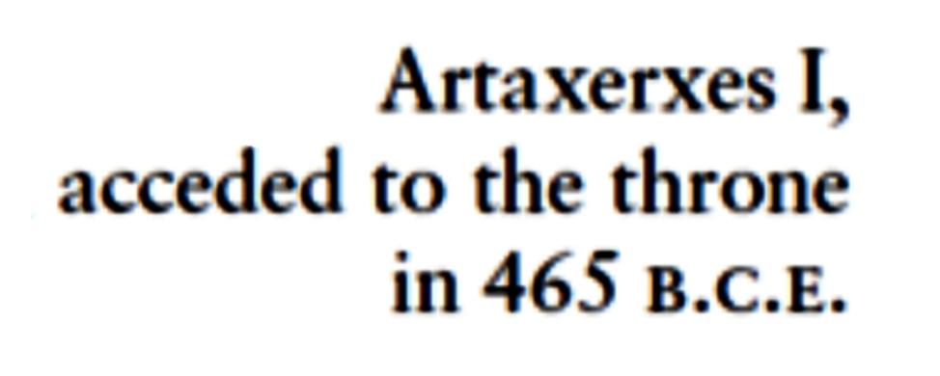

Slide 23
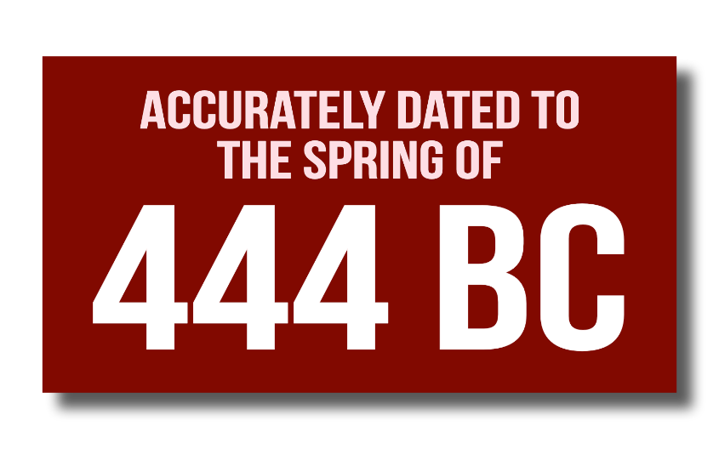
(Neh. 2:1) Early the following spring, in the month of Nisan,
during the twentieth year
of King Artaxerxes’ reign, I was serving the king his wine. I had never before appeared sad in his presence.

Slide 24
(Neh. 2:3) Nehemiah said,
“The city where my ancestors are buried is in ruins.
The gates have been destroyed by fire.”
⁴ The king asked, “How can I help?”

Slide 25
(Neh. 2:5) I replied, “Send me to Judah to rebuild the city where my ancestors are buried.”

Slide 26
(Neh. 2:7) I also said to the king,
“Let me have letters addressed to the governors…”

Slide 27
(Neh. 2:8) “Please give me a letter addressed to Asaph.
I will need it to make beams for the gates of the Temple fortress
and for the city walls.”

Slide 28
(Neh. 2:8) And the king granted these requests.

Slide 30
(Gen. 29:27) Laban said to Jacob,
“Complete the week of this one,
and we will give you the other… for another seven years.
“Sevens” or “Weeks”
“set of seven” (shabu’im)
Like the word “dozen.”
1. Context refers to years
2. Days makes no sense
3. Used for seven years

Slide 31
7 x 7 years = 49 years
62 x 7 years = 434 years
483 years

Slide 35
Very close! But Jesus died in AD 33.
But we forgot something…
The Jewish people used a 360-day calendar year.

Slide 38
(Gen. 8:3-4) After 150 days,
exactly five months from the time the flood began…

Slide 39
“42 months”
Revelation 11:2; 13:5
“1,260 days”
Revelation 11:3; 12:6

Slide 40
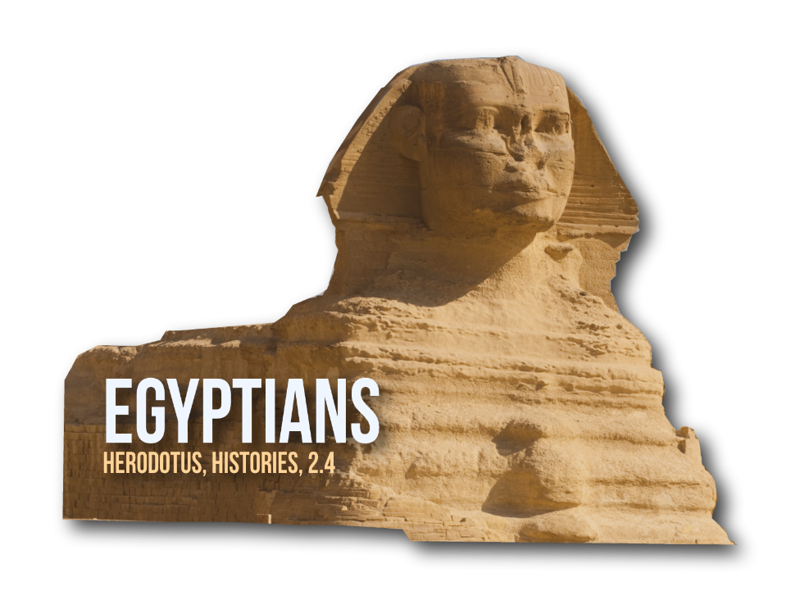
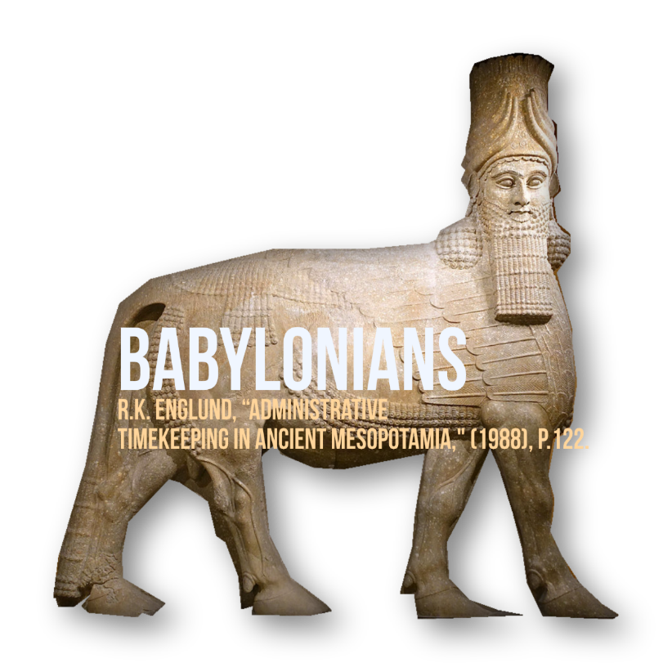

Slide 41
Jonathan Ben-Dov
(Hebrew University)
Jonathan Ben-Dov, “A 360-Day Administrative Year in Ancient Israel.” Harvard Theological Review (Cambridge University Pres, 2021).
Administrators in ancient Judah used schematic 30-day months and a 360-day year alongside other annual frameworks.

Slide 42
Jonathan Ben-Dov
(Hebrew University)
Jonathan Ben-Dov, “A 360-Day Administrative Year in Ancient Israel.” Harvard Theological Review (Cambridge University Pres, 2021).
Until the Old Babylonian period, the most wide-spread system in administrative use was a schematic year of 360 days, existing alongside the lunar calendar.

Slide 43
Jonathan Ben-Dov
(Hebrew University)
Jonathan Ben-Dov, “A 360-Day Administrative Year in Ancient Israel.” Harvard Theological Review (Cambridge University Pres, 2021).
It was an administrative framework used by clerks and administrators for
long-term calculations.

Slide 52
Really close! But not AD 33.
We forgot one more thing…

Slide 59
Why would anyone not believe this?

Slide 60
(Jn. 5:39) You study the Scriptures diligently because you think that in them you have eternal life.
⁴⁰ These are the very Scriptures that testify about me.

Slide 61
(Jn. 5:39) You study the Scriptures diligently because you think that in them you have eternal life.
⁴⁰ These are the very Scriptures that testify about me. Yet you refuse to come to me to have life.
Have you ever had the sense that something is missing in your life?
Have you felt at times that you were created for a greater purpose?
Have you seriously wondered if your life will continue after death?

Slide 62
(Jn. 5:39) You study the Scriptures diligently because you think that in them you have eternal life.
⁴⁰ These are the very Scriptures that testify about me. Yet you refuse to come to me to have life.
(Jn. 5:24) Jesus said, “Those who listen to my message and believe in God who sent me have eternal life.
They will never be condemned for their sins, but they have already passed from death into life.”

Slide 64
Was this a self-fulfilled prediction?
1. A huge admission!
2. Crucifixion was not in Jesus’ self-interest!
3. No one expected a crucified Messiah.
1 Corinthians 1:23
4. Jesus’ closest disciples paid the ultimate price.
Peter, James, and Paul (1 Clement 5:4-5; Tertullian in Ecclesiastical History, 2:25.5; Caius & Dionysius of Corinth, 2:25.8; Josephus, Antiquities of the Jews 20:197-203).
5. The NT authors don’t give a date or cite this.

Slide 65
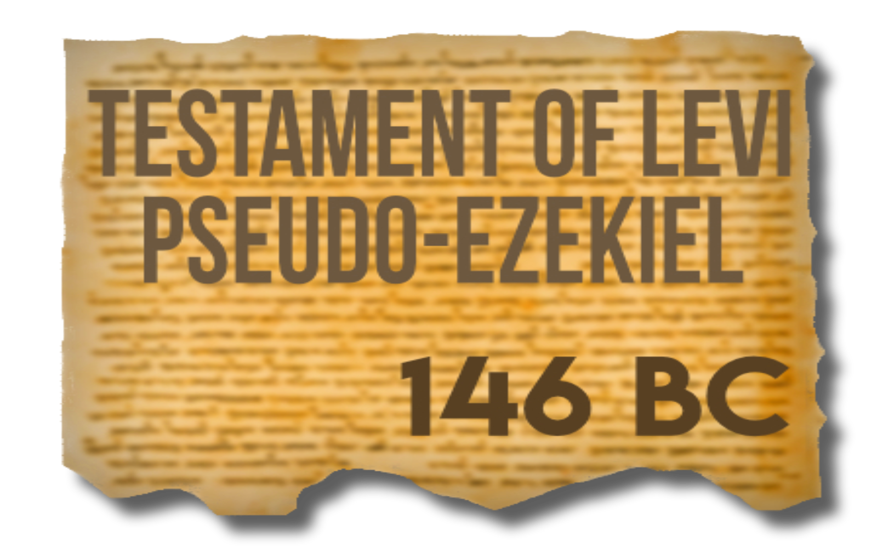
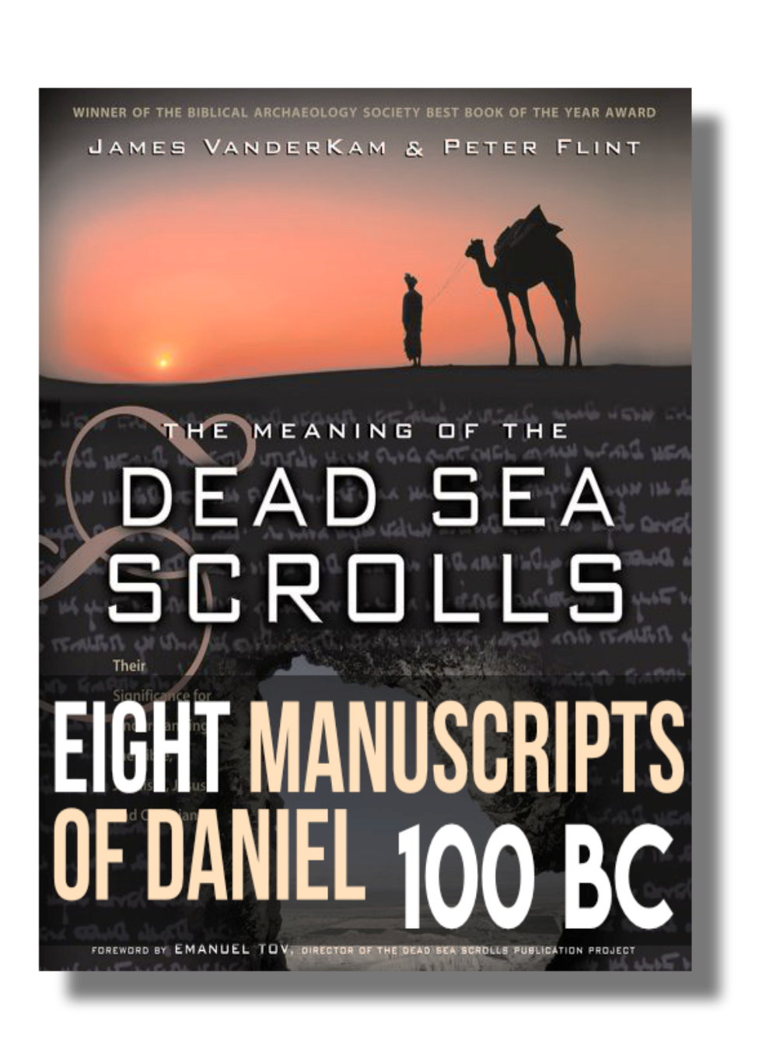
Was this written after Jesus?

Slide 66
445 or 444 BC?

Slide 67
Why not just say 69 years?
“Women should marry when they are about eighteen years of age, and men at seven and thirty.”
“Seven and thirty” (Greek hepta kai triankonta).
Aristotle (4th c. BC), Politics 7.16.
“Eight and twenty, days.”
Aulus Gellius (2nd c. AD), Attic Nights 3.10.
“Four score and seven years ago…”
The Gettysburg Address (November 19, 1863)
49 years = Rebuilding of Jerusalem?

Slide 73
