Slide 1
Leadership Lessons From King Saul
1 Samuel 9-15

Slide 2
1 Samuel 9
1 There was a wealthy, influential man named Kish…
2 His son Saul was the most handsome man in Israel—head and shoulders taller than anyone else in the land.
The Call of King Saul

Slide 3
1 Samuel 9
3 One day Kish’s donkeys strayed away
and he told Saul, “Take a servant with you, and go look for the donkeys.”
Saul’s first leadership task
The Call of King Saul

Slide 4
1 Samuel 9
4 So Saul took one of the servants and traveled through the hill country of Ephraim,
the land of Shalishah,
the Shaalim area,
and the entire land of Benjamin,
but they couldn’t find the donkeys anywhere.
The Call of King Saul

Slide 5
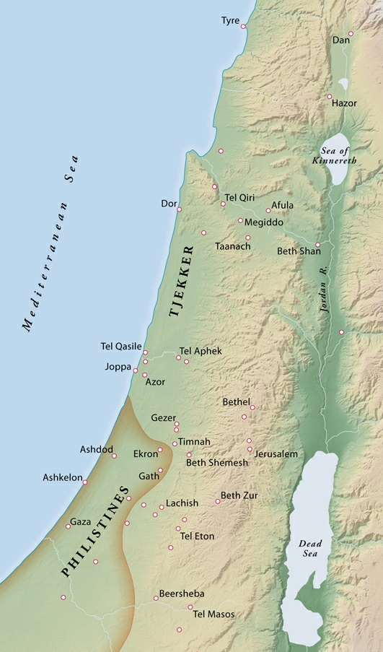
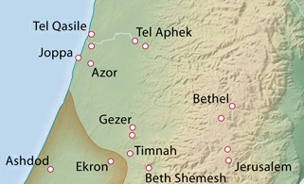
1 Samuel 9
Mizpah
Ramah
Gibeah

Slide 6
1 Samuel 9
5 Finally, they entered the region of Zuph, and Saul said to his servant,
“Let’s go home. By now my father will be more worried about us than about the donkeys!”
6 But the servant said, “I’ve just thought of something!
Mizpah
Ramah
Gibeah

Slide 7
1 Samuel 9
6 There is a man of God who lives here in this town.
He is held in high honor by all the people because everything he says comes true.
Let’s go find him. Perhaps he can tell us which way to go.”
Mizpah
Ramah
Gibeah

Slide 8
1 Samuel 9
7 “But we don’t have anything to offer him,” Saul replied.
“Even our food is gone, and we don’t have a thing to give him.”
Mizpah
Ramah
Gibeah

Slide 9
1 Samuel 9
8 “Well,” the servant said, “I have a quarter of a shekel.
We can at least offer it to the man of God and see what happens!”
Mizpah
Ramah
Gibeah

Slide 10
Observations
Saul hikes over 100 miles looking for his donkeys
The prophet Samuel only lives a few miles away (and Saul has never met him)
His servant generates a creative, spiritual solution
Saul gives a weak reason why the idea won’t work: “We don’t have anything to give him”
The guy he’s supposed to be leading counters with another creative solution

Slide 11
Saul
He has the appearance of a king
Less spiritual than the guy he’s leading
He’d rather hike through the mountains for weeks than walk an hour to ask God about his problem
Not very creative, and doesn’t respond well when his followers have creative ideas
Thinks you have to pay God to do stuff for you

Slide 12
Saul
If you take a guy like this, and load a big spiritual responsibility on his shoulders…

Slide 13
Saul
Application: Prepare for spiritual leadership now
Character and closeness with God take time
Invest now in your relationship with God
What was David doing in the hidden years?
Talk with him about the small things: “Where’s my donkey?”
The Lord is my shepherd; I have all that I need. (Psalm 23:1)

Slide 14
Saul
Unfortunately, Saul hasn’t invested in his spiritual life
Fortunately, God is going to teach him some basic truths of spiritual leadership
He begins by putting some spiritual guys in Saul’s life…

Slide 15
1 Samuel 9
10 “All right,” Saul agreed, “let’s try it!” So they started into the town…
18 Saul approached Samuel at the gateway
and asked, “Can you please tell me where the seer’s house is?”
19 “I am the seer!” Samuel replied.
The Call of King Saul

Slide 16
1 Samuel 9
19 “Go up to the place of worship ahead of me. We will eat there together…
I am here to tell you that you and your family are the focus of all Israel’s hopes.”
The Call of King Saul

Slide 17
1 Samuel 9
21 Saul replied,
“But I’m only from the tribe of Benjamin, the smallest tribe in Israel,
and my family is the least important of all the families of that tribe!
Why are you talking like this to me?”
The Call of King Saul

Slide 18
1 Samuel 9
22 Then Samuel brought Saul and his servant into the hall and placed them at the head of the table, honoring them above the thirty special guests.
23 Samuel then instructed the cook to bring Saul the finest cut of meat, the piece … for the guest of honor.
The Call of King Saul

Slide 19
1 Samuel 9
24 So the cook brought in the meat and placed it before Saul.
“Go ahead and eat it,” Samuel said.
“I was saving it for you even before I invited these others!”
So Saul ate with Samuel that day.
Saul had lived down the road from Samuel his whole life…
The Call of King Saul

Slide 20
1 Samuel 9
25 Samuel took Saul up to the roof of his house and prepared a bed for him there.
The Call of King Saul

Slide 21
1 Samuel 9
26 At daybreak the next morning, Samuel called to Saul, “Get up! It’s time you were on your way.”…
27 When they reached the edge of town, Samuel told Saul to send his servant on ahead.
After the servant was gone, Samuel said, “Stay here, for I have received a special message for you from God.”
The Call of King Saul

Slide 22
1 Samuel 10
1 Then Samuel took a flask of olive oil and poured it over Saul’s head.
He kissed Saul and said, “I am doing this because the Lord has appointed you to be the ruler over Israel, his special possession.
The Call of King Saul

Slide 23
1 Samuel 10
1 Then Samuel took a flask of olive oil and poured it over Saul’s head.
He kissed Saul and said, “I am doing this because the Lord has appointed you to be the ruler over Israel, his special possession.
What is God trying to teach Saul?
“I love you”
“These people are mine”
“Listen to me and I will supply all you need”
The Call of King Saul

Slide 24
1 Samuel 10
2 When you leave me today, you will see two men beside Rachel’s tomb…
They will tell you that the donkeys have been found…
What is God trying to teach Saul?
“I love you”
“These people are mine”
“Listen to me and I will supply all you need”
The Call of King Saul

Slide 25
1 Samuel 10
3-4 “When you get to the oak of Tabor, you will see three men coming toward you…
They will greet you and offer you two loaves of bread, which you are to accept.
What is God trying to teach Saul?
“I love you”
“These people are mine”
“Listen to me and I will supply all you need”
The Call of King Saul

Slide 26
1 Samuel 10
5-6 “When you arrive at Gibeah…
the Spirit of the Lord will come powerfully upon you… You will be changed into a different person
9 As Saul turned and started to leave, God gave him a new heart, and all Samuel’s signs were fulfilled that day.
What is God trying to teach Saul?
“I love you”
“These people are mine”
“Listen to me and I will supply all you need”
The Call of King Saul

Slide 27
1 Samuel 10
What is God trying to teach Saul?
“I love you”
“These people are mine”
“Listen to me and I will supply all you need”
The Call of King Saul

Slide 28
1 Samuel 10
17 Samuel called all the people of Israel to meet before the Lord at Mizpah…
21 And finally Saul son of Kish was chosen from among them.
The Call of King Saul

Slide 29
1 Samuel 10
21 But when they looked for him, he had disappeared!
22 So they asked Yahweh, “Where is he?”
And Yahweh replied, “He is hiding among the baggage.”
#3 “Listen to me and I will supply all you need”
The Call of King Saul

Slide 30
1 Samuel 10
23 So they found him and brought him out, and he stood head and shoulders above anyone else.
24 Then Samuel said to all the people,
“This is the man Yahweh has chosen as your king.
No one in all Israel is like him!”
Application?
#3 “Listen to me and I will supply all you need”
The Call of King Saul

Slide 31
1 Samuel 11
Saul goes back to his farm
Then disaster strikes: The Attack of the Ammonites
The men of Jabesh Gilead send for their new king!
Saul’s First Battle

Slide 32
1 Samuel 11
6 Then the Spirit of God came powerfully upon Saul, and he became very angry.
7 He took two oxen and cut them into pieces and sent the messengers to carry them throughout Israel with this message:
“This is what will happen to the oxen of anyone who refuses to follow Saul and Samuel into battle!”
Saul’s First Battle

Slide 33
1 Samuel 11
7 And Yahweh made the people afraid of Saul’s anger, and all of them came out together as one.
Saul’s First Battle

Slide 34
1 Samuel 11
7 And Yahweh made the people afraid of Saul’s anger, and all of them came out together as one.
1. Is this how a spiritual leader motivates people?
It’s not how God called Saul
We motivate through God’s love and truth
Saul’s First Battle

Slide 35
1 Samuel 11
7 And Yahweh made the people afraid of Saul’s anger, and all of them came out together as one.
2. The plan “worked”, but at what cost?
Scaring people doesn’t work for long
Big contrast with David’s methods (and results)
Saul’s First Battle

Slide 36
1 Samuel 13
[The Philistines are gathering for battle
Saul is supposed to wait 7 days for Samuel]
The Fall of Saul

Slide 37
1 Samuel 13
7 Meanwhile, Saul stayed at Gilgal, and his men were trembling with fear.
8 Saul waited there seven days for Samuel, as Samuel had instructed him earlier, but Samuel still didn’t come.
Saul realized that his troops were rapidly slipping away.
The Fall of Saul

Slide 38
1 Samuel 13
9 So he demanded, “Bring me the burnt offering and the peace offerings!”
And Saul sacrificed the burnt offering himself.
He couldn’t wait on God (cf. 1 Sam 24, 26)
The Fall of Saul

Slide 39
1 Samuel 13
10 Just as Saul was finishing with the burnt offering, Samuel arrived.
Saul went out to meet and welcome him,
The Fall of Saul

Slide 40
1 Samuel 13
11 but Samuel said, “What is this you have done?”
Saul replied, “I saw
my men scattering from me,
and you didn’t arrive when you said you would,
and the Philistines are at Micmash ready for battle.
The Fall of Saul

Slide 41
1 Samuel 13
12 So I said, ‘The Philistines are ready to march against us at Gilgal, and I haven’t even asked for Yahweh’s help!’
So I forced myself to offer the burnt offering before you came.”
It takes a strong grasp on the love of God to say, “I was wrong” (cf. 2 Sam 12; Psalm 32, 51)
The Fall of Saul

Slide 42
1 Samuel 13
13 “How foolish!” Samuel exclaimed. “You have not kept the command the Lord your God gave you…
14 Now your kingdom must end, for the Lord has sought out a man after his own heart.
#2 “These people are mine”
The Fall of Saul

Slide 43
1 Samuel 15
9 Saul and his men spared Agag’s life and kept the best of the sheep and goats, the cattle…
12 Early the next morning Samuel went to find Saul.
Someone told him,
“Saul went to the town of Carmel to set up a monument to himself…
The Fall of Saul

Slide 44
1 Samuel 15
13 When Samuel finally found him, Saul greeted him cheerfully.
“May Yahweh bless you,” he said. “I have carried out Yahweh’s command!”
14 “Then what is all the bleating of sheep and goats and the lowing of cattle I hear?” Samuel demanded.
The Fall of Saul

Slide 45
1 Samuel 15
15 “It’s true that the army spared the best of the sheep, goats, and cattle,” Saul admitted.
“But they are going to sacrifice them to Yahweh your God. We have destroyed everything else.”
The Fall of Saul

Slide 46
1 Samuel 15
16 Then Samuel said to Saul, “Stop! Listen to what Yahweh told me last night!”
“What did he tell you?” Saul asked.
The Fall of Saul

Slide 47
1 Samuel 15
17-18 And Samuel told him,
“Although you may think little of yourself, are you not the leader of the tribes of Israel?
The Fall of Saul

Slide 48
1 Samuel 15
35 Samuel never went to meet with Saul again, but he mourned constantly for him.
And Yahweh was sorry he had ever made Saul king of Israel.
The Fall of Saul

Slide 49
Lessons
Prepare for spiritual leadership now
Cling to the 3 truths of spiritual leadership:
“I love you”
“These people are mine”
“Listen to me and I will supply all you need”

Slide 50
Leadership Lessons From King Saul
Questions?
Comments?
Experiences?

