Slide 3
Why has public support doubled for recreational marijuana
during the very same decades that research scientists have revealed its damaging effects?

Slide 4
“Why can you drink alcohol, but I can’t enjoy weed in moderation?”
“Alcohol is far more dangerous.”
“Weed is legal now…
Get with it, Boomer!”
“The government has exaggerated the effects of weed for decades.”

Slide 6
“Why can you drink alcohol, but I can’t enjoy weed in moderation?”
“Alcohol is far more dangerous.”
“Weed is legal now…
Get with it, Boomer!”
“The government has exaggerated the effects of weed for decades.”

Slide 8
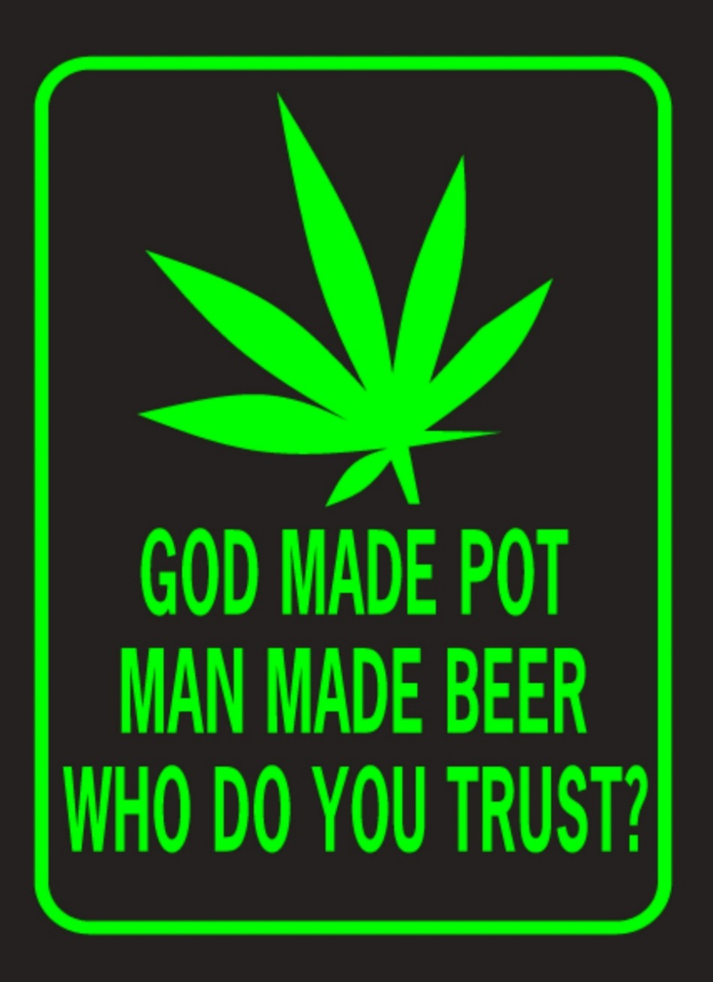
(1) The Bible affirms that all of God’s creation is good (1 Tim. 4:4).
(2) Scripture never makes an exception for marijuana.
(3) In fact, it mentions “plants yielding seed” (Gen. 1:29).
(4) Therefore, marijuana is good.

Slide 9
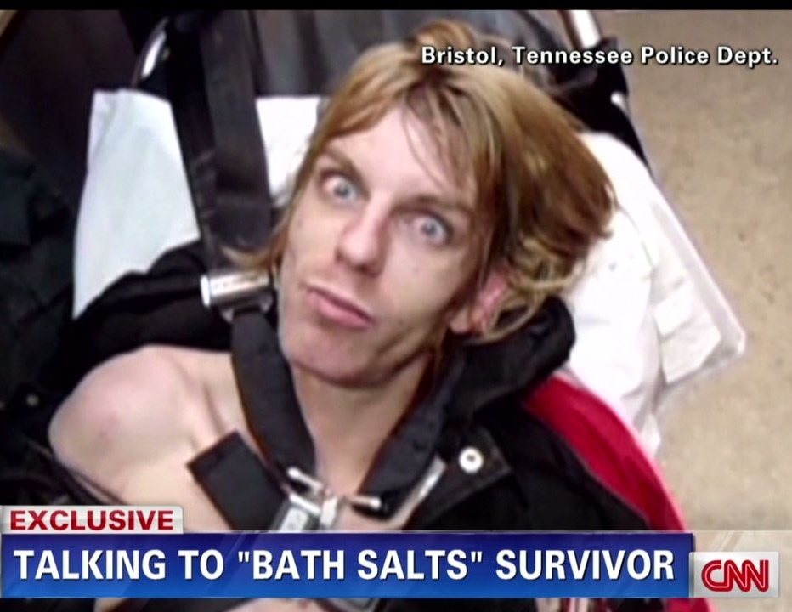
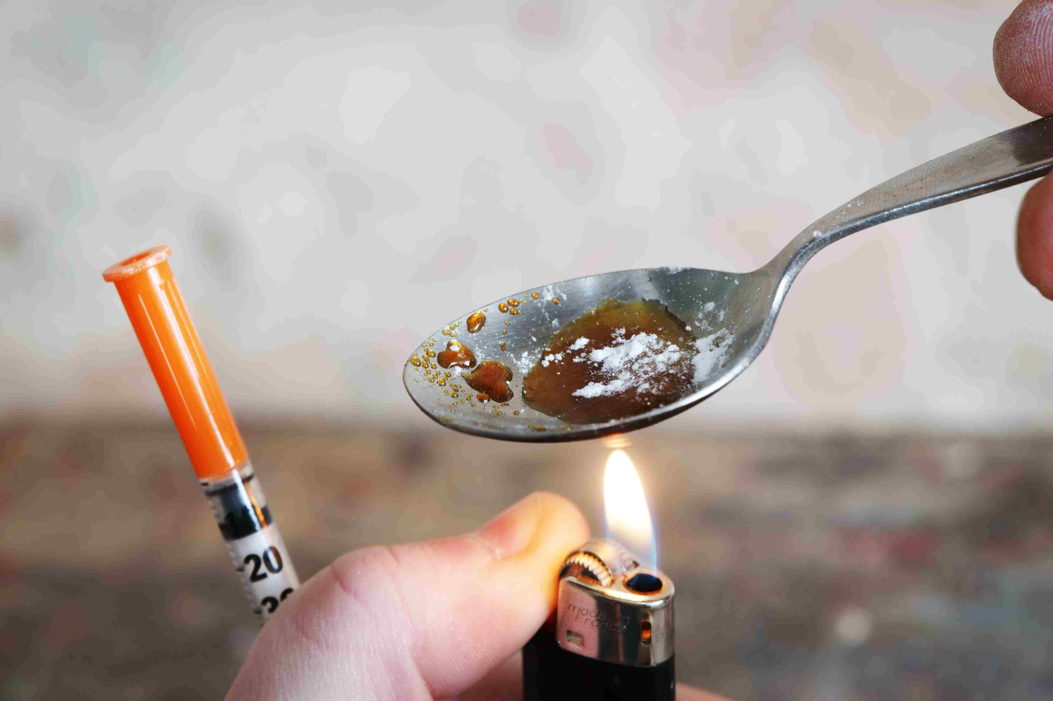
(1) Silence is not affirmation.

Slide 10
What about Scripture?
1 Timothy 4:4 and Genesis 1:29
The context of 1 Timothy 4 is ingestion, not inhalation (v.3).
Why would someone ingest marijuana?
The context for Genesis 1 is pre-Fall.
Creation is good, but not every use is good.
Common sense: This isn’t free license to ingest everything on Earth.
(e.g. crown vetch, nightshade, or hemlock)
(1) Silence is not affirmation.
(2) God’s creation is good, but not always the use of his creation.

Slide 11
The Bible and Alcohol?
Jesus turned water into wine.
John 2:1-11 (150 gallons!)
Jesus drank wine.
Matthew 11:19; 26:29; Luke 22:18
Jesus will drink wine again in heaven.
Matthew 26:29
(Ps. 104:14-15) [God] causes… wine which makes man’s heart glad.
cf. Deuteronomy 14:26
(1) Silence is not affirmation.
(2) God’s creation is good, but not always the use of his creation.
(3) The Bible approves of alcohol.

Slide 12
The Bible and Sobriety?
(Eph. 5:18) “Do not get drunk with wine… but be filled with the Spirit.”
The Bible calls this lifestyle “unrighteous,” and could even result in removal from fellowship.
1 Corinthians 5:11; 6:10
The Bible extols mental sobriety.
1 Thessalonians 5:6, 8; 1 Peter 1:13; 4:7
(Prov. 20:1) Whoever is intoxicated by [strong drink] is not wise.
(1) Silence is not affirmation.
(2) God’s creation is good, but not always the use of his creation.
(3) The Bible approves of alcohol.
(4) The Bible strongly speaks against intoxication.

Slide 13
(1 Pet. 5:8) Be of sober spirit, be on the alert.
Your adversary, the devil, prowls around like a roaring lion, seeking someone to devour.
2 Corinthians 11:3; 1 Timothy 4:1; Revelation 12:9
Why are drug and alcohol abusers often the last to know that they have a problem?
(1) Silence is not affirmation.
(2) God’s creation is good, but not always the use of his creation.
(3) The Bible approves of alcohol.
(4) The Bible strongly speaks against intoxication.
(5) Intoxication is serious because we face a brilliant Enemy.

Slide 14
Don’t waterboard the Bible to agree with you!!
(1) Silence is not affirmation.
(2) God’s creation is good, but not always the use of his creation.
(3) The Bible approves of alcohol.
(4) The Bible strongly speaks against intoxication.
(5) Intoxication is serious because we face a brilliant Enemy.

Slide 16
(1) Changes the physical structure of the brain.
Amygdala
Regulates emotions
Reward-processing
Decision-making
Nucleus accumbens
“Reward circuit” of the brain.
Activates dopamine.
Harvard Medical School & Northwestern University (2014)
Studied weekly users (18-25).
Found abnormalities in the nucleus accumbens, and the amygdala was “deformed inwards.”
Jodi M. Gilman, et al. (2014). “Cannabis Use Is Quantitatively Associated with Nucleus Accumbens and Amygdala Abnormalities in Young Adult Recreational Users.” Journal of Neuroscience. 34 (16) 5529-5538.

Slide 25
Hans Breiter (professor of psychiatry and behavioral sciences)
“People think a little recreational use shouldn’t cause a problem, if someone is doing OK with work or school.
Our data directly says this is not the case.”
Hans Breiter, “Casual Marijuana Use Linked to Brain Abnormalities in Students.” Science Newsline (April 2014).

Slide 26
(1) Changes the physical structure of the brain.
(2) Lowers a person’s IQ.
Regular users under the age of 18 had a permanent 8-point drop in their IQ over a 25-year period.
Madeline H. Meier et al., “Persistent cannabis users show neuropsychological decline from childhood to midlife,” Proceedings of the National Academy of Sciences 109, no. 40 (2012): E2657-E2664.
Kevin P. Hill, M.D., Marijuana: The Unbiased Truth about the World’s Most Popular Weed (Center City, MN: Hazelden Publishing, 2015), p.47.

Slide 27
(1) Changes the physical structure of the brain.
(2) Lowers a person’s IQ.
(3) Debilitates memory,
verbal skills, and our ability
to pay attention.
Messinis, Lambros, et al. “Neuropsychological Deficits in Long-term Frequent Cannabis Users.” Neurology. 66:5 (March 2006): 737. See also Solowij, N. et al. (2002). Cognitive functioning of long-term heavy cannabis users seeking treatment. Journal of the American Medical Association, 287(9), 1123-1131.

Slide 36
The brain naturally produces an endocannabinoid called anandamide (which makes dopamine).
THC mimics this endocannabinoid, which shuts off the brain’s natural function.
Arpana Agrawal et al., “Major Depressive Disorder, Suicidal Thoughts and Behaviours, and Cannabis Involvement in Discordant Twins: A Retrospective Cohort Study,” The Lancet Psychiatry 4, no. 9 (2017): 706-714.
(1) Changes the physical structure of the brain.
(2) Lowers a person’s IQ.
(3) Debilitates memory,
verbal skills, and our ability
to pay attention.
(4) Strongly correlates with depression, anxiety, and psychosis.

Slide 37
(1) Changes the physical structure of the brain.
(2) Lowers a person’s IQ.
(3) Debilitates memory,
verbal skills, and our ability
to pay attention.
(4) Strongly correlates with depression, anxiety, and psychosis.

Slide 40
(1) Changes the physical structure of the brain.
(2) Lowers a person’s IQ.
(3) Debilitates memory,
verbal skills, and our ability
to pay attention.
(4) Strongly correlates with depression, anxiety, and psychosis.
Not merely a correlation, but a “component cause.”
A “component cause” is an unusually high correlation after controlling for other possible causes.
Joseph Pierre, “Cannabis, synthetic cannabinoids, and psychosis risk: What the evidence says.” Current Psychiatry. 10:9. 2011. 51.

Slide 52
8x stronger!
The difference between
a 12-ounce glass of Budweiser,
and a 12-ounce glass of Bacardi!

Slide 55
Amsterdam classified marijuana with a 15% THC content as a “hard drug,” refusing sales to tourists.
“Experts warn that keeping tourists out of Amsterdam coffee shops won’t be easy.” Dutch News (May 26, 2021).

Slide 57
Group #1: “Significantly reduced self-reported subjective distress.”
Group #2. “Increased negative mood overall… threatening and challenging.”
Subjects were aged 18-40 who had experience with marijuana, but not daily users.
Researchers introduced a stress test:
Group #1. 7.5 mgs of THC
Group #2. 12.5 mgs of THC
Emma Childs et al., “Dose-related effects of delta-9-THC on emotional responses to acute psychosocial stress.” Drug Alcohol Depend. 2017 Aug 1; 177: 136-144.

Slide 58
Standard joint is 700 mgs
20% THC = 140 mg.
10% THC = 70 mg.
5% THC = 35 mg.
2% THC = 14 mg.
Evaluation
(1) The participants had experience with marijuana.
(2) The typical joint contains 140 mg of THC.
(3) This “microdose” was equivalent to a full joint of Woodstock weed!
Subjects were aged 18-40 who had experience with marijuana, but not daily users.
Researchers introduced a stress test:
Group #1. 7.5 mgs of THC
Group #2. 12.5 mgs of THC
Emma Childs et al., “Dose-related effects of delta-9-THC on emotional responses to acute psychosocial stress.” Drug Alcohol Depend. 2017 Aug 1; 177: 136-144.
30-50% of the THC is burnt up when marijuana is smoked.
Mario Pérez-Reyes. “Marijuana smoking.” (Research Findings on Smoking of Abused Substances. NIDA Research Monograph, 1990), p.60.

Slide 59
Can anyone seriously argue that smoking an entire joint at Woodstock would be consistent with sobriety??
Coordination tests, blood tests, and saliva swabs have failed to accurately identify if someone is too impaired to drive a car.
James Queally and Sarah Parvini, “For Police, Catching Stoned Drivers Isn’t So Easy,” Los Angeles Times, March 22, 2018.
Subjects were aged 18-40 who had experience with marijuana, but not daily users.
Researchers introduced a stress test:
Group #1. 7.5 mgs of THC
Group #2. 12.5 mgs of THC
Emma Childs et al., “Dose-related effects of delta-9-THC on emotional responses to acute psychosocial stress.” Drug Alcohol Depend. 2017 Aug 1; 177: 136-144.

Slide 61
Not everything that is legal is moral.
“Any reason divorce” was perfectly legal in Jesus’ day (Mt. 19:3).
But Jesus taught that it was profoundly immoral (Mt. 19:4-9).
Currently in Nevada, it is legal to get drunk, watch porno, pay a prostitute for sex, etc.

Slide 63
Marijuana abuse is safer in many respects:
Almost impossible to overdose
Less addictive than other drugs
Much better withdrawal
However, all of these “benefits” deal with the abuse of marijuana or alcohol!

Slide 65
I wouldn’t encourage or endorse the use of CBD, but neither would I consider it immoral.
Cannabidiol (CBD) is one of 100+ cannabinoids in marijuana.
Non-intoxicating.
Non-psychoactive.
Might promote antipsychotic activity.
Epidiolex (CBD med) is approved by the FDA for seizures and epilepsy.
Kevin P. Hill, M.D., Marijuana (Center City, MN: Hazelden Publishing, 2015), p.101.

Slide 67
The FDA reports that delta-8 “has psychoactive and intoxicating effects, similar to delta-9 THC.”
“5 Things to Know about Delta-8 Tetrahydrocannabinol.” (9/14/2021) www.fda.gov.
The CDC states that it is 50-75% as intoxicating as THC.
“Increases in Availability of Cannabis Products Containing Delta-8 THC and Reported Cases of Adverse Events.” CDC Health Alert Network (September 14, 2021).
Delta-8 has only a “slightly lower psychoactive potency” than THC.
Craig A. Townsend & Yutaka Ebizuka (volume eds)., Comprehensive Natural Products II: Chemistry and Biology (Elsevier Ltd., 2010), p.1058.
Delta-8 (Δ8) is one of 100+ cannabinoids in marijuana.
Double bond on the eighth carbon atom.
Delta-9 (Δ9) is THC.
Double bond on the ninth carbon atom.
So far, researchers state that it is intoxicating, and should be avoided.

Slide 69
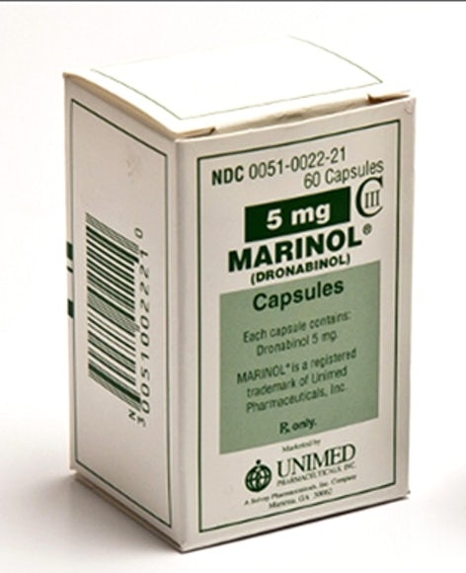
No other “FDA-approved medication is smoked.”
Kevin P. Hill, M.D., Marijuana (Center City, MN: Hazelden Publishing, 2015), p.109.
Willow bark = aspirin
Opium = morphine
Glaucoma? No recommended.
Henry D. Jampel, “Should You Be Smoking Marijuana to Treat Your Glaucoma?” Glaucoma Research Foundation, October 29, 2017.
THC is mind-altering, but so is severe and chronic pain toward the end of life.
Palliative care for HIV/AIDS, cancer
(1) Should be regulated carefully.

Slide 70
Colorado: 94% claimed that “pain” was the reason (only 2% for cancer and 1% for HIV/AIDS).
Colorado Department of Public Health. (n.d.) Medical marijuana statistics.
See http://www.colorado.gov/cs/Satellite/CDPHECHEIS/CBON/1251593017044.
THC is mind-altering, but so is severe and chronic pain toward the end of life.
Palliative care for HIV/AIDS, cancer
(1) Should be regulated carefully.
(2) Rampantly abused.
California: The average medical “patient” in was a 32-year old white male with a history of drug use.
4,000 person sample: Thomas J. O’Connell, “Long term marijuana users seeking medical cannabis in California.” Harm Reduction Journal (Nov. 3, 2007).

Slide 71
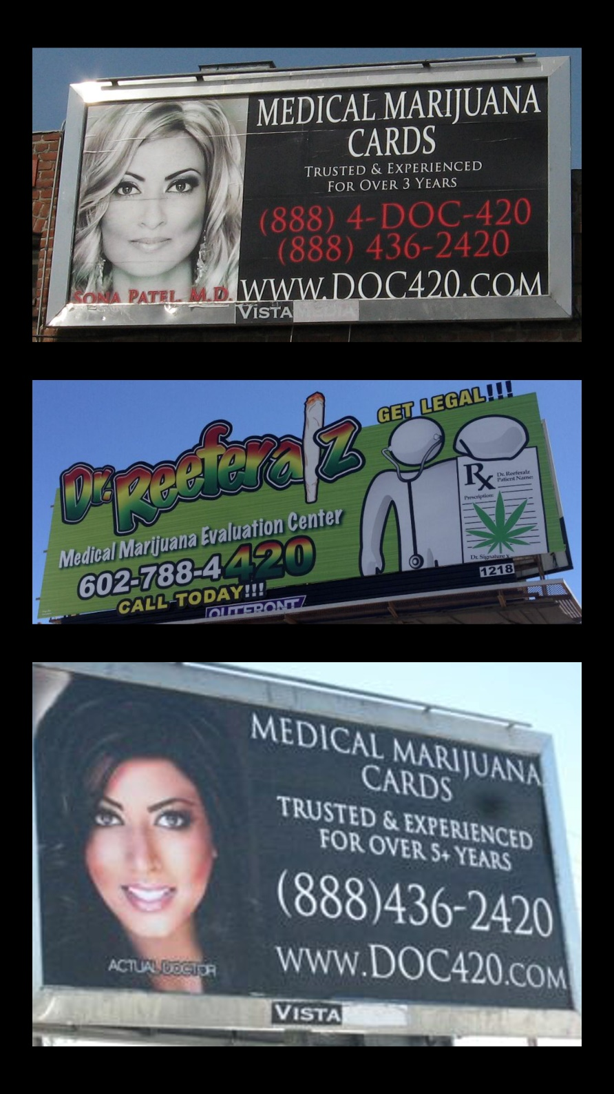
THC is mind-altering, but so is severe and chronic pain toward the end of life.
Palliative care for HIV/AIDS, cancer
(1) Should be regulated carefully.
(2) Rampantly abused.
(3) This is a strategy to normalize marijuana.
Founder of NORML: “We will use [medical marijuana] as a red-herring to give marijuana a good name.”
Keith Stroup. Emory Wheel Entertainment Staff (February 6, 1979).
Director of NORML: “Marijuana has also been de facto legalized under the guise of medical marijuana.”
Proper strategy in Afghanistan; wildfires in California continue; marijuana legalization. (May 9, 2009) CNN Newsroom.

Slide 73
Cover the relevant research.
Show that marijuana and alcohol are not analogous.
Make conservative claims.
Depend on the Holy Spirit who will surely convict the person.
Warn about deception (1 Pet. 5:8).
Share that God wants to give authentic happiness (Eph. 5:18).

Slide 74
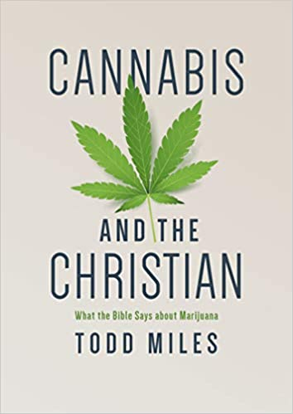
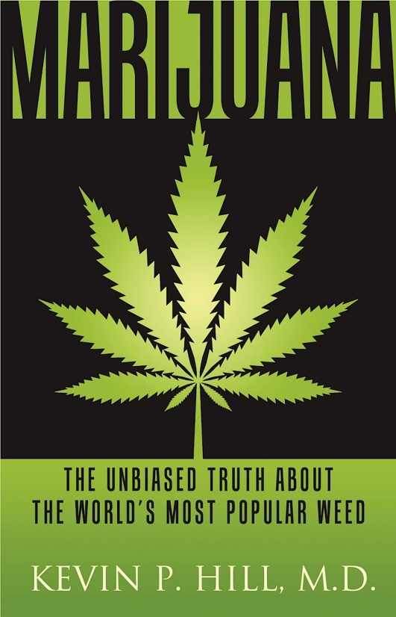
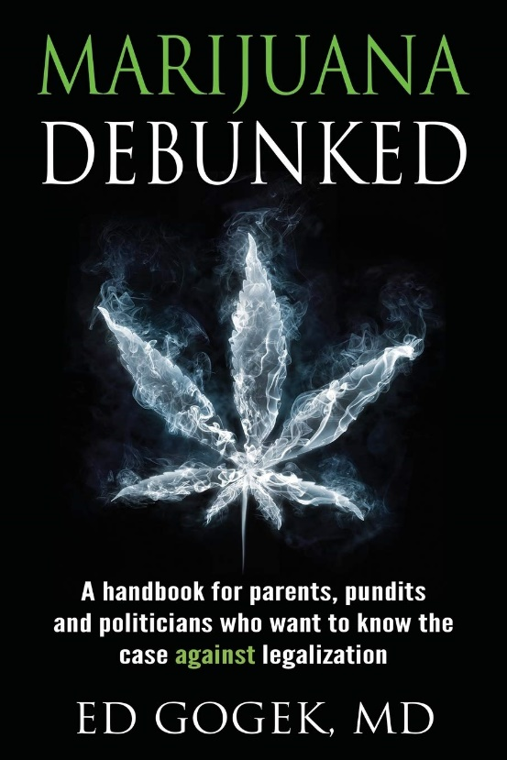
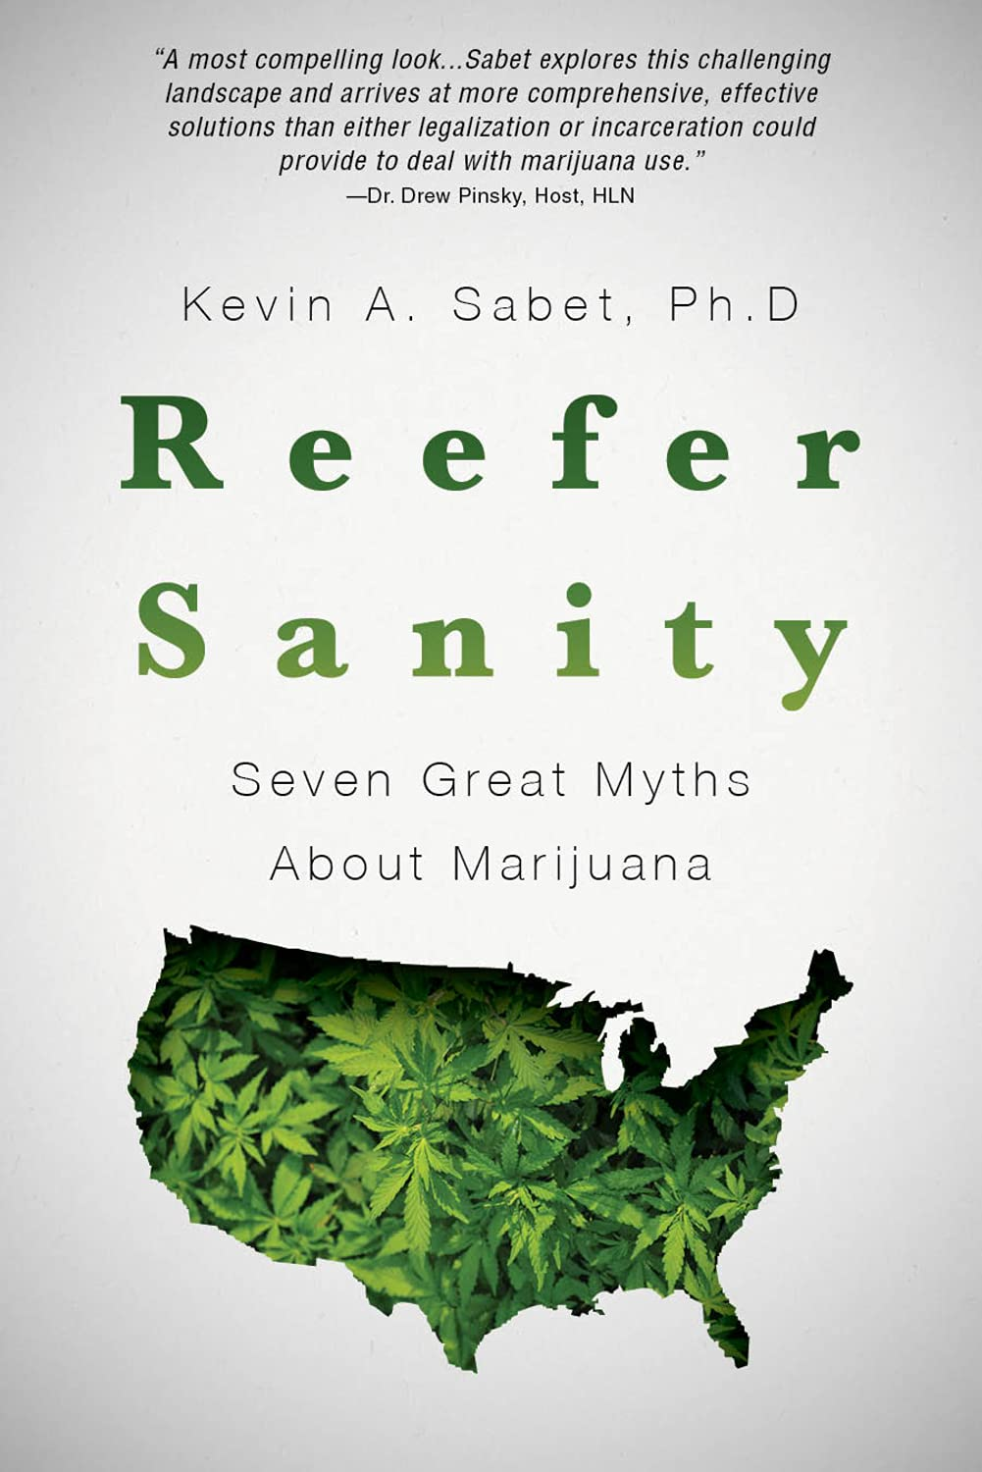

Slide 76
Coordination tests, blood tests, and saliva swabs have failed to accurately identify if someone is too impaired to drive a car.
James Queally and Sarah Parvini, “For Police, Catching Stoned Drivers Isn’t So Easy,” Los Angeles Times, March 22, 2018.
(1) Marijuana is a cocktail of drugs, not just one drug.
(2) Marijuana is fat soluble, while alcohol is water soluble.
(3) Marijuana has become more and more potent over time.
(4) Sobriety is nearly impossible to discern in an objective way.

Slide 77
Endocannabinoid system (ECS) carefully regulates the human body.
(e.g. memory, sleep, motivation, appetite, emotions, etc.)
If you need to eat, endocannabinoids will affect the cannabinoid receptors in the hypothalamus.
Endocannabinoids = “keys”
Cannabinoid receptors = “locks”
These CB receptors are throughout the whole body, but mostly in the brain and central nervous system (CB1) and immune system and nerves (CB2).

Slide 78
Endocannabinoids come from the body, but phytocannabinoids come from marijuana (i.e. foreign cannabinoids!).
THC floods the ECS like someone with a machine gun blasting all the receptors at once.
Leads to “downregulation,” which shuts off your ECS.

Slide 79
Reaction time was 36% slower.
60 mph = 139 feet
Richard Schwartz, “Marijuana.” Pediatrics. 109.2 (February 2002): 287.
4x to 10x the rate of accidents.
M. Asbridge et al. “Cannabis and traffic collision risk” (Apr. 2014) International Journal of Public Health.
B. Laumon et al. “Cannabis intoxication and fatal road crashes in France” (Dec. 2005) British Medical Journal.
S. Blows, et al. (2005). Marijuana use and car crash injury. Addiction, 100(5), 605-611.
Switzerland has a zero-tolerance policy.
Giovanni Battistella, et al., “Weed or Wheel” PLOS One 8:1 (January 2013): 52546.
If marijuana disqualifies us from doing something as simple as driving a car,
how can we be considered sober enough to do something as complex as Christian work?

