Slide 2
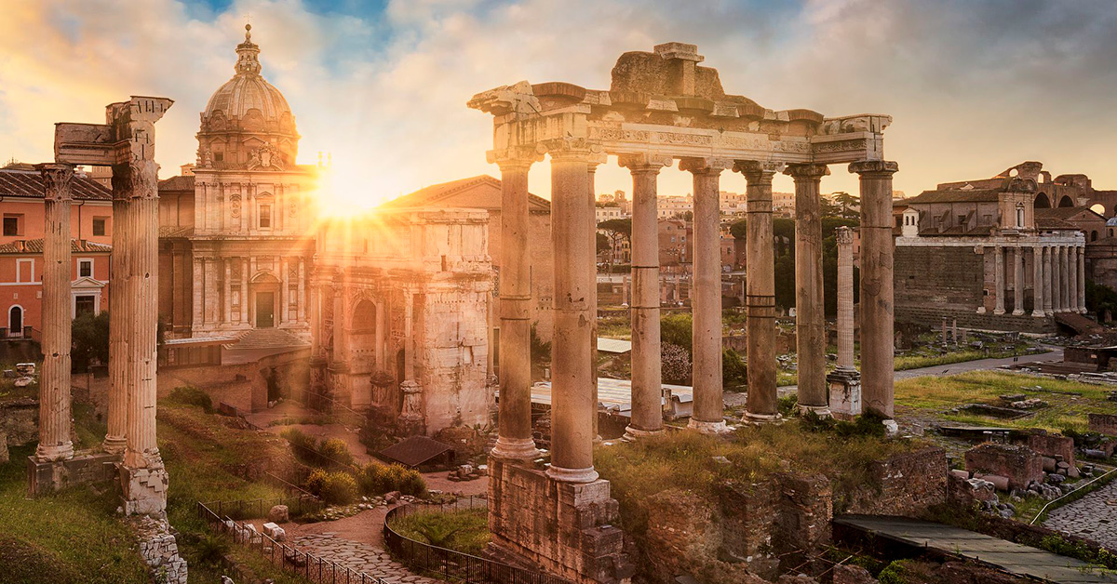
R O M A N S
Romans 10 & 11
Everything’s Going According to Plan

Slide 3
R O M A N S
Romans 1-5: Salvation
Romans 5-8: Spiritual Growth
Romans 9-11: What about Israel?

Slide 4
R O M A N S
The situation: Gentiles responding to the news about Christ in large numbers, but only a small minority of Jews
Is that how it is supposed to go?
How come God’s “chosen people” aren’t buying it?
Is that a reason to second guess the gospel?
Romans 9-11: What about Israel?

Slide 5
R O M A N S
God wants to bring salvation through Jesus Christ to the whole world…
But how does that interface with the fact that He has, up to this point, worked largely through a chosen nation?
And how should Jewish and Gentile Christians view/treat each other?
Romans 9-11: What about Israel?

Slide 6
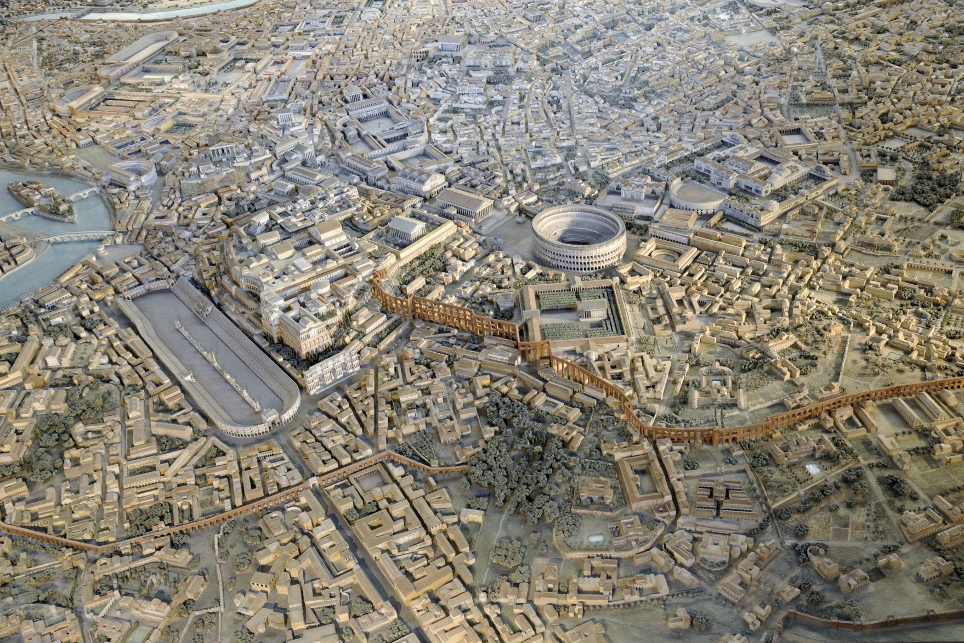
What about Israel?
Chapter 9: Paul begins a “diatribe”

Slide 7
What about Israel?
Chapter 9: Paul begins a “diatribe”
^{Romans 9:6} Well then, has God failed to fulfill his promise to Israel? No…
^{Romans 9:14} “Are we saying, then, that God was unfair? Of course not!”

Slide 8
What about Israel?
^{Romans 9:30} What does all this mean? Even though the Gentiles were not trying to follow God’s standards, they were made right with God. And it was by faith that this took place. ³¹ But the people of Israel, who tried so hard to get right with God by keeping the law, never succeeded.
³² Why not?

Slide 9
What about Israel?
^{Romans 9:30} What does all this mean? Even though the Gentiles were not trying to follow God’s standards, they were made right with God. And it was by faith that this took place. ³¹ But the people of Israel, who tried so hard to get right with God by keeping the law, never succeeded. ³² Why not?

Slide 10
What about Israel?
Why so few?
^{Romans 9:30} What does all this mean? Even though the Gentiles were not trying to follow God’s standards, they were made right with God. And it was by faith that this took place. ³¹ But the people of Israel, who tried so hard to get right with God by keeping the law, never succeeded.
³² Why not?

Slide 11
What about Israel?
Why so few?
^{Romans 9:30} What does all this mean? Even though the Gentiles were not trying to follow God’s standards, they were made right with God. And it was by faith that this took place. ³¹ But the people of Israel, who tried so hard to get right with God by keeping the law, never succeeded.
³² Why not?

Slide 12
What about Israel?
Why so few?
^{Romans 9:30} What does all this mean? Even though the Gentiles were not trying to follow God’s standards, they were made right with God. And it was by faith that this took place. ³¹ But the people of Israel, who tried so hard to get right with God by keeping the law, never succeeded.
³² Why not?

Slide 13
What about Israel?
Why so few?
Answer: Because they are stuck in their traditional “law/works” approach, rather than the “grace/faith” dynamic Jesus brought
^{Romans 9:32} Why not? Because they were trying to get right with God by keeping the law instead of by trusting in him. They stumbled over the great rock in their path. ³³ God warned them of this in the Scriptures when he said, “I am placing a stone in Jerusalem that makes people stumble, a rock that makes them fall. But anyone who trusts in him will not be disappointed.”

Slide 14
What about Israel?
Why so few?
Answer: Because they are stuck in their traditional “law/works” approach, rather than the “grace/faith” dynamic Jesus brought
God warned them His new way would be counterintuitive, and predicted they would get hung up on it
^{Romans 9:32} Why not? Because they were trying to get right with God by keeping the law instead of by trusting in him. They stumbled over the great rock in their path. ³³ God warned them of this in the Scriptures when he said, “I am placing a stone in Jerusalem that makes people stumble, a rock that makes them fall. But anyone who trusts in him will never be disgraced.”

Slide 15
What about Israel?
Why so few?
Answer: Because they are stuck in their traditional “law/works” approach, rather than the “grace/faith” dynamic Jesus brought
^{Romans 10:1} Dear brothers and sisters, the longing of my heart and my prayer to God is for the people of Israel to be saved. ² I know what enthusiasm they have for God, but it is misdirected zeal.

Slide 16
What about Israel?
Why so few?
Answer: Because they are stuck in their traditional “law/works” approach, rather than the “grace/faith” dynamic Jesus brought
^{Romans 10:1} Dear brothers and sisters, the longing of my heart and my prayer to God is for the people of Israel to be saved. ² I know what enthusiasm they have for God, but it is misdirected zeal.

Slide 17
What about Israel?
Why so few?
Answer: Because they are stuck in their traditional “law/works” approach, rather than the “grace/faith” dynamic Jesus brought
^{Romans 10:1} Dear brothers and sisters, the longing of my heart and my prayer to God is for the people of Israel to be saved. ² I know what enthusiasm they have for God, but it is misdirected zeal.

Slide 18
What about Israel?
Why so few?
Answer: Because they are stuck in their traditional “law/works” approach, rather than the “grace/faith” dynamic Jesus brought
^{Romans 10:3} For they don’t understand God’s way of making people right with himself. Refusing to accept God’s way, they cling to their own way of getting right with God by trying to keep the law. ⁴ For Christ has already accomplished the purpose for which the law was given. As a result, all who believe in him are made right with God.

Slide 19
^{Romans 10:3} For they don’t understand God’s way of making people right with himself. Refusing to accept God’s way, they cling to their own way of getting right with God by trying to keep the law. ⁴ For Christ has already accomplished the purpose for which the law was given. As a result, all who believe in him are made right with God.

Slide 20
What about Israel: Why so few?
Answer: They have not understood or embraced God’s plan for salvation
^{Romans 10:3} For they don’t understand God’s way of making people right with himself. Refusing to accept God’s way, they cling to their own way of getting right with God by trying to keep the law. ⁴ For Christ has already accomplished the purpose for which the law was given. As a result, all who believe in him are made right with God.

Slide 21
What about Israel: Why so few?
Answer: They have not understood or embraced God’s plan for salvation
^{Romans 10:3} For they don’t understand God’s way of making people right with himself. Refusing to accept God’s way, they cling to their own way of getting right with God by trying to keep the law. ⁴ For Christ has already accomplished the purpose for which the law was given. As a result, all who believe in him are made right with God.

Slide 22
What about Israel: Why so few?
Answer: They have not understood or embraced God’s plan for salvation
^{Romans 10:3} For they don’t understand God’s way of making people right with himself. Refusing to accept God’s way, they cling to their own way of getting right with God by trying to keep the law. ⁴ For Christ has already accomplished the purpose for which the law was given. As a result, all who believe in him are made right with God.

Slide 23
What about Israel: Why so few?
Answer: They have not understood or embraced God’s plan for salvation
^{Romans 10:5} For Moses writes that the law’s way of making a person right with God requires obedience to all of its commands. ⁶ But faith’s way of getting right with God says…

Slide 24
What about Israel: Why so few?
Answer: They have not understood or embraced God’s plan for salvation
^{Romans 10:5} For Moses writes that the law’s way of making a person right with God requires obedience to all of its commands. ⁶ But faith’s way of getting right with God says…

Slide 25
What about Israel: Why so few?
Answer: They have not understood or embraced God’s plan for salvation
Key to interpreting: Paul is using a “scenes from Israel’s history” style of argumentation
Remember the time when God…
^{Romans 10:6} But faith’s way of getting right with God says, “Don’t say in your heart, ‘Who will go up to heaven?’ (to bring Christ down to earth). ⁷ And don’t say, ‘Who will go down to the place of the dead?’ (to bring Christ back to life again).” ⁸ In fact, it says, “The message is very close at hand; it is on your lips and in your heart.”

Slide 26
What about Israel: Why so few?
Context: I want you to be near to me – I want us to be in relationship at the deepest level of intimacy – the heart, so that you may live. So please follow my instructions!
^{Deut 30:11} “This command I am giving you today is not too difficult for you, and it is not beyond your reach. ¹² It is not kept in heaven, so distant that you must ask, ‘Who will go up to heaven and bring it down so we can hear it and obey?’ ¹³ It is not kept beyond the sea, so far away that you must ask, ‘Who will cross the sea to bring it to us so we can hear it and obey?’ ¹⁴ No, the message is very close at hand; it is on your lips and in your heart so that you can obey it.
^{Romans 10:6} But faith’s way of getting right with God says, “Don’t say in your heart, ‘Who will go up to heaven?’ (to bring Christ down to earth). ⁷ And don’t say, ‘Who will go down to the place of the dead?’ (to bring Christ back to life again).” ⁸ In fact, it says, “The message is very close at hand; it is on your lips and in your heart.”

Slide 27
What about Israel: Why so few?
Moses’s purpose was to prevent the Israelites from evading responsibility by pleading they don’t know what to do
^{Deut 30:11} “This command I am giving you today is not too difficult for you, and it is not beyond your reach. ¹² It is not kept in heaven, so distant that you must ask, ‘Who will go up to heaven and bring it down so we can hear it and obey?’ ¹³ It is not kept beyond the sea, so far away that you must ask, ‘Who will cross the sea to bring it to us so we can hear it and obey?’ ¹⁴ No, the message is very close at hand; it is on your lips and in your heart so that you can obey it.
^{Romans 10:6} But faith’s way of getting right with God says, “Don’t say in your heart, ‘Who will go up to heaven?’ (to bring Christ down to earth). ⁷ And don’t say, ‘Who will go down to the place of the dead?’ (to bring Christ back to life again).” ⁸ In fact, it says, “The message is very close at hand; it is on your lips and in your heart.”

Slide 28
What about Israel: Why so few?
The principle that carries over to today: God is gracious in his efforts to establish a relationship with us. He provides a way, and brings it near to us. It is accessible and understandable, because he wants us to be with Him.
^{Deut 30:11} “This command I am giving you today is not too difficult for you, and it is not beyond your reach. ¹² It is not kept in heaven, so distant that you must ask, ‘Who will go up to heaven and bring it down so we can hear it and obey?’ ¹³ It is not kept beyond the sea, so far away that you must ask, ‘Who will cross the sea to bring it to us so we can hear it and obey?’ ¹⁴ No, the message is very close at hand; it is on your lips and in your heart so that you can obey it.
Remember the time I pled with you to listen to my commands so we could have intimacy? And I put my program right out there and didn’t hide the ball? This is just like that. Only now the command is faith in Christ!
^{Romans 10:6} But faith’s way of getting right with God says, “Don’t say in your heart, ‘Who will go up to heaven?’ (to bring Christ down to earth). ⁷ And don’t say, ‘Who will go down to the place of the dead?’ (to bring Christ back to life again).” ⁸ In fact, it says, “The message is very close at hand; it is on your lips and in your heart.”

Slide 29
What about Israel: Why so few?
The principle that carries over to today: God is gracious in his efforts to establish a relationship with us. He provides a way, and brings it near to us. It is accessible and understandable, because he wants us to be with Him.
IOW you don’t have to go to the ends of the earth to find out how to be near me – here It is!
The same is true now… in fact… how much more so?
^{Romans 10:6} But faith’s way of getting right with God says, “Don’t say in your heart, ‘Who will go up to heaven?’ (to bring Christ down to earth). ⁷ And don’t say, ‘Who will go down to the place of the dead?’ (to bring Christ back to life again).” ⁸ In fact, it says, “The message is very close at hand; it is on your lips and in your heart.”

Slide 30
What about Israel: Why so few?
The principle that carries over to today: God is gracious in his efforts to establish a relationship with us. He provides a way, and brings it near to us. It is accessible and understandable, because he wants us to be with Him.
IOW you don’t have to go to the ends of the earth to find out how to be near me – here It is!
The same is true now… in fact… how much more so?
^{Romans 10:6} But faith’s way of getting right with God says, “Don’t say in your heart, ‘Who will go up to heaven?’ (to bring Christ down to earth). ⁷ And don’t say, ‘Who will go down to the place of the dead?’ (to bring Christ back to life again).” ⁸ In fact, it says, “The message is very close at hand; it is on your lips and in your heart.”

Slide 31
What about Israel: Why so few?
The principle that carries over to today: God is gracious in his efforts to establish a relationship with us. He provides a way, and brings it near to us. It is accessible and understandable, because he wants us to be with Him.
IOW you don’t have to go to the ends of the earth to find out how to be near me – here It is!
The same is true now… in fact… how much more so?
^{Romans 10:6} But faith’s way of getting right with God says, “Don’t say in your heart, ‘Who will go up to heaven?’ (to bring Christ down to earth). ⁷ And don’t say, ‘Who will go down to the place of the dead?’ (to bring Christ back to life again).” ⁸ In fact, it says, “The message is very close at hand; it is on your lips and in your heart.”

Slide 32
What about Israel: Why so few?
The principle that carries over to today: God is gracious in his efforts to establish a relationship with us. He provides a way, and brings it near to us. It is accessible and understandable, because he wants us to be with Him.
IOW you don’t have to go to the ends of the earth to find out how to be near me – here It is!
The same is true now… in fact… how much more so?
^{Romans 10:6} But faith’s way of getting right with God says, “Don’t say in your heart, ‘Who will go up to heaven?’ (to bring Christ down to earth). ⁷ And don’t say, ‘Who will go down to the place of the dead?’ (to bring Christ back to life again).” ⁸ In fact, it says, “The message is very close at hand; it is on your lips and in your heart.”

Slide 33
You don’t need to go to the ends of the earth to be right with me… you only need to obey what I have commanded
(which is to put your trust in Christ!)
What I want is your heart… and in My Son, I have made that available – right here at hand!
^{Romans 10:6} But faith’s way of getting right with God says, “Don’t say in your heart, ‘Who will go up to heaven?’ (to bring Christ down to earth). ⁷ And don’t say, ‘Who will go down to the place of the dead?’ (to bring Christ back to life again).” ⁸ In fact, it says, “The message is very close at hand; it is on your lips and in your heart.”

Slide 34
What about Israel: Why so few?
Answer: They have not understood or embraced God’s plan for salvation
But it is neither hard to understand or to embrace!
^{Romans 10:6} But faith’s way of getting right with God says, “Don’t say in your heart, ‘Who will go up to heaven?’ (to bring Christ down to earth). ⁷ And don’t say, ‘Who will go down to the place of the dead?’ (to bring Christ back to life again).” ⁸ In fact, it says, “The message is very close at hand; it is on your lips and in your heart.”

Slide 35
What about Israel: Why so few?
Answer: They have not understood or embraced God’s plan for salvation
But it is neither hard to understand or to embrace!
^{Romans 10:8} And that message is the very message about faith that we preach:

Slide 36
What about Israel: Why so few?
Answer: They have not understood or embraced God’s plan for salvation
But it is neither hard to understand or to embrace!
Salvation is not far off… It’s right here on your lips and in your heart
^{(NASB) Romans 10:9} that if you confess with your mouth Jesus as Lord, and believe in your heart that God raised Him from the dead, you will be saved; ¹⁰ for with the heart a person believes, resulting in righteousness, and with the mouth he confesses, resulting in salvation. ¹¹ For the Scripture says, “Whoever believes in Him will not be disappointed.”

Slide 37
What about Israel: Why so few?
Answer: They have not understood or embraced God’s plan for salvation
But it is neither hard to understand or to embrace!
Salvation is not far off… It’s right here on your lips and in your heart
^{(NASB) Romans 10:9} that if you confess with your mouth Jesus as Lord, and believe in your heart that God raised Him from the dead, you will be saved; ¹⁰ for with the heart a person believes, resulting in righteousness, and with the mouth he confesses, resulting in salvation. ¹¹ For the Scripture says, “Whoever believes in Him will not be disappointed.”

Slide 38
What about Israel: Why so few?
Answer: They have not understood or embraced God’s plan for salvation
But it is neither hard to understand or to embrace!
Salvation is not far off… It’s right here on your lips and in your heart
^{(NASB) Romans 10:9} that if you confess with your mouth Jesus as Lord, and believe in your heart that God raised Him from the dead, you will be saved; ¹⁰ for with the heart a person believes, resulting in righteousness, and with the mouth he confesses, resulting in salvation. ¹¹ For the Scripture says, “Whoever believes in Him will not be disappointed.”

Slide 39
What about Israel: Why so few?
Answer: They have not understood or embraced God’s plan for salvation
Homologeo: “To say the same thing”
But it is neither hard to understand or to embrace!
Salvation is not far off… It’s right here on your lips and in your heart
^{(NASB) Romans 10:9} that if you confess with your mouth Jesus as Lord, and believe in your heart that God raised Him from the dead, you will be saved; ¹⁰ for with the heart a person believes, resulting in righteousness, and with the mouth he confesses, resulting in salvation. ¹¹ For the Scripture says, “Whoever believes in Him will not be disappointed.”

Slide 40
What about Israel: Why so few?
Answer: They have not understood or embraced God’s plan for salvation
But it is neither hard to understand or to embrace!
Salvation is not far off… It’s right here on your lips and in your heart
^{(NASB) Romans 10:9} that if you confess with your mouth Jesus as Lord, and believe in your heart that God raised Him from the dead, you will be saved; ¹⁰ for with the heart a person believes, resulting in righteousness, and with the mouth he confesses, resulting in salvation. ¹¹ For the Scripture says, “Whoever believes in Him will not be disappointed.”

Slide 41
What about Israel: Why so few?
Answer: They have not understood or embraced God’s plan for salvation
But it is neither hard to understand or to embrace!
Salvation is not far off… It’s right here on your lips and in your heart
This is all you need to know about getting right with God right here
^{Romans 10:12} Jew and Gentile are the same in this respect. They have the same Lord, who gives generously to all who call on him. ¹³ For “Everyone who calls on the name of the Lord will be saved.”

Slide 42
What about Israel: Why so few?
Answer: They have not understood or embraced God’s plan for salvation
But it is neither hard to understand or to embrace!
Salvation is not far off… It’s right here on your lips and in your heart
This is all you need to know about getting right with God right here
^{Romans 10:12} Jew and Gentile are the same in this respect. They have the same Lord, who gives generously to all who call on him. ¹³ For “Everyone who calls on the name of the Lord will be saved.”

Slide 43
What about Israel: Why so few?
Is it because nobody told them?
messenger sent → messenger goes → messenger tells →
they hear → they believe → they call on him for salvation
^{Romans 10:14} But how can they call on him to save them unless they believe in him? And how can they believe in him if they have never heard about him? And how can they hear about him unless someone tells them? ¹⁵ And how will anyone go and tell them without being sent? That is why the Scriptures say, “How beautiful are the feet of messengers who bring good news!”

Slide 44
What about Israel: Why so few?
Is it because nobody told them?
messenger sent → messenger goes → messenger tells →
they hear → they believe → they call on him for salvation
^{Romans 10:14} But how can they call on him to save them unless they believe in him? And how can they believe in him if they have never heard about him? And how can they hear about him unless someone tells them? ¹⁵ And how will anyone go and tell them without being sent? That is why the Scriptures say, “How beautiful are the feet of messengers who bring good news!”
Isaiah 52:7

Slide 45
What about Israel: Why so few?
Is it because nobody told them?
messenger sent → messenger goes → messenger tells →
they hear → they believe → they call on him for salvation
So where is the break in the chain??
^{Romans 10:14} But how can they call on him to save them unless they believe in him? And how can they believe in him if they have never heard about him? And how can they hear about him unless someone tells them? ¹⁵ And how will anyone go and tell them without being sent? That is why the Scriptures say, “How beautiful are the feet of messengers who bring good news!”

Slide 46
What about Israel: Why so few?
God has always clearly communicated to Israel
Is it because nobody told them?
God has sent messengers
messenger sent → messenger goes → messenger tells →
they hear → they believe → they call on him for salvation
So where is the break in the chain??
^{Romans 10:14} But how can they call on him to save them unless they believe in him? And how can they believe in him if they have never heard about him? And how can they hear about him unless someone tells them? ¹⁵ And how will anyone go and tell them without being sent? That is why the Scriptures say, “How beautiful are the feet of messengers who bring good news!”

Slide 47
What about Israel: Why so few?
^{Romans 10:8} And that message is the very message about faith that we preach:
God has always clearly communicated to Israel
Is it because nobody told them?
God has sent messengers
messenger sent → messenger goes → messenger tells →
they hear → they believe → they call on him for salvation
So where is the break in the chain??
^{Romans 10:14} But how can they call on him to save them unless they believe in him? And how can they believe in him if they have never heard about him? And how can they hear about him unless someone tells them? ¹⁵ And how will anyone go and tell them without being sent? That is why the Scriptures say, “How beautiful are the feet of messengers who bring good news!”

Slide 48
What about Israel: Why so few?
Is it because nobody told them?
messenger sent → messenger goes → messenger tells →
they hear → they believe → they call on him for salvation
So where is the break in the chain??
Remember the times God brought you good news and you didn’t believe?
^{Romans 10:16} But not everyone welcomes the Good News, for Isaiah the prophet said, “Lord, who has believed our message?”
Isaiah 53:1

Slide 49
What about Israel: Why so few?
Because we can resist the Good News in our heart, even when we hear it with our ears
messenger sent → messenger goes → messenger tells →
they hear → they believe → they call on him for salvation
So where is the break in the chain??
^{Romans 10:16} But not everyone welcomes the Good News, for Isaiah the prophet said, “Lord, who has believed our message?”

Slide 50
What about Israel: Why so few?
Because we can resist the Good News in our heart, even when we hear it with our ears
messenger sent → messenger goes → messenger tells →
they hear → they believe → they call on him for salvation
So where is the break in the chain??
^{Romans 10:17} So faith comes from hearing, that is, hearing the Good News about Christ. ¹⁸ But I ask, have the people of Israel actually heard the message?

Slide 51
What about Israel: Why so few?
Because we can resist the Good News in our heart, even when we hear it with our ears
messenger sent → messenger goes → messenger tells →
they hear → they believe → they call on him for salvation
So where is the break in the chain??
^{Romans 10:17} So faith comes from hearing, that is, hearing the Good News about Christ. ¹⁸ But I ask, have the people of Israel actually heard the message? Yes, they have: “The message has gone throughout the earth, and the words to all the world.”
Psalm 19:4

Slide 52
What about Israel: Why so few?
Because we can resist the Good News in our heart, even when we hear it with our ears
messenger sent → messenger goes → messenger tells →
they hear → they believe → they call on him for salvation
So where is the break in the chain??
^{Romans 10:19} But I ask, did the people of Israel really understand?

Slide 53
What about Israel: Why so few?
Because we can resist the Good News in our heart, even when we hear it with our ears
The point: Israel should recognize from their own scriptures that God is at work in the gospel
messenger sent → messenger goes → messenger tells →
they hear → they believe → they call on him for salvation
So where is the break in the chain??
^{Romans 10:19} But I ask, did the people of Israel really understand? Yes, they did, for even in the time of Moses, God said, “I will rouse your jealousy through people who are not even a nation. I will provoke your anger through the foolish Gentiles.”
Deut 32:21

Slide 54
What about Israel: Why so few?
Because we can resist the Good News in our heart, even when we hear it with our ears
messenger sent → messenger goes → messenger tells →
they hear → they believe → they call on him for salvation
So where is the break in the chain??
^{Romans 10:20} And later Isaiah spoke boldly for God, saying, “I was found by people who were not looking for me. I showed myself to those who were not asking for me.”
Isaiah 65:1

Slide 55
What about Israel: Why so few?
Because we can resist the Good News in our heart, even when we hear it with our ears
The Gentiles didn’t have a problem hearing or understanding the message… and they weren’t even looking for it!
^{Romans 10:20} And later Isaiah spoke boldly for God, saying, “I was found by people who were not looking for me. I showed myself to those who were not asking for me.”
Isaiah 65:1

Slide 56
What about Israel: Why so few?
Because we can resist the Good News in our heart, even when we hear it with our ears
The Gentiles didn’t have a problem hearing or understanding the message… and they weren’t even looking for it!
^{Romans 10:21} But regarding Israel, God said, “All day long I opened my arms to them, but they were disobedient and rebellious.”
Isaiah 65:2

Slide 57
What about Israel: Why so few?
Because even though they have heard, they have not embraced God’s plan for salvation by grace through faith, and have instead clung to a misguided plan to earn salvation by the law
^{Romans 10:21} But regarding Israel, God said, “All day long I opened my arms to them, but they were disobedient and rebellious.”

Slide 58
What about Israel: Has God rejected them?
^{Romans 11:1} I ask, then, has God rejected his own people, the nation of Israel?

Slide 59
What about Israel: Has God rejected them?
^{Romans 11:1} I ask, then, has God rejected his own people, the nation of Israel? Of course not! I myself am an Israelite, a descendant of Abraham and a member of the tribe of Benjamin. ² No, God has not rejected his own people, whom he chose from the very beginning.

Slide 60
What about Israel: Has God rejected them?
NO!
God doesn’t make mistakes in his plan
^{Romans 11:1} I ask, then, has God rejected his own people, the nation of Israel? Of course not! I myself am an Israelite, a descendant of Abraham and a member of the tribe of Benjamin. ² No, God has not rejected his own people, whom he chose from the very beginning.

Slide 61
What about Israel: Has God rejected them?
NO!
God doesn’t make mistakes in his plan
^{Romans 11:2} Do you realize what the Scriptures say about this? Elijah the prophet complained to God about the people of Israel and said, ³ “Lord, they have killed your prophets and torn down your altars. I am the only one left, and now they are trying to kill me, too.”

Slide 62
What about Israel: Has God rejected them?
NO!
The current situation is not out of the norm
And God has always kept his promise to Israel, even when only a tiny remnant was responsive to him
^{Romans 11:4} And do you remember God’s reply? He said, “No, I have 7,000 others who have never bowed down to Baal!”

Slide 63
What about Israel: Has God rejected them?
NO!
The current situation is not out of the norm
And God has always kept his promise to Israel, even when only a tiny remnant was responsive to him
^{Rom 11:5} It is the same today, for a few of the people of Israel have remained faithful because of God’s grace—his undeserved kindness in choosing them. ⁶ And since it is through God’s kindness, then it is not by their good works. For in that case, God’s grace would not be what it really is—free and undeserved.

Slide 64
What about Israel: Has God rejected them?
NO!
The current situation is not out of the norm
And God has always kept his promise to Israel, even when only a tiny remnant was responsive to him
His promise in choosing Israel was an act of grace, not contingent on their faithfulness
^{Rom 11:5} It is the same today, for a few of the people of Israel have remained faithful because of God’s grace—his undeserved kindness in choosing them. ⁶ And since it is through God’s kindness, then it is not by their good works. For in that case, God’s grace would not be what it really is—free and undeserved.

Slide 65
What about Israel: Has God rejected them?
NO!
The current situation is not out of the norm
And God has always kept his promise to Israel, even when only a tiny remnant was responsive to him
And by his grace, a faithful remnant remains today
^{Rom 11:5} It is the same today, for a few of the people of Israel have remained faithful because of God’s grace—his undeserved kindness in choosing them. ⁶ And since it is through God’s kindness, then it is not by their good works. For in that case, God’s grace would not be what it really is—free and undeserved.

Slide 66
What about Israel: Has God rejected them?
NO!
The current situation is not out of the norm
And God has always kept his promise to Israel, even when only a tiny remnant was responsive to him
^{Rom 11:5} It is the same today, for a few of the people of Israel have remained faithful because of God’s grace—his undeserved kindness in choosing them. ⁶ And since it is through God’s kindness, then it is not by their good works. For in that case, God’s grace would not be what it really is—free and undeserved.

Slide 67
What about Israel: Has God rejected them?
NO!
The current situation is not out of the norm
And God has always kept his promise to Israel, even when only a tiny remnant was responsive to him
^{Rom 11:7} So this is the situation: Most of the people of Israel have not found the favor of God they are looking for so earnestly. A few have—the ones God has chosen—but the hearts of the rest were hardened.

Slide 68
What about Israel: Has God rejected them?
NO!
The current situation is not out of the norm
And God has always kept his promise to Israel, even when only a tiny remnant was responsive to him
^{Rom 11:8} As the Scriptures say…

Slide 69
What about Israel: Has God rejected them?
NO!
The current situation is not out of the norm
And God has always kept his promise to Israel, even when only a tiny remnant was responsive to him
Remember those times when Israel resisted God, and God gave them over to their hardened heart to wander in the wilderness?
And how He used that to sovereignly advance his strategy among the nations?
^{Rom 11:8} As the Scriptures say, “God has put them into a deep sleep. To this day he has shut their eyes so they do not see, and closed their ears so they do not hear.”
Deut 29:4

Slide 70
What about Israel: Has God rejected them?
NO!
The current situation is not out of the norm
And God has always kept his promise to Israel, even when only a tiny remnant was responsive to him
Psalm 69:22
^{Romans 11:9} Likewise, David said, “Let their bountiful table become a snare, a trap that makes them think all is well. Let their blessings cause them to stumble, and let them get what they deserve. ¹⁰ Let their eyes go blind so they cannot see, and let their backs be bent forever.”

Slide 71
What about Israel: Has God rejected them?
NO!
The current situation is not out of the norm
And God has always kept his promise to Israel, even when only a tiny remnant was responsive to him
Remember the time many of God’s people persecuted David without cause, and how God sided against them?
^{Romans 11:9} Likewise, David said, “Let their bountiful table become a snare, a trap that makes them think all is well. Let their blessings cause them to stumble, and let them get what they deserve. ¹⁰ Let their eyes go blind so they cannot see, and let their backs be bent forever.”

Slide 72
What about Israel: Has God rejected them?
NO!
God is doing what he has always done, working with the “faithful remnant” of Israel, even while many others turn away from him
^{Romans 11:9} Likewise, David said, “Let their bountiful table become a snare, a trap that makes them think all is well. Let their blessings cause them to stumble, and let them get what they deserve. ¹⁰ Let their eyes go blind so they cannot see, and let their backs be bent forever.”

Slide 73
What about Israel: Is it hopeless for them?
^{Romans 11:11} Did God’s people stumble and fall beyond recovery?

Slide 74
What about Israel: Is it hopeless for them?
No! In this chapter of history, God is using their hardness of heart to win the Gentiles. But His desire is that they too will come to salvation by grace through faith.
^{Romans 11:11} Did God’s people stumble and fall beyond recovery? Of course not! They were disobedient, so God made salvation available to the Gentiles. But he wanted his own people to become jealous and claim it for themselves.

Slide 75
What about Israel: Is it hopeless for them?
No! In this chapter of history, God is using their hardness of heart to win the Gentiles. But His desire is that they too will come to salvation by grace through faith.
^{Romans 11:11} Did God’s people stumble and fall beyond recovery? Of course not! They were disobedient, so God made salvation available to the Gentiles. But he wanted his own people to become jealous and claim it for themselves.
Righteous jealousy is a felt desire for things to be as they ought to be

Slide 76
What about Israel: Is it hopeless for them?
No! In this chapter of history, God is using their hardness of heart to win the Gentiles. But His desire is that they too will come to salvation by grace through faith.
God’s plan anticipates and works through human failure to win more
^{Romans 11:11} Did God’s people stumble and fall beyond recovery? Of course not! They were disobedient, so God made salvation available to the Gentiles. But he wanted his own people to become jealous and claim it for themselves. ¹² Now if the Gentiles were enriched because the people of Israel turned down God’s offer of salvation, think how much greater a blessing the world will share when they finally accept it.

Slide 77
What about Israel: Is it hopeless for them?
No! In this chapter of history, God is using their hardness of heart to win the Gentiles. But His desire is that they too will come to salvation by grace through faith.
God’s plan anticipates and works through human failure to win more
^{Romans 11:11} Did God’s people stumble and fall beyond recovery? Of course not! They were disobedient, so God made salvation available to the Gentiles. But he wanted his own people to become jealous and claim it for themselves. ¹² Now if the Gentiles were enriched because the people of Israel turned down God’s offer of salvation, think how much greater a blessing the world will share when they finally accept it.

Slide 78
What about Israel: Is it hopeless for them?
No! In this chapter of history, God is using their hardness of heart to win the Gentiles. But His desire is that they too will come to salvation by grace through faith.
God’s plan anticipates and works through human failure to win more
^{Romans 11:13} I am saying all this especially for you Gentiles. God has appointed me as the apostle to the Gentiles. I stress this, ¹⁴ for I want somehow to make the people of Israel jealous of what you Gentiles have, so I might save some of them.

Slide 79
What about Israel: Is it hopeless for them?
No! In this chapter of history, God is using their hardness of heart to win the Gentiles. But His desire is that they too will come to salvation by grace through faith.
God’s plan anticipates and works through human failure to win more
^{Romans 11:13} I am saying all this especially for you Gentiles. God has appointed me as the apostle to the Gentiles. I stress this, ¹⁴ for I want somehow to make the people of Israel jealous of what you Gentiles have, so I might save some of them.

Slide 80
What about Israel: Is it hopeless for them?
No! In this chapter of history, God is using their hardness of heart to win the Gentiles. But His desire is that they too will come to salvation by grace through faith.
God’s plan anticipates and works through human failure to win more
^{Romans 11:15} For since their rejection meant that God offered salvation to the rest of the world, their acceptance will be even more wonderful. It will be life for those who were dead!

Slide 81
What about Israel: Is it hopeless for them?
God is “rocking the car out of the snow”
In this chapter of history, He’s using the failure of Israel to reach the Gentiles…
… But it is with a view to the next chapter in which He will win back the heart of Israel!
^{Romans 11:15} For since their rejection meant that God offered salvation to the rest of the world, their acceptance will be even more wonderful. It will be life for those who were dead!

Slide 82
What about Israel: Is it hopeless for them?
God will keep his promise to Abraham, even through times when most of Abraham’s descendants are being unfaithful
^{Romans 11:16} And since Abraham and the other patriarchs were holy, their descendants will also be holy—just as the entire batch of dough is holy because the portion given as an offering is holy. For if the roots of the tree are holy, the branches will be, too.

Slide 83
What about Israel: Is it hopeless for them?
God will keep his promise to Abraham, even through times when most of Abraham’s descendants are being unfaithful
^{Romans 11:16} And since Abraham and the other patriarchs were holy, their descendants will also be holy—just as the entire batch of dough is holy because the portion given as an offering is holy. For if the roots of the tree are holy, the branches will be, too.

Slide 84
^{Romans 11:17} But some of these branches from Abraham’s tree—some of the people of Israel—have been broken off. And you Gentiles, who were branches from a wild olive tree, have been grafted in. So now you also receive the blessing God has promised Abraham and his children, sharing in the rich nourishment from the root of God’s special olive tree.

Slide 85
^{Romans 11:17} But some of these branches from Abraham’s tree—some of the people of Israel—have been broken off. And you Gentiles, who were branches from a wild olive tree, have been grafted in. So now you also receive the blessing God has promised Abraham and his children, sharing in the rich nourishment from the root of God’s special olive tree.

Slide 86
^{Romans 11:17} But some of these branches from Abraham’s tree—some of the people of Israel—have been broken off. And you Gentiles, who were branches from a wild olive tree, have been grafted in. So now you also receive the blessing God has promised Abraham and his children, sharing in the rich nourishment from the root of God’s special olive tree.

Slide 87
^{Romans 11:17} But some of these branches from Abraham’s tree—some of the people of Israel—have been broken off. And you Gentiles, who were branches from a wild olive tree, have been grafted in. So now you also receive the blessing God has promised Abraham and his children, sharing in the rich nourishment from the root of God’s special olive tree.

Slide 88
^{Romans 11:18 (NASB)} do not be arrogant toward the branches; but if you are arrogant, remember that it is not you who supports the root, but the root supports you.
It’s not that it went from being a “Jewish Tree” to a “Gentile Tree” … The tree is the Tree of God and those saved by his grace

Slide 89
^{Romans 11:19} “Well,” you may say, “those branches were broken off to make room for me.”
²⁰ Yes, but remember—those branches were broken off because they didn’t believe in Christ, and you are there because you do believe. So don’t think highly of yourself, but fear what could happen.

Slide 90
^{Romans 11:19} “Well,” you may say, “those branches were broken off to make room for me.”
²⁰ Yes, but remember—those branches were broken off because they didn’t believe in Christ, and you are there because you do believe. So don’t think highly of yourself, but fear what could happen.

Slide 91
^{Romans 11:21} For if God did not spare the original branches, he won’t spare you either. ²² Notice how God is both kind and severe. He is severe toward those who disobeyed, but kind to you if you continue to trust in his kindness. But if you stop trusting, you also will be cut off.
Key context: This is about God’s work among nations… not individuals
The Gentiles don’t get special guarantees any more than Israel did!
Whoa… does this mean we could lose our personal salvation if we mess up?

Slide 92
^{Romans 11:21} For if God did not spare the original branches, he won’t spare you either. ²² Notice how God is both kind and severe. He is severe toward those who disobeyed, but kind to you if you continue to trust in his kindness. But if you stop trusting, you also will be cut off.
Which means it could just as easily trend back the other way
The tree is the tree of faith in Christ, and anyone who believes in him can be a part of it

Slide 93
^{Romans 11:23} And if the people of Israel turn from their unbelief, they will be grafted in again, for God has the power to graft them back into the tree.

Slide 94
^{Romans 11:24} You, by nature, were a branch cut from a wild olive tree. So if God was willing to do something contrary to nature by grafting you into his cultivated tree, he will be far more eager to graft the original branches back into the tree where they belong.

Slide 95
^{Romans 11:25} I want you to understand this mystery, dear brothers and sisters, so that you will not feel proud about yourselves. Some of the people of Israel have hard hearts, but this will last only until the full number of Gentiles comes to Christ.

Slide 96
^{Romans 11:25} I want you to understand this mystery, dear brothers and sisters, so that you will not feel proud about yourselves. Some of the people of Israel have hard hearts, but this will last only until the full number of Gentiles comes to Christ.

Slide 97
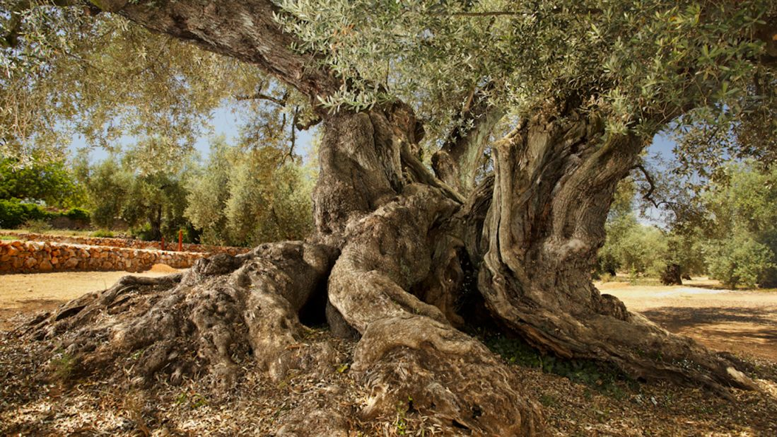
What about Israel: Is it hopeless for them?
This is one chapter in the story
(the chapter where the Gentiles meet Christ)
But there are more chapters… make no mistake!
^{Romans 11:26} And so all Israel will be saved. As the Scriptures say, “The one who rescues will come from Jerusalem, and he will turn Israel away from ungodliness. ²⁷ And this is my covenant with them, that I will take away their sins.”

Slide 98
What about Israel: Is it hopeless for them?
This is one chapter in the story
(the chapter where the Gentiles meet Christ)
But there are more chapters… make no mistake!
^{Romans 11:28} Many of the people of Israel are now enemies of the Good News, and this benefits you Gentiles. Yet they are still the people he loves because he chose their ancestors Abraham, Isaac, and Jacob. ²⁹ For God’s gifts and his call can never be withdrawn.

Slide 99
What about Israel: Is it hopeless for them?
This is one chapter in the story
(the chapter where the Gentiles meet Christ)
But there are more chapters… make no mistake!
^{Romans 11:30} Once, you Gentiles were rebels against God, but when the people of Israel rebelled against him, God was merciful to you instead. ³¹ Now they are the rebels, and God’s mercy has come to you so that they, too, will share in God’s mercy. ³² For God has imprisoned everyone in disobedience so he could have mercy on everyone.

Slide 100
Everything is going according to plan
^{Romans 11:30} Once, you Gentiles were rebels against God, but when the people of Israel rebelled against him, God was merciful to you instead. ³¹ Now they are the rebels, and God’s mercy has come to you so that they, too, will share in God’s mercy. ³² For God has imprisoned everyone in disobedience so he could have mercy on everyone.

Slide 101
Everything is going according to plan
^{Romans 11:30} Once, you Gentiles were rebels against God, but when the people of Israel rebelled against him, God was merciful to you instead. ³¹ Now they are the rebels, and God’s mercy has come to you so that they, too, will share in God’s mercy. ³² For God has imprisoned everyone in disobedience so he could have mercy on everyone.

Slide 102
Everything is going according to plan
^{Romans 11:33} Oh, how great are God’s riches and wisdom and knowledge! How impossible it is for us to understand his decisions and his ways!

Slide 103
Everything is going according to plan
^{Romans 11:34} For who can know the Lord’s thoughts? Who knows enough to give him advice? ³⁵ And who has given him so much that he needs to pay it back? ³⁶ For everything comes from him and exists by his power and is intended for his glory. All glory to him forever! Amen.

Slide 104
R O M A N S

