Slide 3
(Rev. 4:1) After this I looked, and there before me was a door standing open in heaven.
The voice I had first heard speaking to me like a trumpet said, “Come up here, and I will show you what will take place later.”

Slide 8
(Rev. 4:1) After this I looked, and there before me was a door standing open in heaven.
The voice said, “Come up here, and I will show you
what will take place later.”

Slide 9
These two chapters give a defense for why God has the ultimate authority to rule and reign on Earth.

Slide 10
(Rev. 4:1) After this I looked, and there before me was a door standing open in heaven.
The voice I had first heard speaking to me like a trumpet said, “Come up here, and I will show you what will take place later.”

Slide 11
(Rev. 4:2) At once I was in the Spirit, and there before me was a throne in heaven with someone sitting on it.

Slide 12
(Rev. 4:3) And the one who sat there had the appearance of jasper and ruby. A rainbow that shone like an emerald encircled the throne.
God “dwells in unapproachable light, whom no man has seen or can see.”
1 Timothy 6:16

Slide 13
(Rev. 4:4) Surrounding the throne were twenty-four other thrones, and seated on them were twenty-four elders.
They were dressed in white garments and had crowns of gold on their heads.
Twenty-Four Elders?
Humans are promised white garments.
Revelation 3:4-5, 18; 6:11; 7:9, 13; 19:14
Humans are promised crowns.
Revelation 2:10; 3:11
Humans are promised thrones.
Revelation 3:21

Slide 14
(Rev. 4:4) Surrounding the throne were twenty-four other thrones, and seated on them were twenty-four elders.
They were dressed in white garments and had crowns of gold on their heads.
(Rev. 5:11) Then I looked and heard the voice of many angels…
They encircled the throne
and the living creatures
and the elders.

Slide 15
(Rev. 4:4) Surrounding the throne were twenty-four other thrones, and seated on them were twenty-four elders.
They were dressed in white garments and had crowns of gold on their heads.
(1) The apostles and OT counterparts?
Matthew 19:28; Revelation 21:12-14
(2) Representative of all believers?
1 Chronicles 24:1-4, 7-19; Revelation 5:10; 21:12-14
(Rev. 5:11) Then I looked and heard the voice of many angels…
They encircled the throne
and the living creatures
and the elders.

Slide 16
(Rev. 4:5) From the throne came flashes of lightning, rumblings and peals of thunder. In front of the throne, seven lamps were blazing. These are the seven spirits of God.

Slide 17
(Rev. 4:6) Also in front of the throne there was what looked like a sea of glass, clear as crystal.
The “sea” typically refers to hostile humanity in rebellion against God.
Revelation 13:1; Daniel 7:3; Isaiah 17:12; 57:20

Slide 18
(Rev. 4:6) In the center, around the throne,
were four living creatures,
and they were covered with eyes, in front and in back.
⁷ The first living creature was like a lion,
the second was like an ox,
the third had a face like a man,
the fourth was like a flying eagle.
Ezekiel 1:10, 28

Slide 19
(Rev. 4:8) Each of the four living creatures had six wings and was covered with eyes all around, even under its wings.
Day and night they never stop saying:
“‘Holy, holy, holy is the Lord God Almighty,’ who was, and is, and is to come.”
Isaiah 6:3
Why say it three times?
To the Hebrews, this showed its importance.
“Truly, truly, I say to you…”
“Full of pits” is literally “pit, pits” (Genesis 14:10).
“Pure gold” is literally “gold, gold” (2 Kings 25:15).

Slide 20
(Rev. 4:9) Whenever the living creatures give glory, honor and thanks to him who sits on the throne and who lives for ever and ever,
the twenty-four elders fall down before him who sits on the throne and worship him who lives for ever and ever.

Slide 21
(Rev. 4:10) They lay their crowns before the throne and say:
¹¹ “You are worthy, our Lord and God, to receive glory and honor and power, for you created all things, and by your will they were created and have their being.”
Domitian was called “lord and god.”
Suetonius, Life of Domitian 13
(dominus et deus noster)
Are they laying down their reward—only to get it back?

Slide 22
So far, any good Jewish author could’ve written what we just read…

Slide 23
(Rev. 5:1) Then I saw in the right hand of him who sat on the throne a scroll with writing on both sides and sealed with seven seals.

Slide 26
(Rev. 5:1) Then I saw in the right hand of him who sat on the throne a scroll with writing on both sides and sealed with seven seals.
What does the scroll symbolize?
God’s future judgments?
Robert L. Thomas, Revelation 1-7 (1992), 379.
Leon Morris, Revelation (1987), 96.
Title deed of the world?
Chuck Smith and Mark Hitchcock lectures
God’s will and plan for the future.
Alan F. Johnson, Revelation (1981), 468.

Slide 27
(Rev. 5:1) Then I saw in the right hand of him who sat on the throne a scroll with writing on both sides and sealed with seven seals.
What does the scroll symbolize?
God’s future judgments?
Robert L. Thomas, Revelation 1-7 (1992), 379.
Leon Morris, Revelation (1987), 96.
Title deed of the world?
Chuck Smith and Mark Hitchcock lectures
God’s will and plan for the future.
Alan F. Johnson, Revelation (1981), 468.
The seals unlock God’s future purposes for humanity.
Daniel 8:26; cf. Isaiah 29:11

Slide 28
(Rev. 5:1) Then I saw in the right hand of him who sat on the throne a scroll with writing on both sides and sealed with seven seals.
What if humanity was really headed nowhere?

Slide 29
Leonard Wolff
(Politician, author, husband of Virginia Woolf)
Leonard Woolf, The Journey Not the Arrival Matters: An Autobiography of the Years 1939 to 1969 (London: The Hogarth Press, 1973), 157-158.
What was the use of all this work?
Was it of the slightest importance?
Did it achieve anything substantial of what it was intended to achieve?

Slide 30
Leonard Wolff
(Politician, author, husband of Virginia Woolf)
Leonard Woolf, The Journey Not the Arrival Matters: An Autobiography of the Years 1939 to 1969 (London: The Hogarth Press, 1973), 157-158.
Looking back at the age of eighty-eight over the fifty-seven years of my political work in England,
knowing what I aimed at and the results… I see clearly that I achieved practically nothing.

Slide 31
Leonard Wolff
(Politician, author, husband of Virginia Woolf)
Leonard Woolf, The Journey Not the Arrival Matters: An Autobiography of the Years 1939 to 1969 (London: The Hogarth Press, 1973), 157-158.
…The history of the human anthill during the last fifty-seven years would be exactly the same
as it is if I had played pingpong instead of sitting on committees and writing books and memoranda.

Slide 32
Leonard Wolff
(Politician, author, husband of Virginia Woolf)
Leonard Woolf, The Journey Not the Arrival Matters: An Autobiography of the Years 1939 to 1969 (London: The Hogarth Press, 1973), 157-158.
I have therefore to make the rather ignominious confession… that I must have… ground through between 150,000 and 200,000 hours
of perfectly useless work.

Slide 33
(Rev. 5:2) I saw a mighty angel proclaiming in a loud voice,
“Who is worthy to break the seals and open the scroll?”

Slide 34
(Rev. 5:3) But no one in heaven or on earth or under the earth could open the scroll or even look inside it.

Slide 35
(Rev. 5:4) I wept and wept because no one was found who was worthy to open the scroll or look inside.
⁵ Then one of the elders said to me,
“Do not weep!
See, the Lion of the tribe of Judah, the Root of David, has triumphed. He is able to open the scroll and its seven seals.”
Genesis 49:9-10
Isaiah 11:1, 10

Slide 36
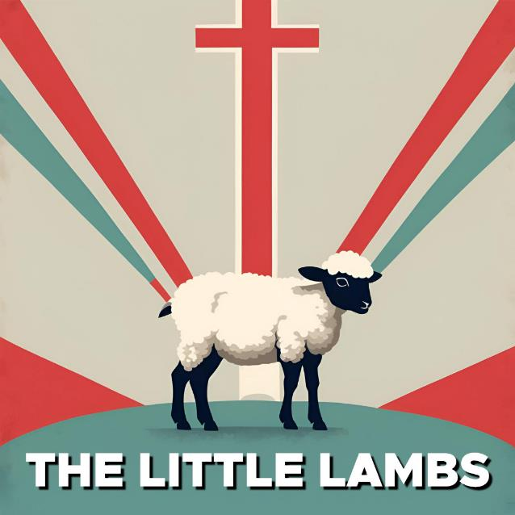
(Rev. 5:6) Then I saw a Lamb, looking as if it had been slain, standing at the center of the throne, encircled by the four living creatures and the elders.

Slide 37
(Rev. 5:6) Then I saw a Lamb, looking as if it had been slain, standing at the center of the throne, encircled by the four living creatures and the elders.
The Lamb had seven horns and seven eyes,
which are the seven spirits of God sent out into all the earth.
Horns symbolize strength.
(1 Sam. 2:1; 2 Sam. 22:3; 1 Kings 22:11; Ps. 75:4; 132:17; Dan. 7:20-21; 8:5)
Eyes symbolize knowledge.
(1 Pet. 3:12; Mt. 6:22-23; 13:16; Prov. 20:12)

Slide 38
(Rev. 5:7) He went and took the scroll from the right hand of him who sat on the throne.
⁸ And when he had taken it, the four living creatures and the twenty-four elders fell down before the Lamb. Each one had a harp and they were holding golden bowls full of incense, which are the prayers of God’s people.

Slide 39
(Rev. 5:9) And they sang a new song, saying:
“You are worthy to take the scroll and to open its seals, because you were slain, and with your blood you purchased for God persons from every tribe and language and people and nation.”

Slide 40
(Rev. 5:10) “You have made them to be a kingdom and priests to serve our God, and they will reign on the earth.”

Slide 41
(Rev. 5:11) Then I looked, and I heard the voice of many angels around the throne and the living creatures and the elders.
The number of them was myriads of myriads, and thousands of thousands.
A “myriad” is 10,000.
400 million angels?

Slide 42
(Rev. 5:12) In a loud voice they were saying:
“Worthy is the Lamb, who was slain, to receive power and wealth and wisdom and strength and honor and glory and praise!”

Slide 43
(Rev. 5:13) Then I heard every creature in heaven and on earth and under the earth and on the sea, and all that is in them, saying:
“To him who sits on the throne and to the Lamb be praise and honor and glory and power, for ever and ever!”
¹⁴ The four living creatures said, “Amen,” and the elders fell down and worshiped.

Slide 46
(Rev. 4:8) “Holy, holy, holy is the Lord God Almighty.”
#1. Jesus is the only morally flawless ruler.
Revelation 4:8
Could you love and respect a King who never brought justice?

Slide 47
“You are worthy… for you created all things, and by your will they were created and have their being” (Rev. 4:11).
#1. Jesus is the only
morally flawless ruler.
Revelation 4:8
#2. Jesus created and owns the world.
Revelation 3:14 ; 4:11
Jesus is “the ruler of God’s creation” (Rev. 3:14).

Slide 48
Jesus has the right to rule as the lion,
because he laid down his life as the lamb.
Revelation 5:5-6
#1. Jesus is the only
morally flawless ruler.
Revelation 4:8
#2. Jesus created and owns the world.
Revelation 3:14; 4:11
#3. Jesus gave his life for the world.
Revelation 5:5-9
“You are worthy to take the scroll and to open its seals,
because you were slain, and with your blood you purchased for God persons from every tribe and language and people and nation” (Rev. 5:9).

Slide 49
What if history is headed nowhere?
What if there is not justice in the end?
What if no one sits on the cosmic throne?
Then again,
what if there is?

Slide 50
