Slide 1
The Kindness of the King
2 Samuel 9

Slide 2
2 Samuel 9
David is at the high point of his life
Peace on all sides (2 Sam 7:1)
Jerusalem (2 Sam 5:9)
Cedar palace (2 Sam 5:11)
The ark (2 Sam 6:15)
God’s promise of a dynasty and temple (2 Sam 7)

Slide 3
2 Samuel 9
¹ One day David asked, “Is anyone in Saul’s family still alive
New regimes always purged the old

Slide 4
2 Samuel 9
¹ One day David asked, “Is anyone in Saul’s family still alive—
anyone to whom I can show kindness [hesed] for Jonathan’s sake?”
“May you treat me with the faithful love [hesed] of Yahweh as long as I live.
But if I die, treat my family with this faithful love, even when Yahweh destroys all your enemies from the face of the earth.” (1 Sam 20:14-15)

Slide 5
2 Samuel 9
¹ One day David asked, “Is anyone in Saul’s family still alive—
anyone to whom I can show kindness [hesed] for Jonathan’s sake?”
Hesed
“It is a kind of love, including mercy… when the object is in a pitiful state.” (R. Laird Harris, Theological Wordbook of the Old Testament (Chicago: Moody Press, 1999), 307.)
“loyal love” or “steadfast love” or “lovingkindness.”
The New Testament equivalent of God’s “grace”

Slide 6
2 Samuel 9
¹ One day David asked, “Is anyone in Saul’s family still alive—
anyone to whom I can show kindness [hesed] for Jonathan’s sake?”
Hesed (God’s grace)
Scripture tells us “God is love” (1 John 4:8)
It’s hard for us to understand

Slide 7
2 Samuel 9
¹ One day David asked, “Is anyone in Saul’s family still alive—
anyone to whom I can show kindness [hesed] for Jonathan’s sake?”
Hesed (God’s grace)
God gives us many different pictures of His Grace
- Parables (Luke 15; Matt 20:1-16; Luke 10:30-37; Luke 14:15-24)
- Stories (Luke 19:1-10; Luke 7:36-50; John 8:1-11; Matt 8:1-4; John 21)
- Tonight: one of the great pictures from the OT

Slide 8
2 Samuel 9
¹ One day David asked, “Is anyone in Saul’s family still alive—
anyone to whom I can show kindness [hesed] for Jonathan’s sake?”
You probably came in with a certain view of God
- When you think about what he’s like…
- The thought of being in his presence?
- You look at your problems…
- The thought of following him?

Slide 9
2 Samuel 9
¹ One day David asked, “Is anyone in Saul’s family still alive—
anyone to whom I can show kindness [hesed] for Jonathan’s sake?”
“May you have the power to understand, as all God’s people should, how wide, how long, how high, and how deep his love is.
May you experience the love of Christ, though it is too great to understand fully.” (Eph 3:18-19)
God’s Grace Seeks

Slide 10
2 Samuel 9
² He summoned a man named Ziba, who had been one of Saul’s servants.
“Are you Ziba?” the king asked.
“Yes sir, I am,” Ziba replied.
³ The king then asked him, “Is anyone still alive from Saul’s family?
If so, I want to show God’s kindness to them.”
God’s Grace Seeks

Slide 11
2 Samuel 9
³ Ziba replied, “Yes, one of Jonathan’s sons is still alive.
He is crippled in both feet.”
God’s Grace Seeks

Slide 12
2 Samuel 9
³ Ziba replied, “Yes, one of Jonathan’s sons is still alive.
He is crippled in both feet.” (2 Samuel 4:4)
Saul’s son Jonathan had a son named Mephibosheth, who was crippled as a child.
He was five years old when the report came from Jezreel that Saul and Jonathan had been killed in battle.
God’s Grace Seeks

Slide 13
2 Samuel 9
³ Ziba replied, “Yes, one of Jonathan’s sons is still alive.
He is crippled in both feet.” (2 Samuel 4:4)
When the child’s nurse heard the news, she picked him up and fled.
But as she hurried away, she dropped him, and he became crippled. (2 Samuel 4:4)
God’s Grace Seeks

Slide 14
2 Samuel 9
³ Ziba replied, “Yes, one of Jonathan’s sons is still alive.
He is crippled in both feet.”
What was 5-year-old Mephibosheth like?
“When I grow up…”
“My daddy is going to be king!”
Jonathan was one of the greatest men in Scripture
Then one day…
God’s Grace Seeks

Slide 15
2 Samuel 9
³ Ziba replied, “Yes, one of Jonathan’s sons is still alive.
He is crippled in both feet.”
“Daddy is dead…”
“There’s a cruel man named David…”
We must flee…
His world is shattered
Mephibosheth = “one who scatters shame”
God’s Grace Seeks

Slide 16
2 Samuel 9
⁴ “Where is he?” the king asked.
“In Lo-debar,” Ziba told him, “at the home of Makir son of Ammiel.”
Lo-debar = “No pasture”, nowhere
God’s Grace Seeks

Slide 17
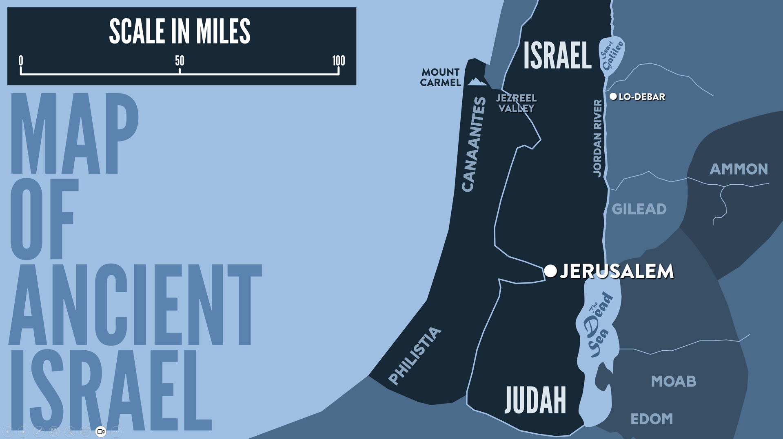

Slide 18
2 Samuel 9
⁵ So David sent for him
and brought him from Makir’s home.
What was that like?
God’s Grace Calls

Slide 19
2 Samuel 9
⁵ So David sent for him
and brought him from Makir’s home.
David supplied everything to bring him near
God’s Grace Calls

Slide 20
2 Samuel 9
⁶ His name was Mephibosheth; he was Jonathan’s son and Saul’s grandson.
When he came to David, he bowed low to the ground in deep respect.
David said, “Greetings, Mephibosheth.”
Mephibosheth replied, “I am your servant.”
What does David see?
God’s Grace Calls

Slide 21
2 Samuel 9
⁷ “Don’t be afraid!” David said.
He had no clue about the King’s character or the King’s promise of hesed
God’s Grace Calls

Slide 22
2 Samuel 9
⁷ “Don’t be afraid!” David said.
I will give
you all the property that once belonged to your grandfather Saul,
and you will eat here with me at the king’s table!”
All that you lost on that fateful day when you fell
God’s Grace Gives

Slide 23
2 Samuel 9
⁷ “Don’t be afraid!” David said.
I will give
you all the property that once belonged to your grandfather Saul,
and you will eat here with me at the king’s table!”
Relationship: You will eat with me at my table
God’s Grace Gives

Slide 24
2 Samuel 9
⁸ Mephibosheth bowed respectfully and exclaimed, “Who is your servant, that you should regard a dead dog like me?”
You see how he feels about himself and how he had always been treated (cf. John 9:3)
God’s Grace Gives

Slide 25
2 Samuel 9
⁸ Mephibosheth bowed respectfully and exclaimed, “Who is your servant, that you should regard a dead dog like me?”
Humility: God’s grace brings us down while raising us up
God’s Grace Gives

Slide 26
2 Samuel 9
⁹ Then the king summoned Saul’s servant Ziba and said, “I have given your master’s grandson everything that belonged to Saul and his family.
¹⁰ You and your sons and servants are to farm the land for him to produce food for your master’s household.
God’s Grace Gives

Slide 27
2 Samuel 9
¹⁰ But Mephibosheth, your master’s grandson, will eat here at my table.” (Ziba had fifteen sons and twenty servants.)
God isn’t stingy with his grace
God’s Grace Gives

Slide 28
2 Samuel 9
¹¹ Ziba replied, “Yes, my lord the king;
I am your servant, and I will do all that you have commanded.”
And from that time on, Mephibosheth ate regularly at David’s table, like one of the king’s own sons.
God’s Grace Gives

Slide 29
2 Samuel 9
¹¹ Ziba replied, “Yes, my lord the king;
I am your servant, and I will do all that you have commanded.”
And from that time on, Mephibosheth ate regularly at David’s table, like one of the king’s own sons.
God’s Grace Gives

Slide 30
2 Samuel 9
¹¹ Ziba replied, “Yes, my lord the king;
I am your servant, and I will do all that you have commanded.”
And from that time on, Mephibosheth ate regularly at David’s table, like one of the king’s own sons.
What were those dinnertimes like?
The conversations around that table?
How much more at the great wedding feast!
God’s Grace Gives

Slide 31
2 Samuel 19
The next time we see Mephibosheth, (2 Sam 19:24-30) he is a changed man.
We see deep loyalty to David, grateful trust, and we see him valuing his relationship with David far above all the stuff David had given him.
God’s grace will change you from the inside out.
God’s Grace Transforms

Slide 32
Lessons About God’s Grace
God’s Grace Seeks
We are a lot farther away
“The Son of Man came to seek and save those who are lost.” (Luke 19:10)
God
Afraid
Alienated
Distorted View
Not seeking

Slide 33
Lessons About God’s Grace
God’s Grace Calls
“When I am lifted up… I will draw everyone to myself.” (John 12:32)
God
“Fear not”

Slide 34
Lessons About God’s Grace
God’s Grace Calls
God
“Fear not”
Provides a way
Overcomes our misconceptions
Gives us value

Slide 35
Lessons About God’s Grace
God’s Grace Gives
God
When we were utterly helpless, Christ came at just the right time and died for us sinners…
God showed his great love for us by sending Christ to die for us while we were still sinners. (Romans 5:6,8)

Slide 36
Lessons About God’s Grace
God’s Grace Gives
God
Acceptance
Humility
Abundance
A Choice

Slide 37
The Kindness of the King
Questions?
Comments?
Experiences?
risleys@dwellcc.org
See the Dwell App OR teachings.dwellcc.org
Next time: David’s Downfall (2 Samuel 11-12; Psalm 32, 51)

